Slide 1
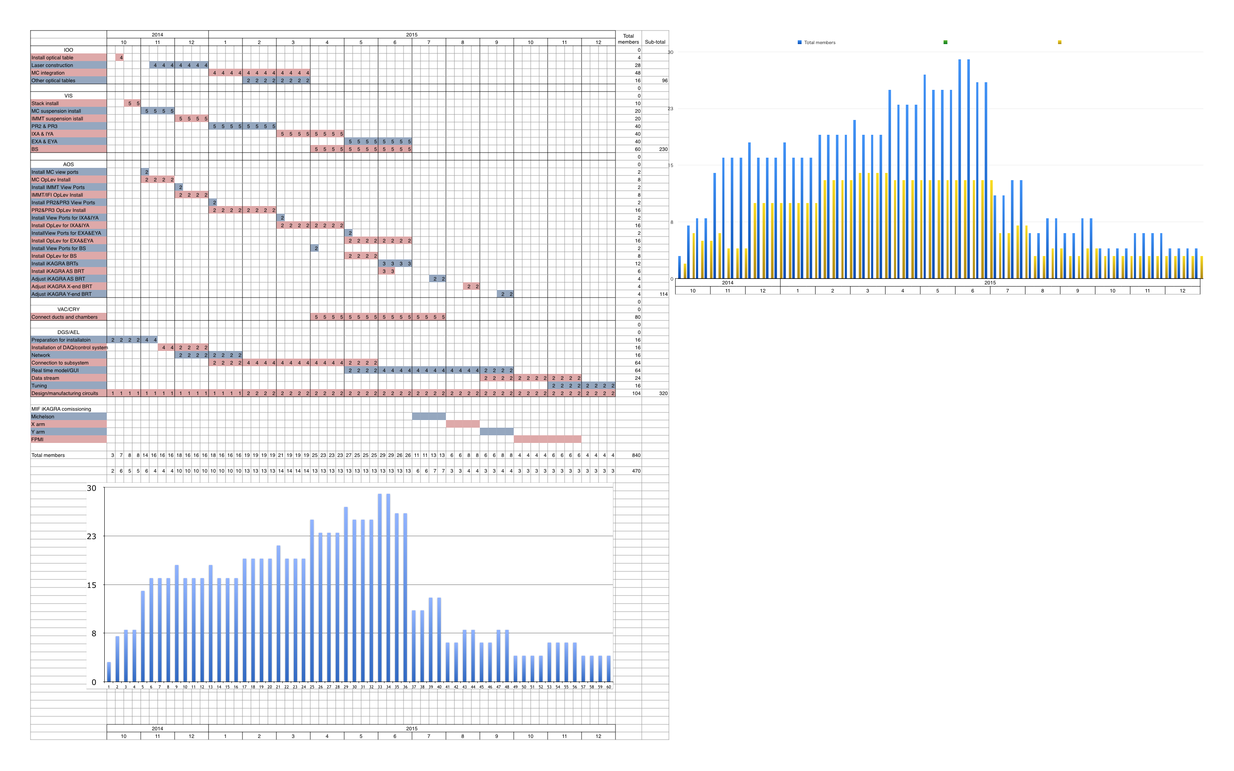
iKAGRA: from installation to operation (commissioning not included)
470 person-week by staff (840 of total)

