Slide 1
Channel List

Slide 2
Motivation
To make glitch-free interferometer
It is necessary to identify/remove glitch sources from each small system in the commissioning phase before becoming a complex system.
To save commissioning time
DetChar system is useful to identify troublesome noise sources in the commissioning phase.

Slide 3
Channel
Digital
Test Point
Physical quantity
Signals from Sensors
DAQ
DetChar
It is need to cover all channel without luck
To make consistency between channels that DetChar system need and experiment need.

Slide 4
Activity
To make basis of cannel list
Plan
To make wiki page where subgroup member can add/revise channel list easily.

Slide 5
Discussion
Assignment of making channel list between DGS, Analog circuit and DetChar.
Naming rule of channels
Along with LIGO and Vilgo.
(for example)
L1:PEM-EX_SEISY_OUTPUT (16)
L1:PEM-EX_SEISY_OUT_DQ (256)
Livingstone
X-arm End
Seismometor Y-direction
16Hz Sampling
Physical Environmental Monitor

Slide 6
Preliminary Image

Slide 7
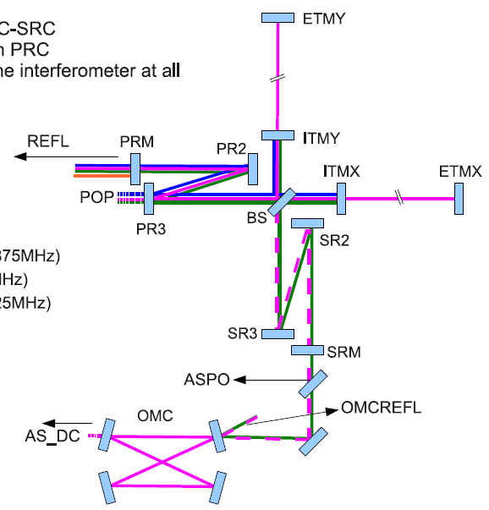
MIF_LSC
1
・REFL_PD1_DC
・REFL_PD1_I
・REFL_PD1_Q
・REFL_PD2_DC
・REFL_PD2_I
・REFL_PD2_Q
2
・POP_PD1_DC
・POP_PD1_I
・POP_PD1_Q
・POP_PD2_DC
・POP_PD2_I
・POP_PD2_Q
3
1
2
4
・AS_PD1_DC
・AS_PD1_I
・AS_PD1_Q
5
5
6
・OMCREFL_PD1_DC
・OMCREFL_PD1_I
・OMCREFL_PD1_Q
6
7
7
・AS_DC

Slide 8
MIF_ASC_Yaw
1
・REFL_QPD1_Total
・REFL_QPD1_DC
・REFL_QPD1_I
・REFL_QPD1_Q
・REFL_QPD2_Total
・REFL_QPD2_DC
・REFL_QPD2_I
・REFL_QPD2_Q
2
・POP_QPD1_Total
・POP_QPD1_DC
・POP_QPD1_I
・POP_QPD1_Q
・POP_QPD2_Total
・POP_QPD2_DC
・POP_QPD2_I
・POP_QPD2_Q
3
1
3
・EY_QPD_Total
・EY_QPD_DC
4
・EX_QPD_Total
・EX_QPD_DC
2
4
5
・AS_QPD1_Total
・AS_QPD1_DC
・AS_QPD1_I
・AS_QPD1_Q
5
6
7

Slide 9
MIF_ASC_Pitch
1
・REFL_QPD1_Total
・REFL_QPD1_DC
・REFL_QPD1_I
・REFL_QPD1_Q
・REFL_QPD2_Total
・REFL_QPD2_DC
・REFL_QPD2_I
・REFL_QPD2_Q
2
・POP_QPD1_Total
・POP_QPD1_DC
・POP_QPD1_I
・POP_QPD1_Q
・POP_QPD2_Total
・POP_QPD2_DC
・POP_QPD2_I
・POP_QPD2_Q
3
1
3
・EY_QPD_Total
・EY_QPD_DC
4
・EX_QPD_Total
・EX_QPD_DC
2
4
5
・AS_QPD1_Total
・AS_QPD1_DC
・AS_QPD1_I
・AS_QPD1_Q
5
6
7

Slide 10
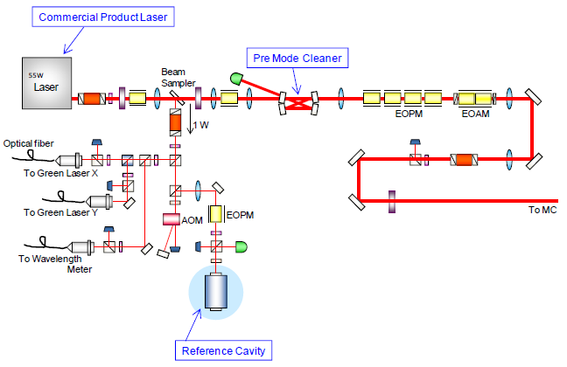
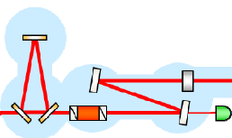
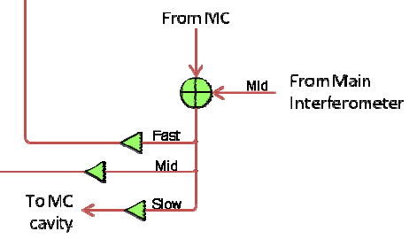
IOO_PSL
1
3
5
2
4
1
・PMC_DC
・PMC_RF
2
・RC_DC
・RC_RF_Fast
・RC_RF_Mid
・RC_RF_Slow
3
・IS_DC
4
・FA_Fast
・FA_Mid
・FA_Slow
5
・Wavelength
Intensity
Stabilization
Feed-Around

Slide 11
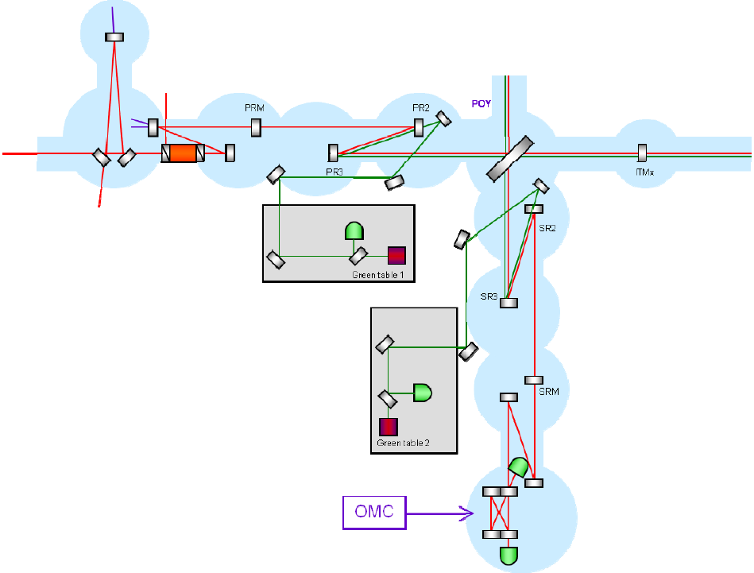
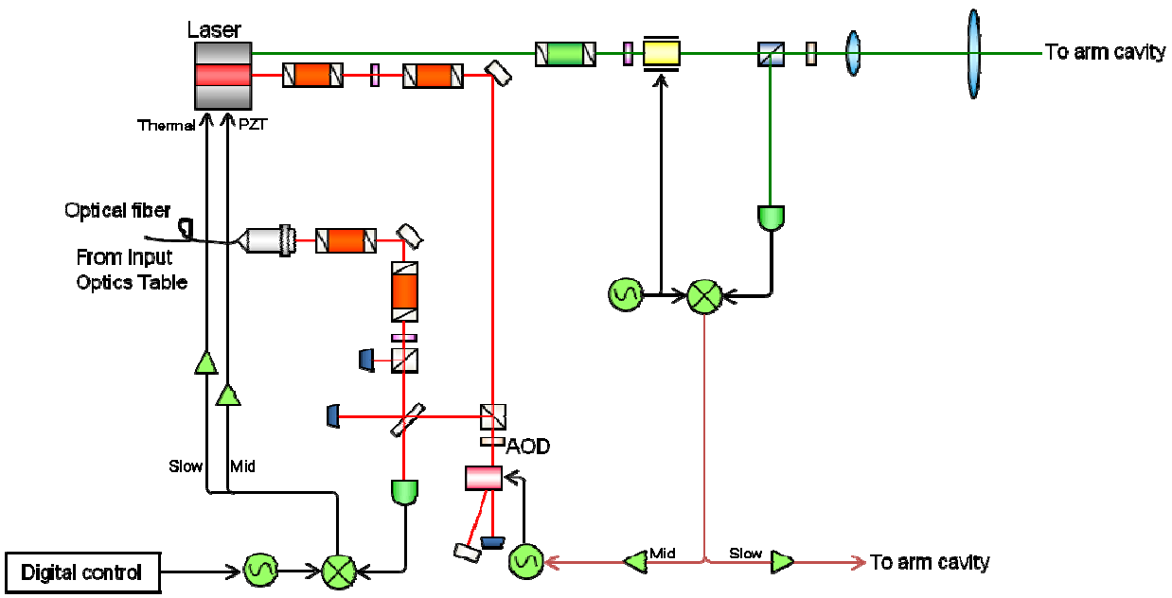
IOO_Green
1
2
1
・In_Mid
・In_Slow
2
・Out_Mid
・Out_Slow

Slide 12
VIS

Slide 13
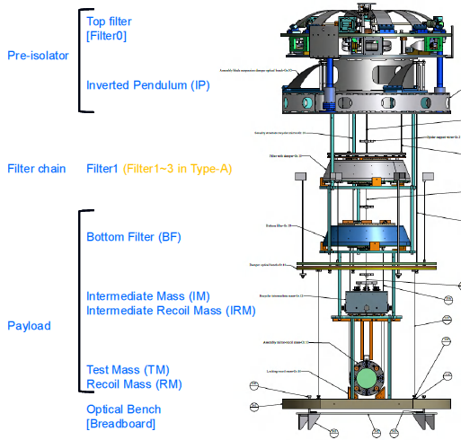
VIS_(SAS-B)
 | Filter0 | Filter1(-3) | BF | IM-IRM | TM-RM
Sensor | ACC(H) x3 ACC(V) x1 LVDT(H) x3 LVDT(V) x1 | LVDT(V) x1 | LVDT(V) x1 | PS(H) x3 PS(V) x3 | PS(H) x2 PS(V) x2 OL x1
Actuator | MC(H) x3 MC(V) x1 | MC(V) x1 | MC(V) x1 | MC(H) x3 MC(V) x3 | MC(H) x2 MC(V) x2
Motor | STP(H) x3 STP(V) x1 PIC(Y) x1 |  | PIC(H) x2 PIC(Y) x1 | PIC(H) x2
1
2
3
1
2
4
5
4
・F0_ACC_H1
・F0_ACC_H2
・F0_ACC_H3
・F0_ACC_V
・F0_LVDT_H1
・F0_LVDT_H2
・F0_LVDT_H3
・F0_LVDT_V
・F0_MC_H1
・F0_MC_H2
・F0_MC_H3
・F0_MC_V
・F0_STP_H1
・F0_STP_H2
・F0_STP_H3
・F0_STP_V
・F0_PIC_Y
・F1_LVDT_V
・F1_MC_V
・F2_LVDT_V
・F2_MC_V
・F3_LVDT_V
・F3_MC_V
・IM-IRM_PS_H1
・IM-IRM_PS_H2
・IM-IRM_PS_H3
・IM-IRM_PS_V1
・IM-IRM_PS_V2
・IM-IRM_PS_V3
・IM-IRM_MC_H1
・IM-IRM_MC_H2
・IM-IRM_MC_H3
・IM-IRM_MC_V1
・IM-IRM_MC_V2
・IM-IRM_MC_V3
・IM-IRM_PIC_H1
・IM-IRM_PIC_H2
・TM-RM_PS_H1
・TM-RM_PS_H2
・TM-RM_PS_V1
・TM-RM_PS_V2
・TM-RM_MC_H1
・TM-RM_MC_H2
・TM-RM_MC_V1
・TM-RM_MC_V2
・OL_X
・OL_Y
・OL_Total
5
3
・BF_LVDT_V
・BF_MC_V
・BF_PIC_H1
・BF_PIC_H2
・BF_PIC_Y

Slide 14
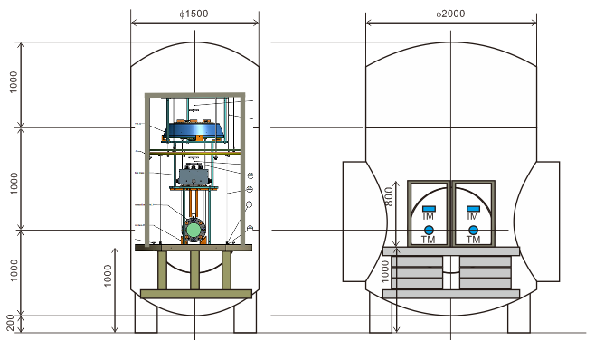
VIS_(SAS-Bp)
1
・BF_LVDT_V
・BF_MC_V
・BF_PIC_H1
・BF_PIC_H2
・BF_PIC_Y
1
2
3
2
・IM-IRM_PS_H1
・IM-IRM_PS_H2
・IM-IRM_PS_H3
・IM-IRM_PS_V1
・IM-IRM_PS_V2
・IM-IRM_PS_V3
・IM-IRM_MC_H1
・IM-IRM_MC_H2
・IM-IRM_MC_H3
・IM-IRM_MC_V1
・IM-IRM_MC_V2
・IM-IRM_MC_V3
・IM-IRM_PIC_H1
・IM-IRM_PIC_H2
3
・TM-RM_PS_H1
・TM-RM_PS_H2
・TM-RM_PS_V1
・TM-RM_PS_V2
・TM-RM_MC_H1
・TM-RM_MC_H2
・TM-RM_MC_V1
・TM-RM_MC_V2
・OL_X
・OL_Y
・OL_Total

