Slide 1
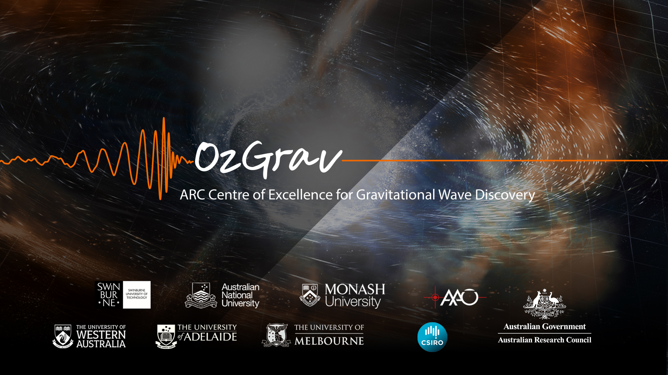
A 1.5 um NEMO detector in a KAGRA envelope
David Ottaway, Peter Calipari, Muskan Pathak and Dan Brown

Slide 2
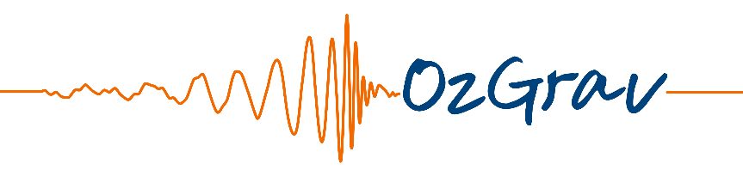
Overview Talk
NEMO : Neutron star Extreme Matter Observatory : technology enabler for 3G
NEMO Astrophysics
NEMO Detector Design
Conclusions
NEMO paper : Ackley, K., et al. "Neutron Star Extreme Matter Observatory: A kilohertz-band gravitational-wave detector in the global network." Publications of the Astronomical Society of Australia 37 (2020).
Notes:
PASA which the Publications of the Astronomical Society of Australia

Slide 3
NEMO Overview
NEMO is a design concept for a dedicated kilohertz-band GW observatory: Neutron star Extreme Matter Observatory
NEMO concept design was an OzGrav wide effort
Detector with its own science case , but also a technology enabler for future 3G detectors
Can NEMO ideas apply to a future Kagra upgrade?
Image Credit: Carl Knox
From: Sarin & Lasky, Gen
Relativ Gravit 53, 59 (2021)

Slide 4
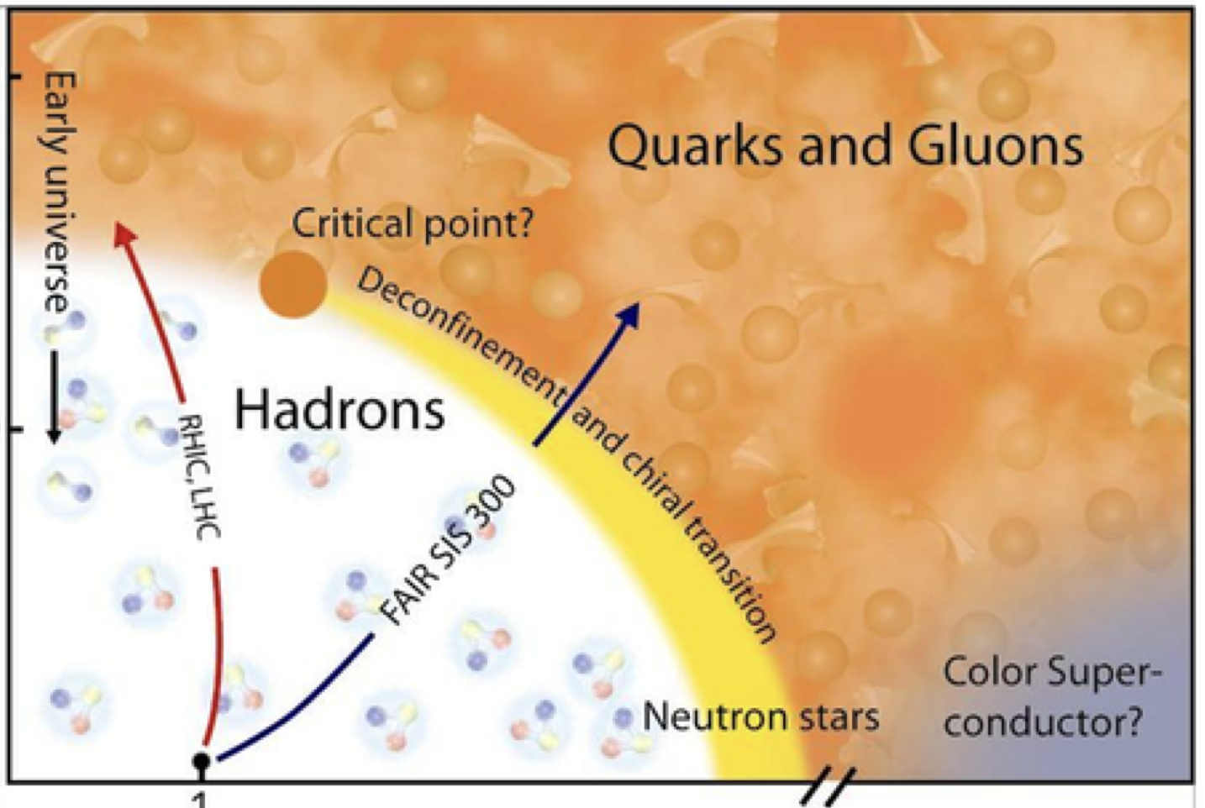
NEMO : The Science
  “High Frequency Detectors are Matter Machines”
Temperature
NEMO is here!
10¹⁵
density
NEMO paper : arXiv:2007.03128 (submitted to PASA)
Reference : arXiv:1102.5531
Slide credit : Paul Lasky

Slide 5
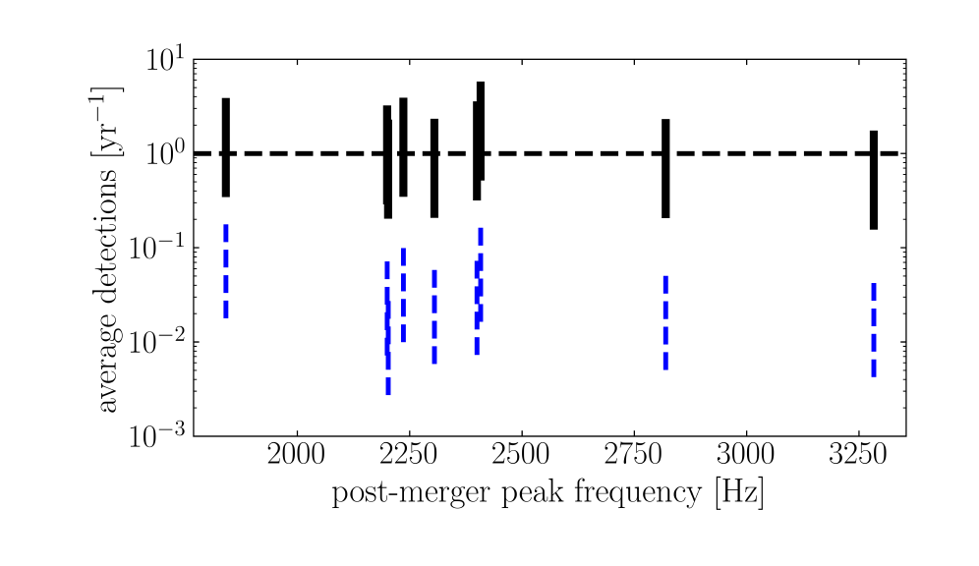
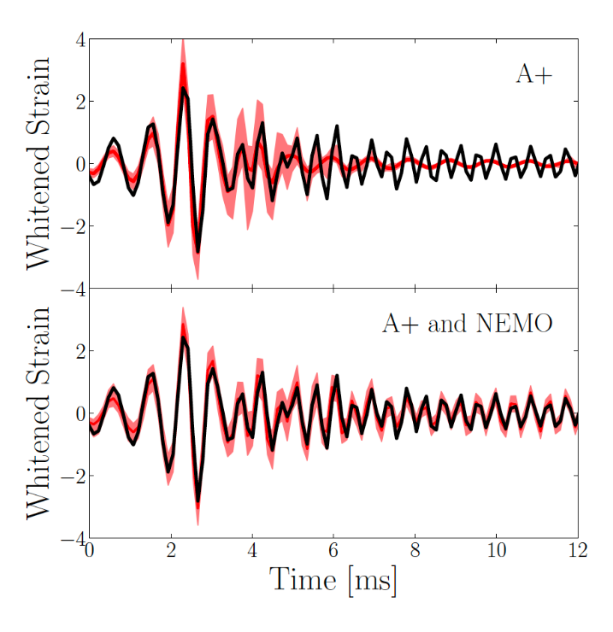
NEMO : The Science
Average number of post merger events detected with with NEMO increased to 1 – a few per year
Increased sensitivity at kHz places significant constraints on EoS
Potential to measure phase transitions in hot remnants : deconfined quarks, other exotica
Reference : NEMO paper

Slide 6
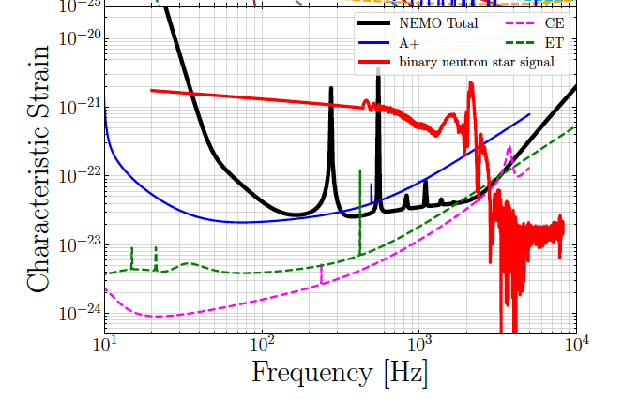
Design Sensitivity
Reference : NEMO paper

Slide 7
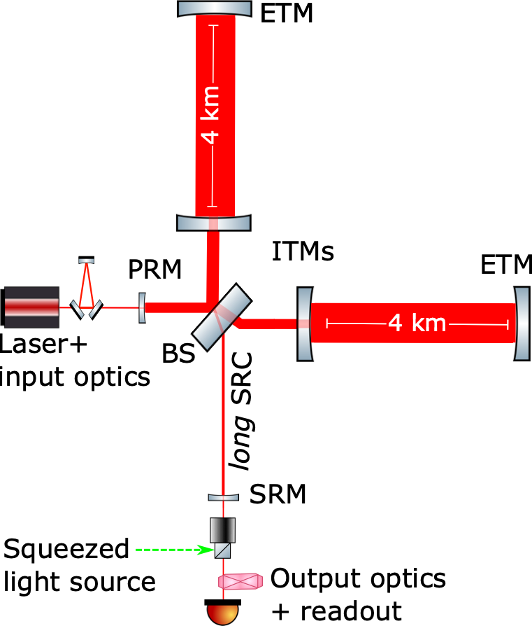
Initial NEMO design choices
4.5 MW
Test mass weight = 74.1 kg
Test mass coating : AlGaAs/GaAs*
Test mass substrate: Silicon
ITM = 150 K, ETM = 123 K
ROC_{ITM} = 1800 m; ROC_{ETM} = 2500 m
Suspension material : steel
Test mass cooling method : radiative
3 MW Circulating Arm Power
27 kW in Recycling Cavity
T = 5 ppm
2µm, 500 W
31.2 kW
T = 1.4%ç
l_{SRC} = 354 m
T = 4.8 %
10 dB injected
Picture modified from : J. V. van Heijningen, NEMO paper

Slide 8
Signal Recycling Cavity
Long SRC – Upper and lower signal sidebands equally enhanced
Advantages over detuned SRC: Control potentially easier, requires no filter cavity to improve sensitivity around coupled cavity pole
SRC loss needs to be less than 1500 ppm !
T_{itm} limited so high circulating power in substrates – TCS will have to work extremely well
Martynov Phys. Rev. D 99, 102004

Slide 9
Choice of Material: Silicon versus Sapphire

Slide 10
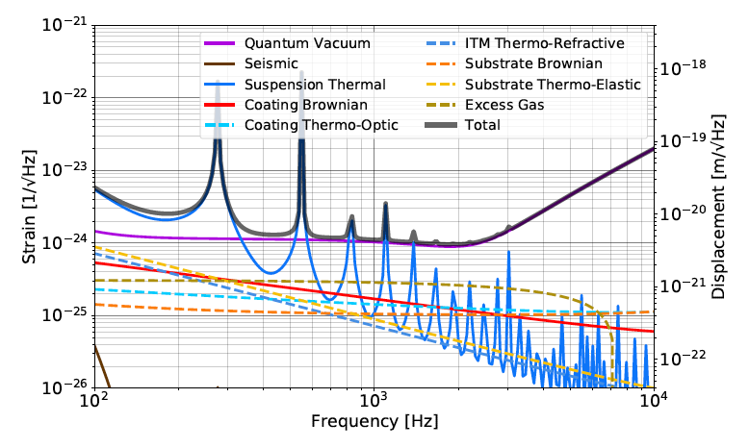
NEMO instrument noise budget
Reference : NEMO paper

Slide 11
The advantages and disadvantages of 1.5/2um for Silicon NEMO Operation
Interferometer Feature | Scaling | 1.5 um | 2.0 um
Power for equivalent sensitivity | λ | Better | OK
Achieving Lasers Power Scaling |  | Not demonstrated | Much higher power demonstrated
Stable Master Lasers |  | Mature | Less Mature
Sensitivity to substrate polishing errors and scattered light* | 1/λ² |  | Advantage
Photodetectors |  | Peak InGaAs Sensitivity | Significant development including materials science
Coating Absorption |  | Significant for SiO₂/Si coatings Crystalline Coatings OK | Much better for SiO₂/Si coatings Crystalline Coatings OK
Substrate Absorption Advantage |  | Slight advantage
Substrate/Coating Size |  | Significantly Smaller | Can’t use floatzone or crystalline coatings
Beam Splitter Material |  | Silica OK | Silica Likely Out
Over Technical Readiness |  | Likely much higher TRL* | Likely lower TRL

Slide 12
NEMO Wavelength Parameters
Current max size of float zone silicon test masses is 20 cm diameter
Forecast readily achievable crystalline coatings is about 20 cm diameter
ITMs were designed for this limitation
ETMs are not sensitive to absorption => Bigger using Magnetic Czochralski method
If coatings or low absorption silicon test mass change then alter ITM/ETM spot size ratio

Slide 13
A new noise source on Crystalline Coatings?
Thermal noise may not be as low as first thought
Significant excess noise has recently been observed which has alarmingly high spatial coherence – measurements done at low freq
Authors quote noise may be related to defects and impurities – Cause for hope?
https://arxiv.org/pdf/2210.15671.pdf

Slide 14
NEMO Comparison
Noise sensitivity looks comparable

Slide 15
Conclusions
NEMO looks feasible in KAGRA envelope using 1.5 um laser technology if the new noise source crystalline coating are not as big issue as they appear – Can purification fix ?
If coating issue is fixed 1.5 um interferometer looks more technologically ready that the 2 um interferometer.

Slide 16
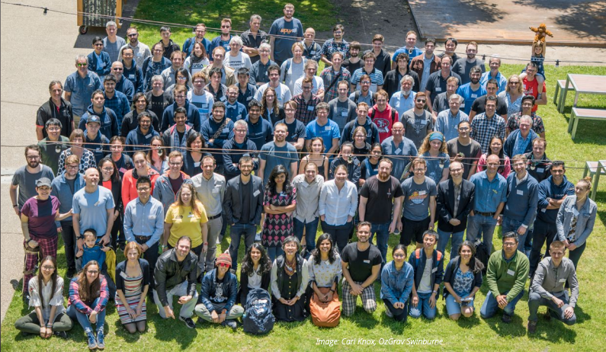
Questions / comments ?

