Slide 1
Cryo meeting Jan 19 KEK
Kieran Craig

Slide 2
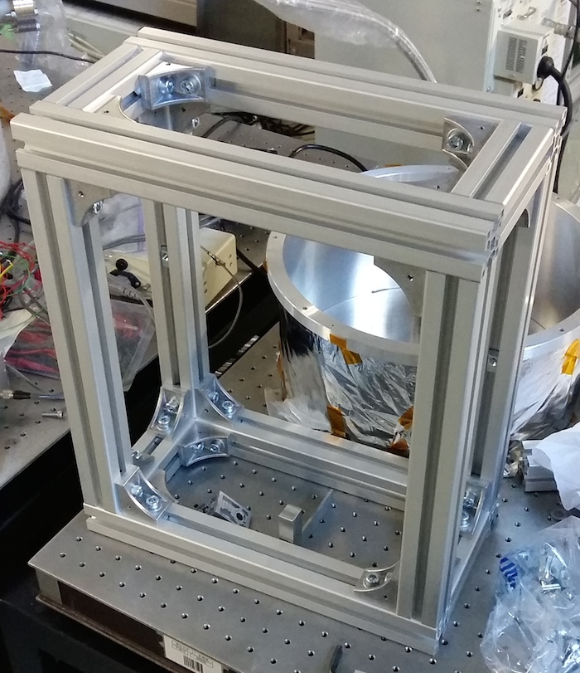
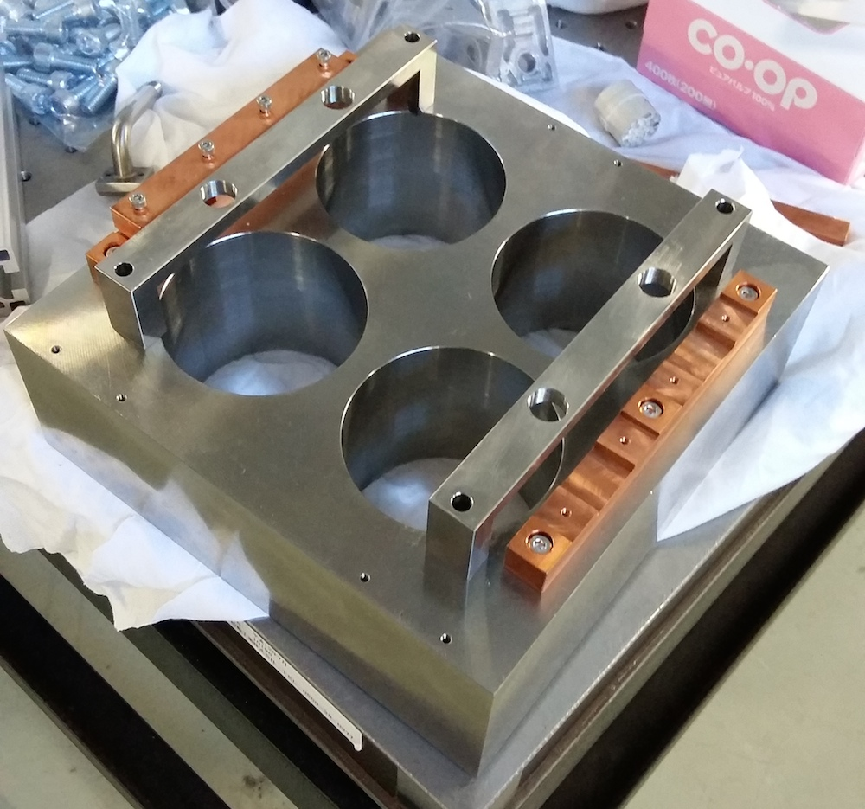
Frame and intermediate mass

Slide 3
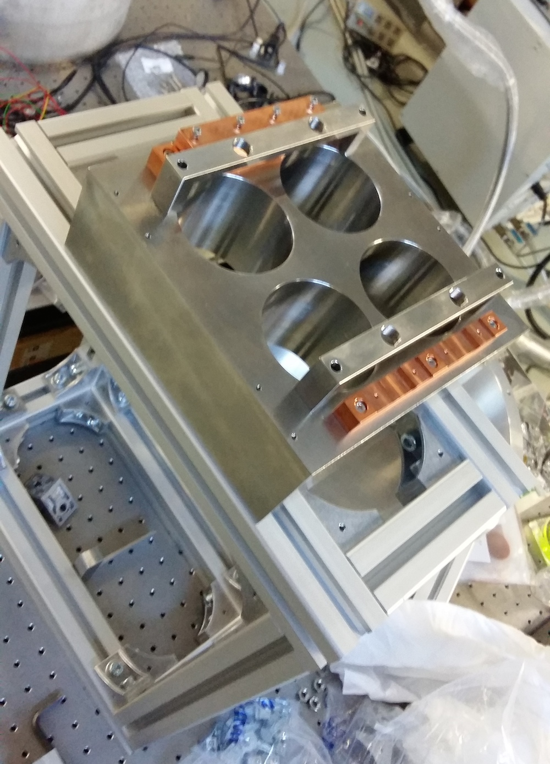
Intermediate mass on frame

Slide 4
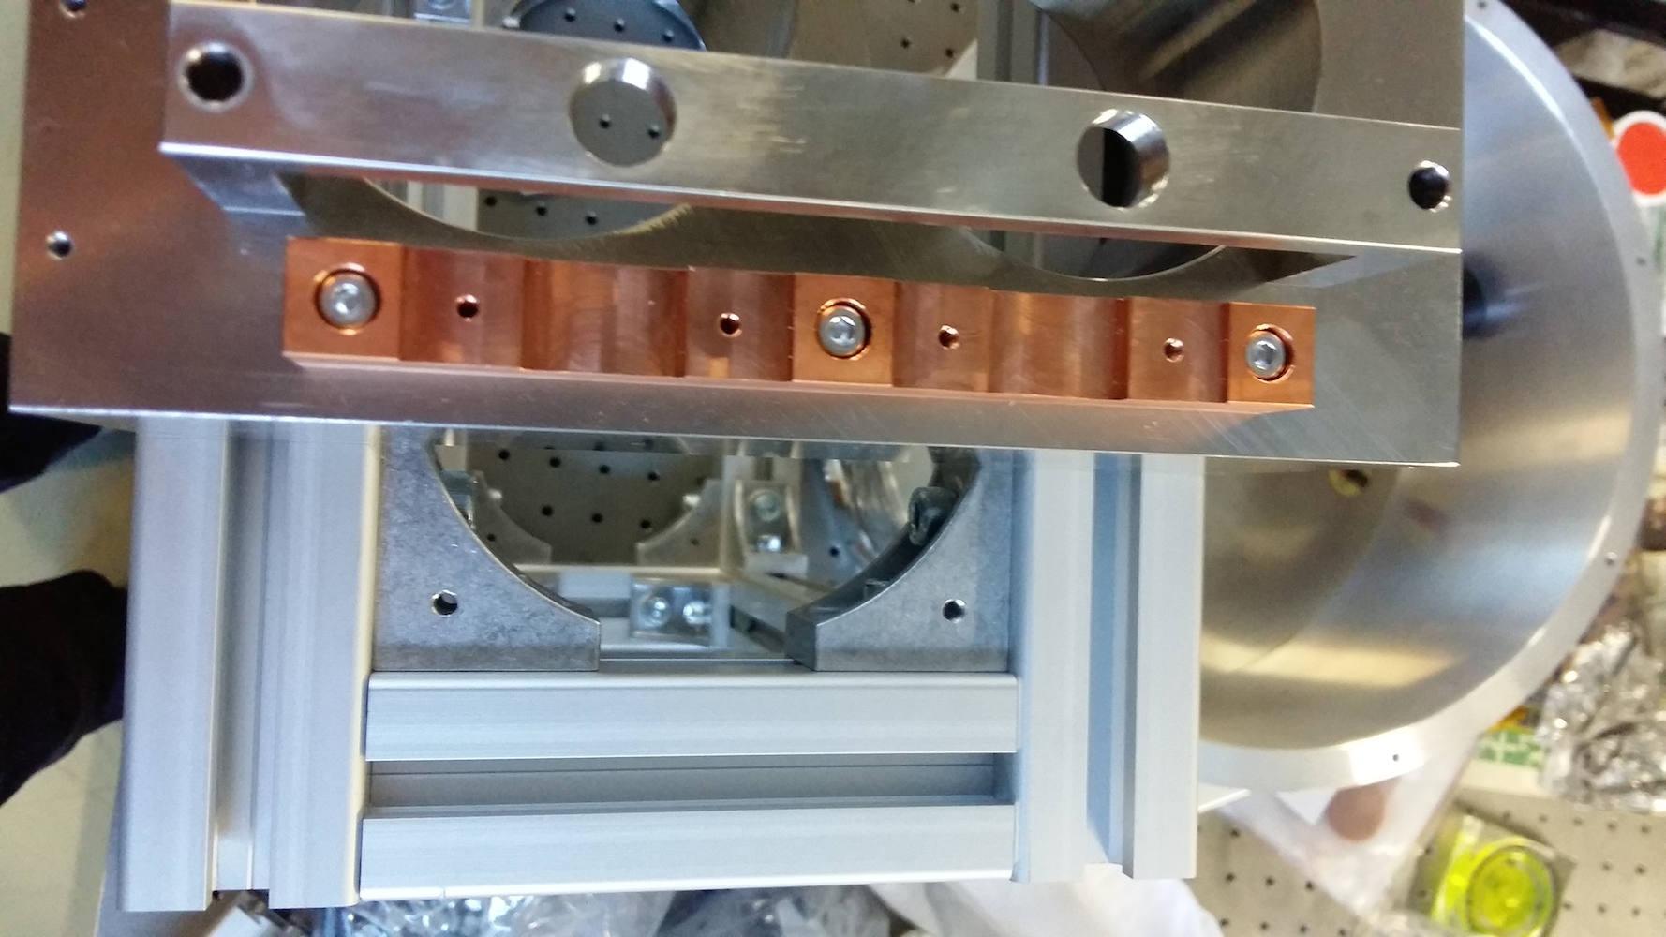
Framing leaves little space for fiber!

Slide 5
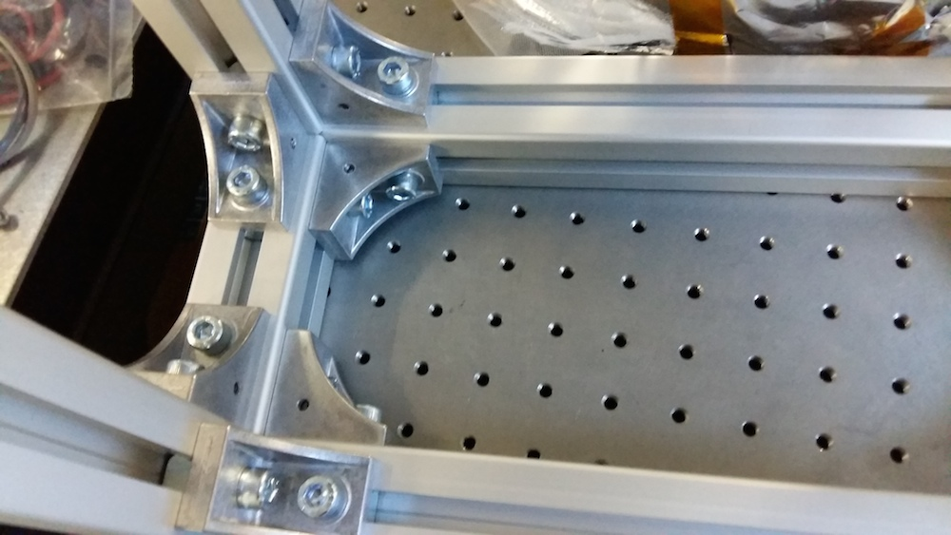
Same at the bottom – should remove for earthquake stoppers

Slide 6
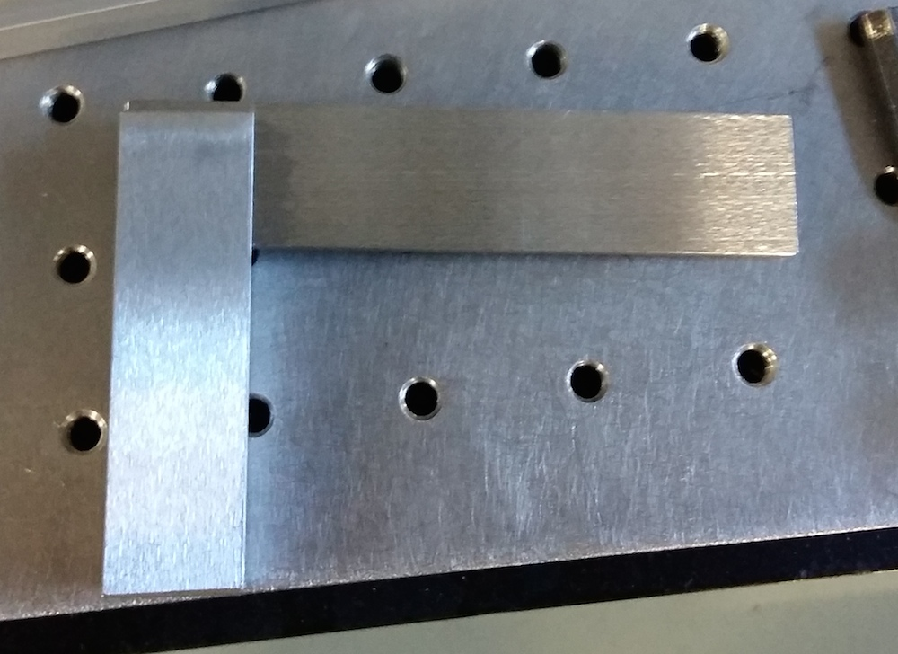
Engineers square (スコヤ) for keeping everything 90 degrees during assembly

Slide 7
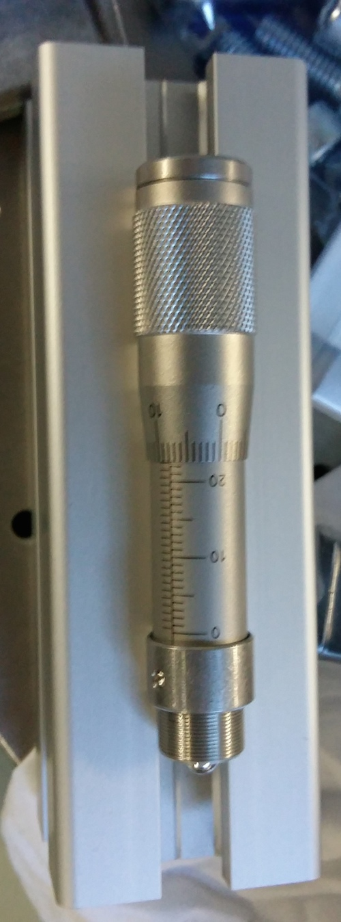
Micrometers (we have 4) for tensioning blade springs

Slide 8
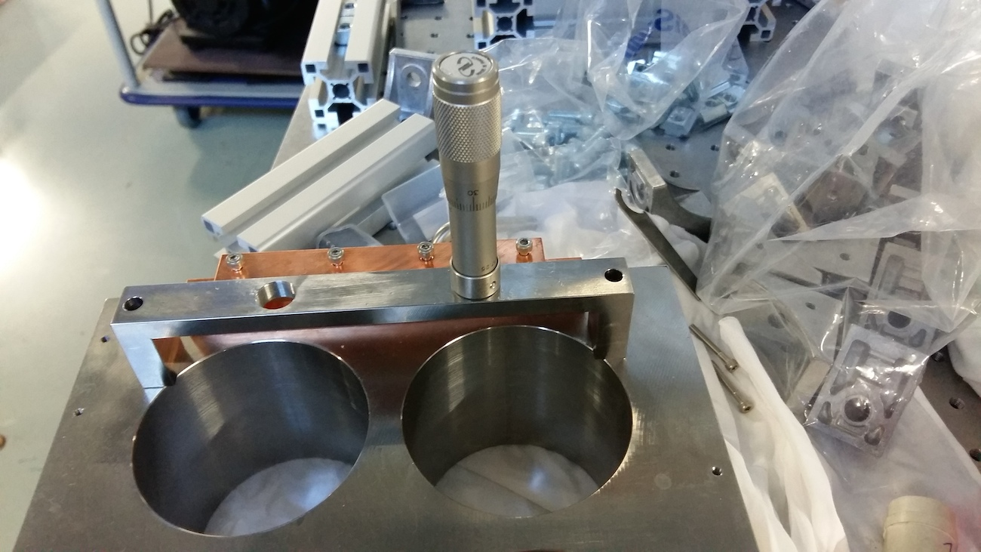
Micrometer attached to IM

Slide 9
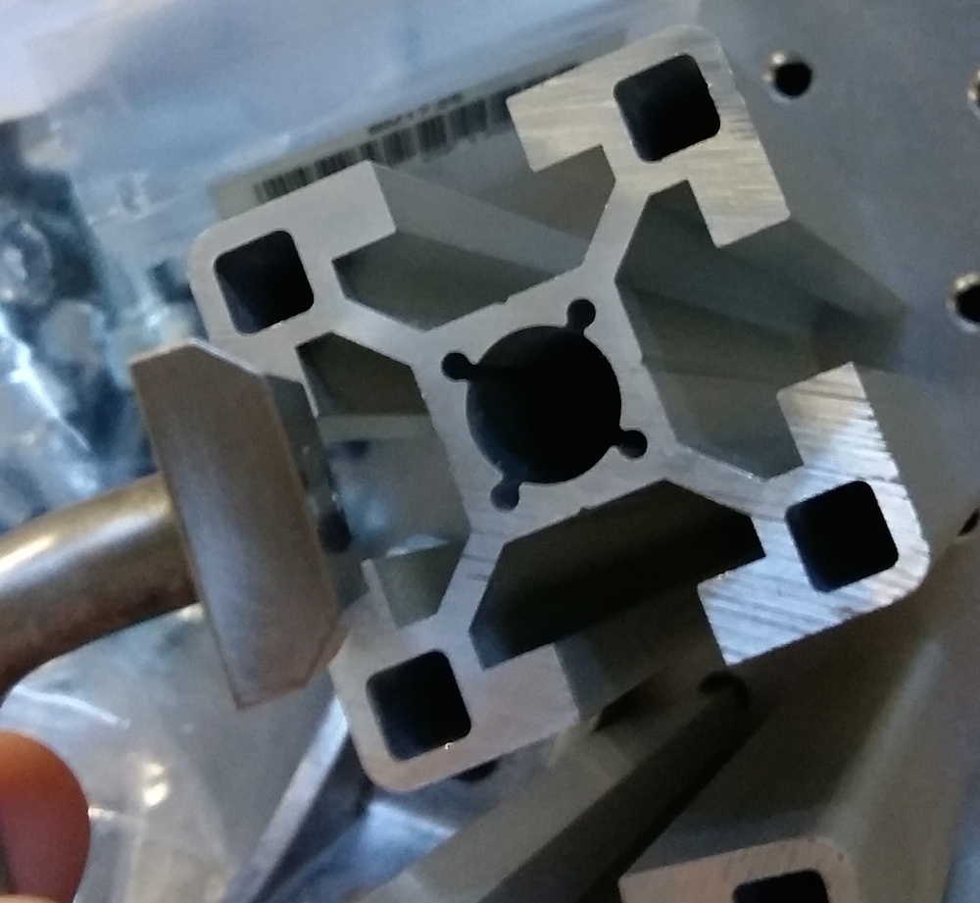
Outstanding problem: earthquake stoppers don’t fit into frame. Submitted to workshop for correction.

Slide 10
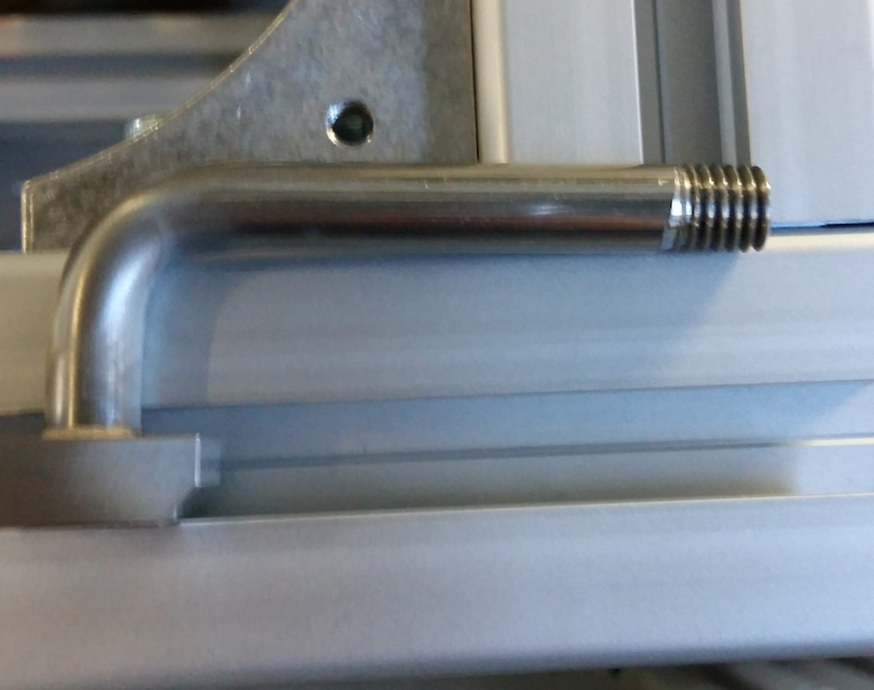
Earthquake stoppers threaded at the other end for cap attachment (M8 thread)

Slide 11
ANSYS workbench
One fiber prototype ANSYS Workbench model for Q estimation
Previous problem: importing geometry from CAD fused all parts to one body
Solved by importing via STEP files.
Added effects of gravity
Should be able to solve this week to obtain E_i/E_total

