Slide 1
Collaboration with Perugia/Glasgow
Kieran Craig

Slide 2
Bonding in Perugia
Different HCB procedure is used in Perugia/Virgo to that used by Glasgow/LIGO
Rahul and I learned the procedure used in Perugia from Helios and Flavio
We bonded small pieces of silica and sapphire as practice (silica – 5mm/10mm diameter, sapphire – 5mm diameter)
We also bonded one ear-sized piece to practice bonding larger samples

Slide 3
Bonding procedures
Virgo HCB Procedure | LIGO HCB Procedure
Cleaning: All pieces submerged in piranha solution (1:3 mixture of H₂O₂, H₂SO₄) Bonding surfaces wiped with Isoprop. Bonding surfaces wiped with DI water and blow dried (2x) Bonding solution: KOH salt added to water (1:80 mass ratio) Lots of bonding solution added to the bonding surface, enough to overflow from the sides. Attach second piece. More solution added regularly to the edges until a change in surface tension observed Then water glass solution added | Cleaning: Rinse samples with D.I. Water Clean samples with Cerium Oxide (2x) Clean samples with sodium bicarb. (2x) Rinse samples with DI Water Rinse samples with Methanol Bonding solution: 2ml sodium silicate 12ml DI water Mix, centrifuge, filter with medical filter Apply one drop of bonding solution to one bonding surface, attach second piece

Slide 4
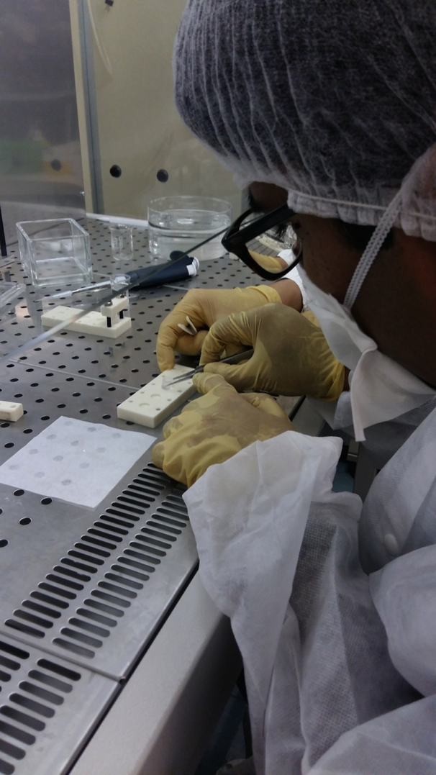
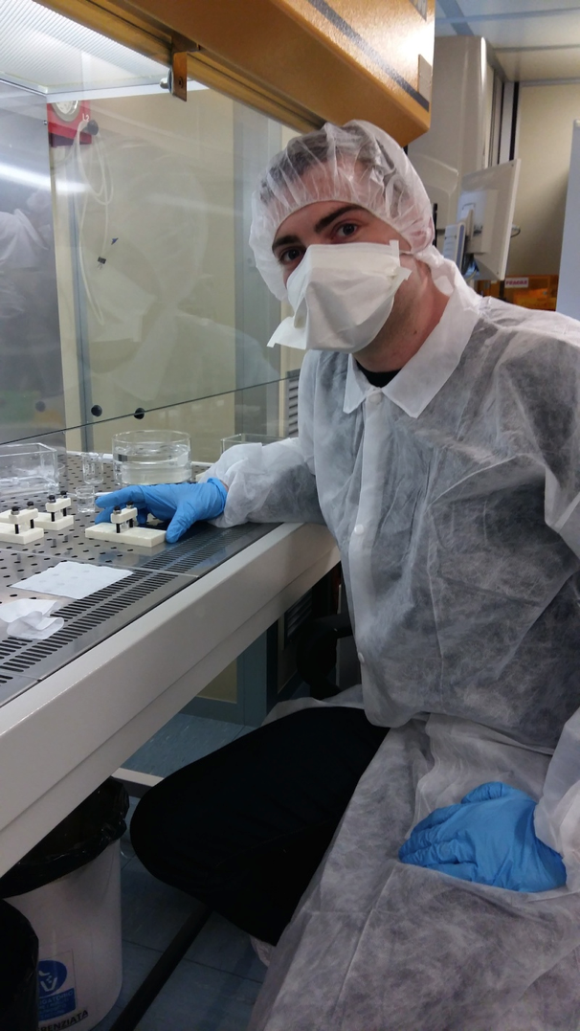

Slide 5
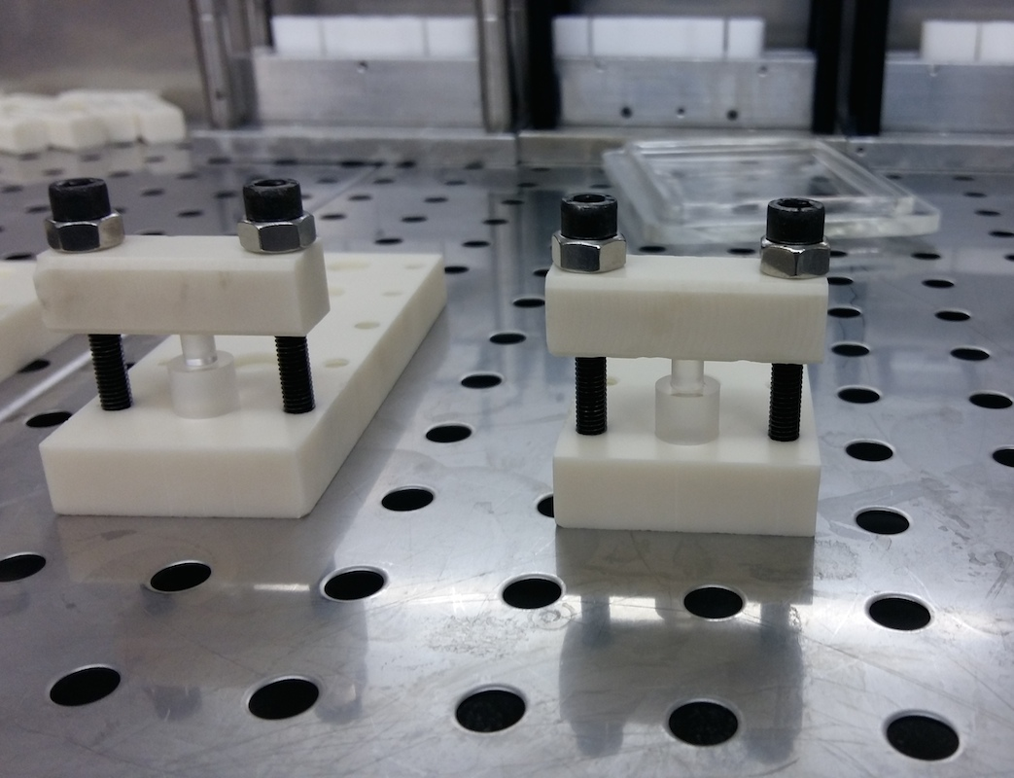
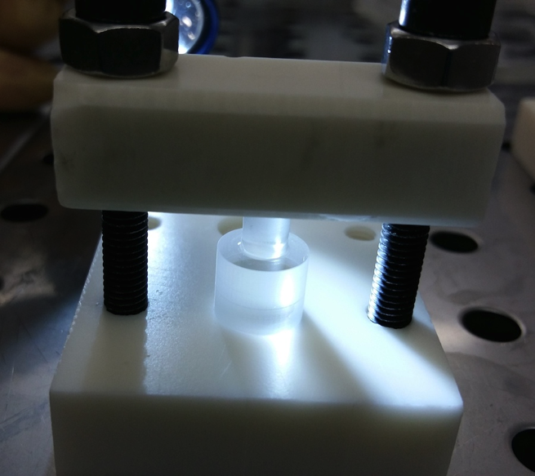
Bonding small pieces – 5mm and 10mm diameter

Slide 6
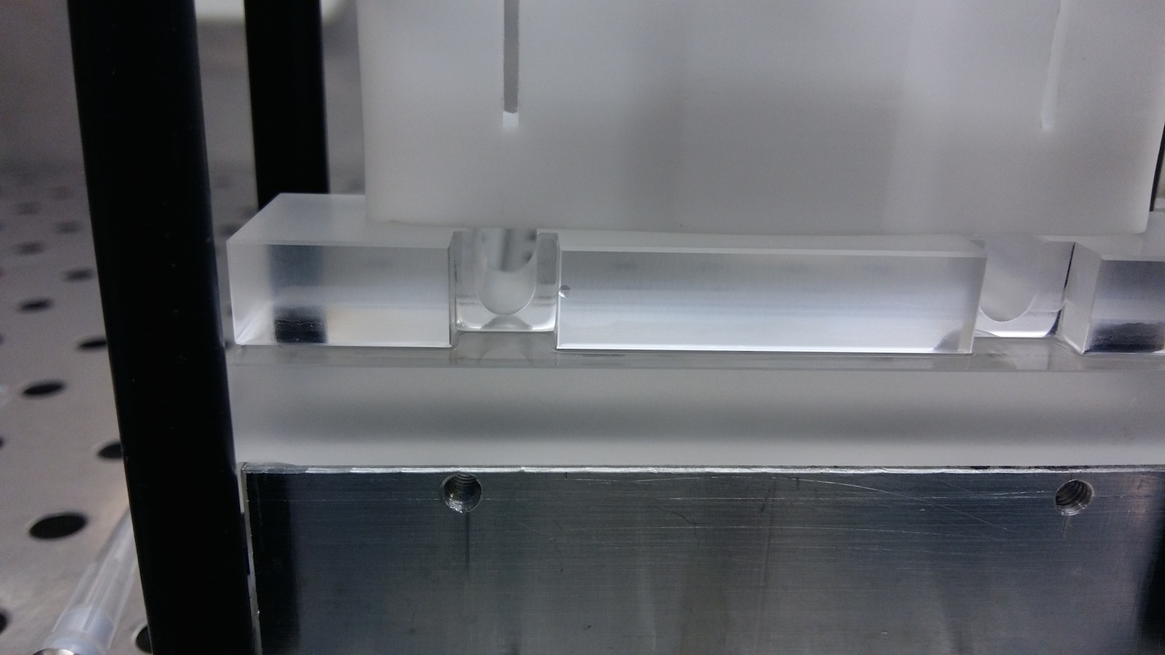
Ear bonding – front view

Slide 7
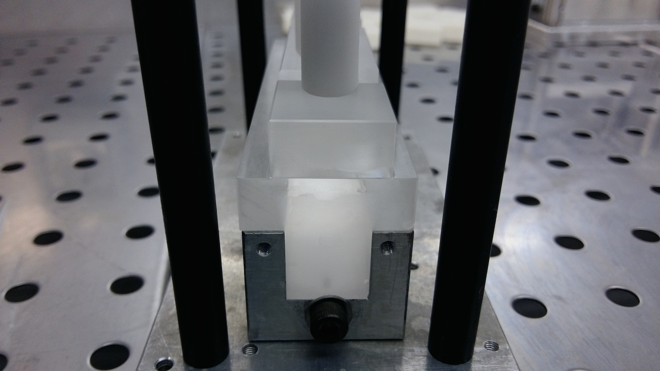
Ear bonding – side view

Slide 8
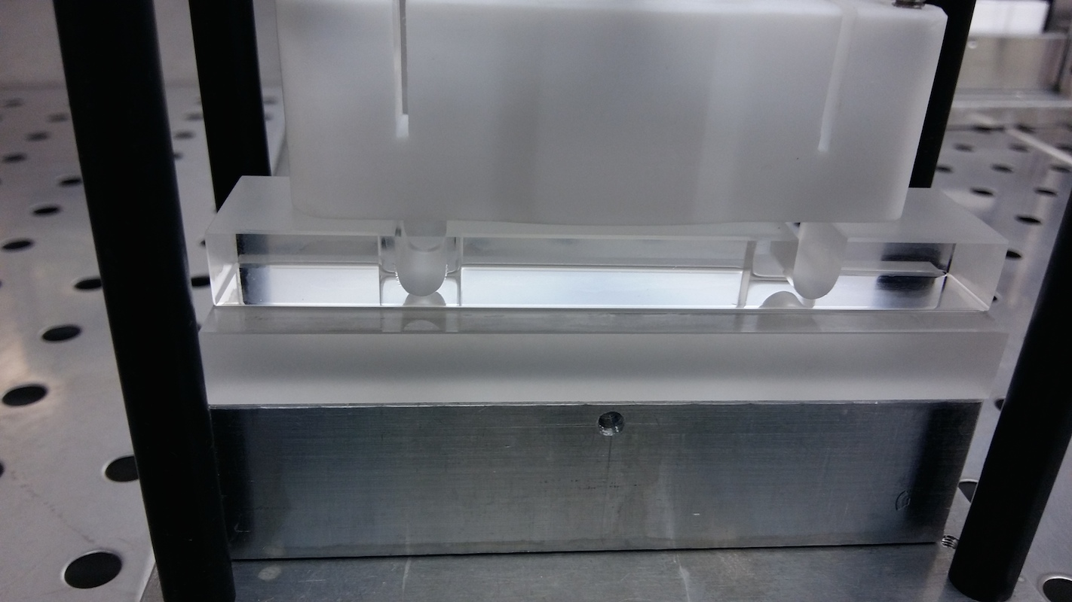
Ear bonding – back view

Slide 9
HCB Bonding
Interesting to note the differences, however KAGRA must use the LIGO style bonding
Surface of sapphire parts usually not flat enough to use Virgo style bonding
LIGO style HCB has a more involved cleaning process, but the bonding process itself is less complicated

Slide 10
KAGRA mirror box
Great progress made with KAGRA mirror box
The box has been made, with all pieces appropriate for the Prototype mass fabricated (several pieces need to be changed for use with the real KAGRA mirrors)
Box is now in Japan, ready for cleaning, assembly and testing

Slide 11
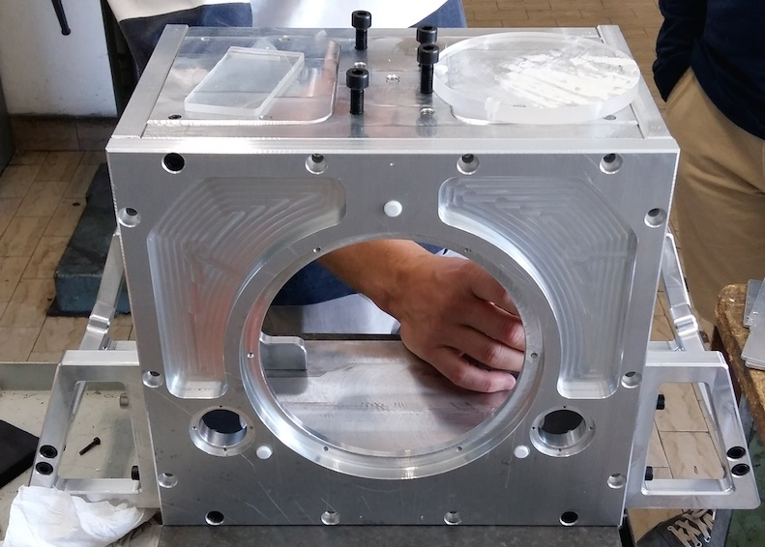
KAGRA mirror box

Slide 12
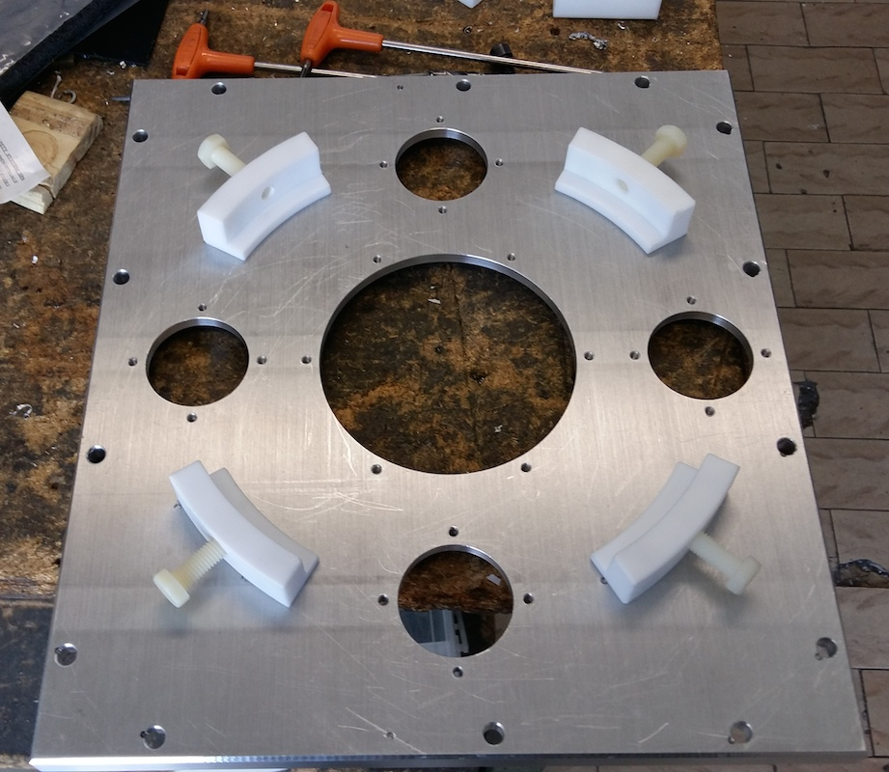
KAGRA mirror box front panel

Slide 13
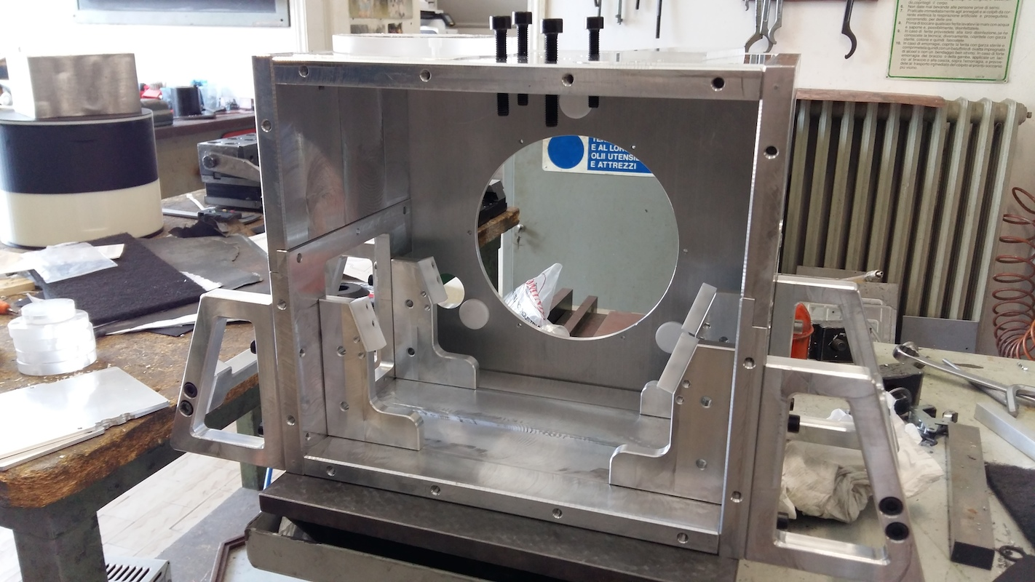
KAGRA mirror box inside

Slide 14
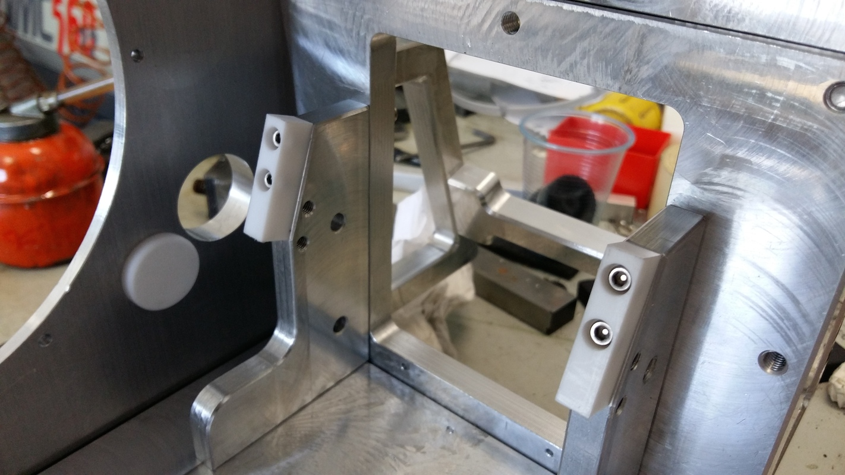
KAGRA mirror box inside - shelves

Slide 15
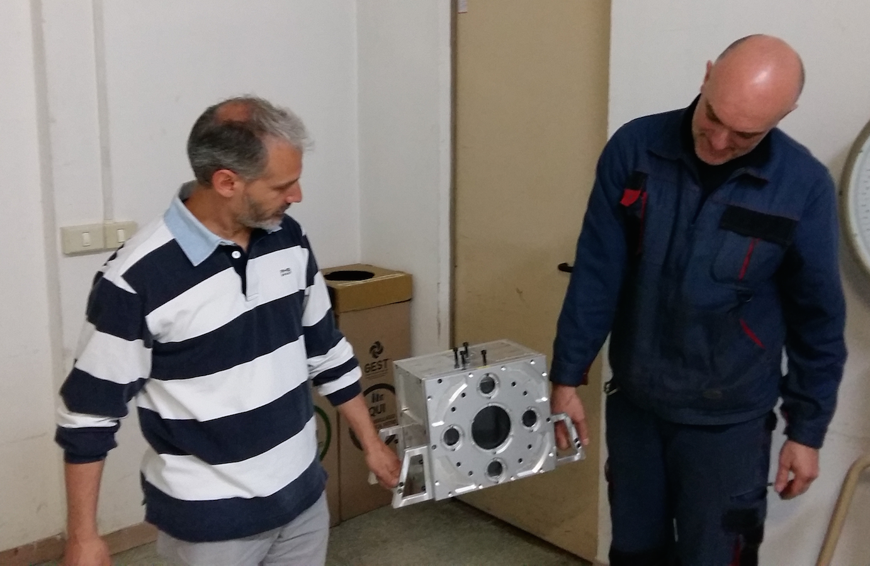

Slide 16
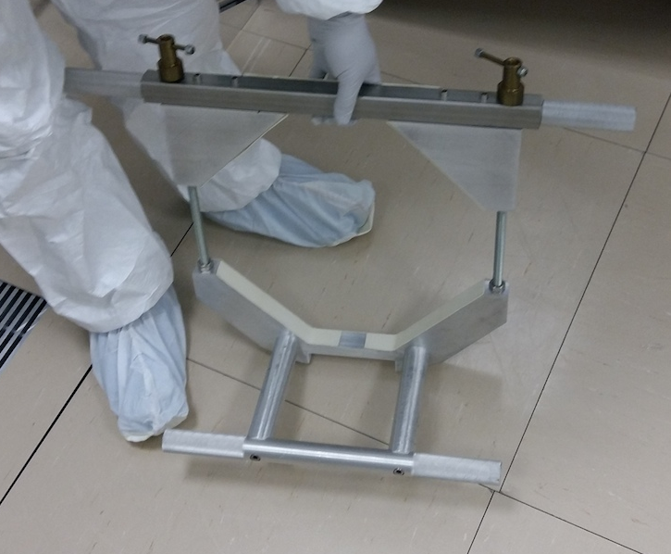
Jig to lift mirror into box

Slide 17
Discussions at Glasgow
The wire clamps used at the marionette, IM and recoil masses should be improved
Cylinders could be changed to triangular prisms – sapphire pieces used for this purpose in advanced LIGO
This gives clear definition of break-off point
In such a case, ANSYS would need to be used to calculate stress in the system to compare with breaking stress of wires
CuBe wires can be fixed to the same length by measuring the violin modes using a guitar pickup and tuning head
Perugia suggested using current system to fix wire length, but then use additional clamps to lock everything down

Slide 18
Discussions at Glasgow
Does the 1/300 tilt cause problems? Tilt redistributes stress in suspensions. Kazuhiro said that the sapphire fibers should be ok, but how about the CuBe wires? They hold twice the load and are thinner
How do we clean the mirror before bonding? Inside the box or before inserting into the box?
My idea is to clean it while we are holding it with the jig used to insert the mirror into the box

Slide 19
Discussions at Glasgow
Marielle will come to Japan to help with bonding, but can only come for one week
When is best? Should be there when we are doing the cleaning/bonding of sapphire parts, but schedule should be fixed
Also possible for Giles to come to Japan for one week to collaborate on suspensions

Slide 20
KAGRA HCB (rough) schedule
Prototype box arrived is in Japan
Cleaning/assembly this week.
Box test using metal ears + mass TBD
Should measure metal mass/ears using 3D coordinate measurement system before bonding (glue) tests
Should be repeated several times to test reproducibility of ear placement (sapphire parts can only be bonded once!)
Testing with metal parts should be done this month

Slide 21
KAGRA HCB (rough) Schedule
Helios will be in Japan during July/August
If necessary, further discussion using metal parts can be done at the start of this time
Sapphire parts will be bonded during Helios’ visit, and the prototype sapphire suspension will begin construction
Must consult KAGRA schedule – when do we expect to be bonding KAGRA ears? (this will be after coating)

Slide 22
To do:
KAGRA mirror box testing w/ metal parts
Clean room setup for bonding of prototype sapphire parts
3D coordinate measurement system in cleanroom
LIGO uses Romer arm, but expensive (10^6 JPY)
Fabrication of jig to hold mirror to insert into box (may also be used during cleaning the mirror flats)
Coordinate with mirror subgroup w.r.t. mirror storage, transport, etc.

