Slide 1
Report from MESCO meeting
2014.04.10
Suzuki, Tomaru, Kimura

Slide 2
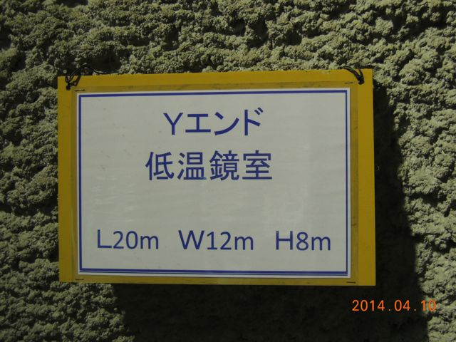
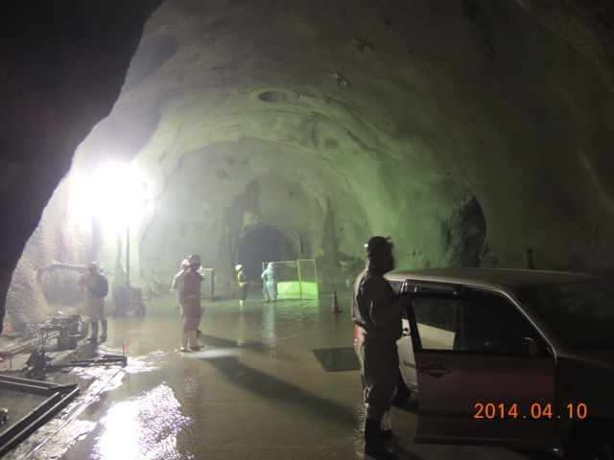
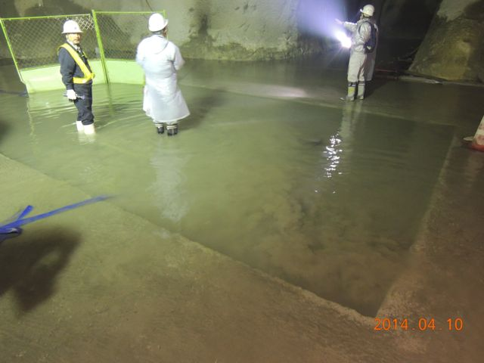
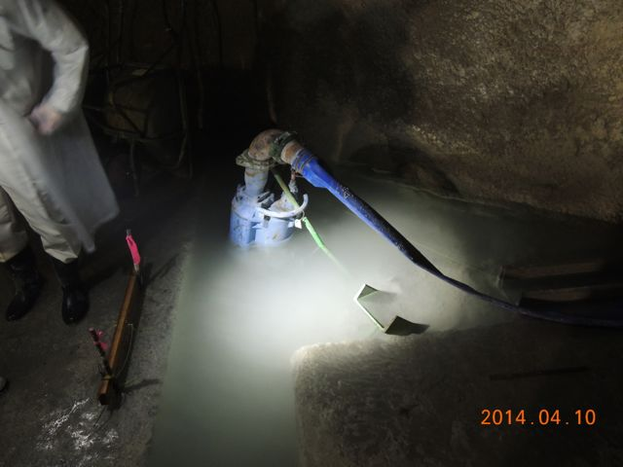
1. Present Tunnel Condition
Cryostat base

Slide 3
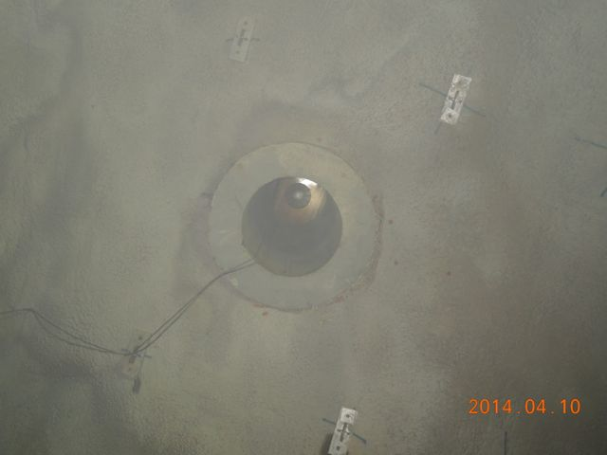
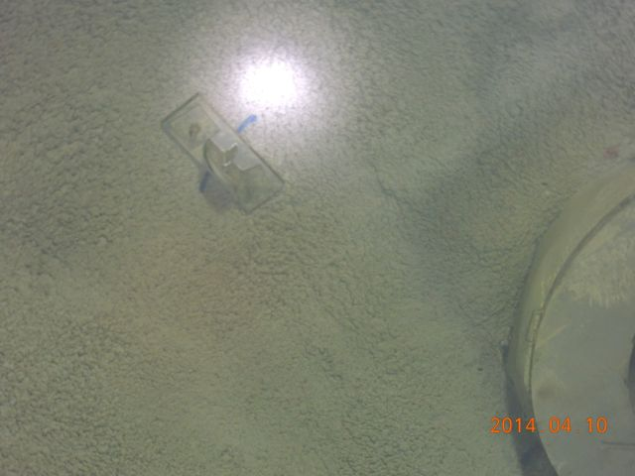
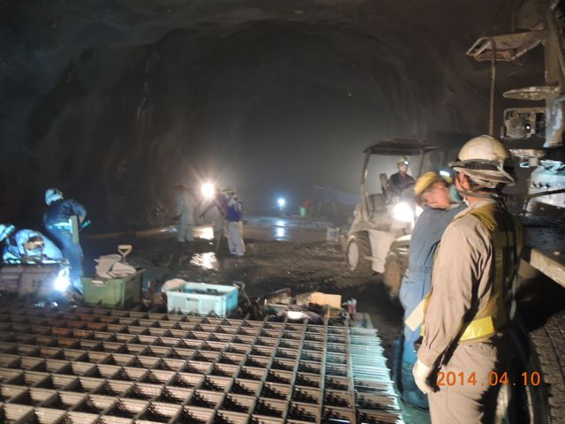
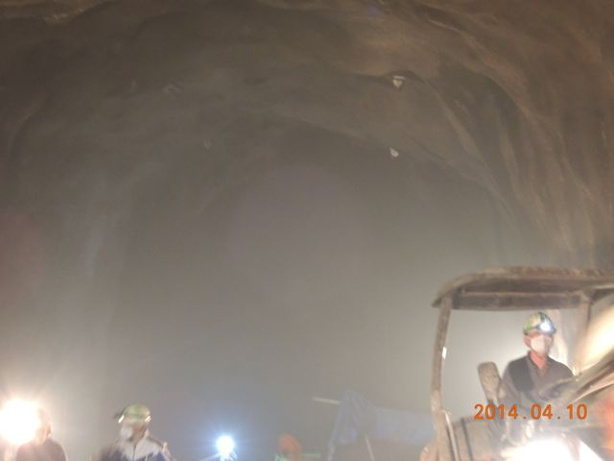
Type-A hole
(view from cryostat room)
Hooking anchor
Upper room for Type-A
Hooking anchor points
at upper room

Slide 4
2. MESCO Meeting Summary
• Carrying cart for cryostat will be fabricated soon. We got the CAD. See next page.
• MESCO assumes 4days/cryostat for transport and put it from the warehouse to
the sitting position. Carrying out and rearrangement of the storage may take additional two days.(-> page 6)
• They need to move air duct in X-arm for this transportation.(-> page 7)
• They can use temporary electric power in the transporting and putting cryostats.
• Holes of chemical anchors for the cyorstats and the duct shields will be drilled by MESCO. (Location of holes -> MESCO)
• We will have final tunnel CAD in this month.
• We keep our installation schedule of the cryostats into end-rooms. It is end of June.
• But present proposed schedule for it by Kajima and MESCO is September.
Saito-san will push their schedule forward.
It is difficult to fix the schedule without fixing the way to dispose water.

Slide 5
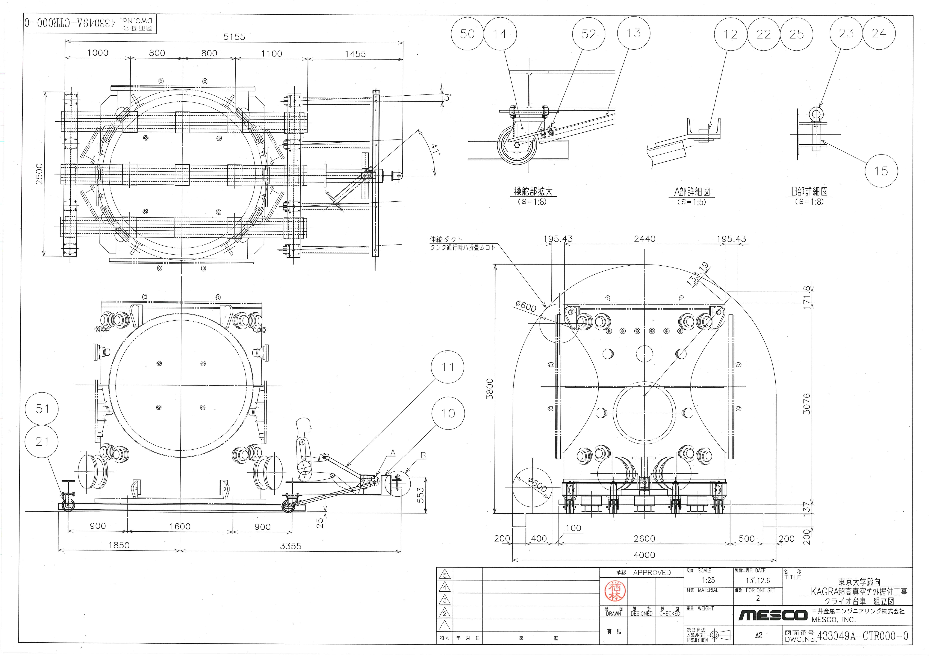

Slide 6
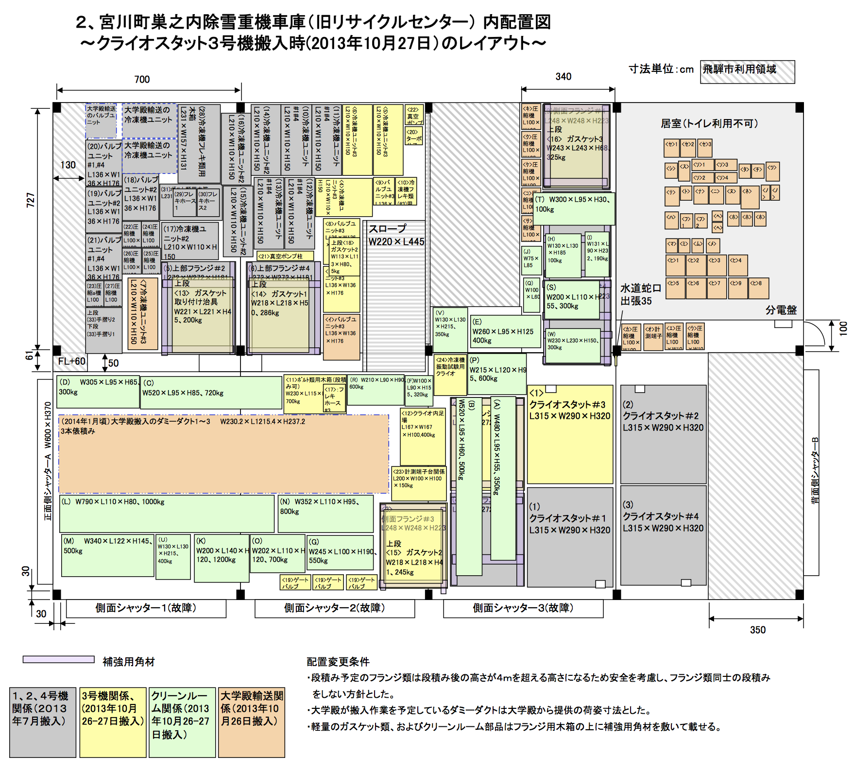

Slide 7
