Slide 1
Discussion from CRY
Integration Meeting
13. Jun. 2016
Tomaru

Slide 2
1) Readout
2) HCB
3) Cool down, Type-A installation and
Room temp. operation?
4) Optical Levers and AR coated windows

Slide 3
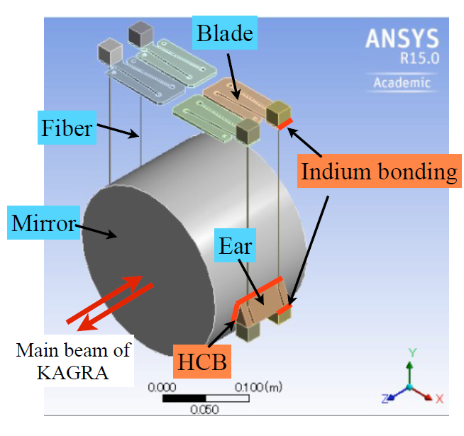
HCB on Mirrors and Fiber Assembly
First trial of HCB on the prototype-mirror
will be performed at end of this July or beginning
of August.
Helios Vocca in Perugia Univ. will give us his help
for this work.
We plan to use a aVIRGO style box to do HCB
of ears. This box can be also used as gluing actuator
magnets (on sapphire spacer attached by HCB on
mirror), assembly process of fibers and mirror
container in transportation.
Discussion 1
We’d like to use this box in practical mirror assembly, too.

Slide 4
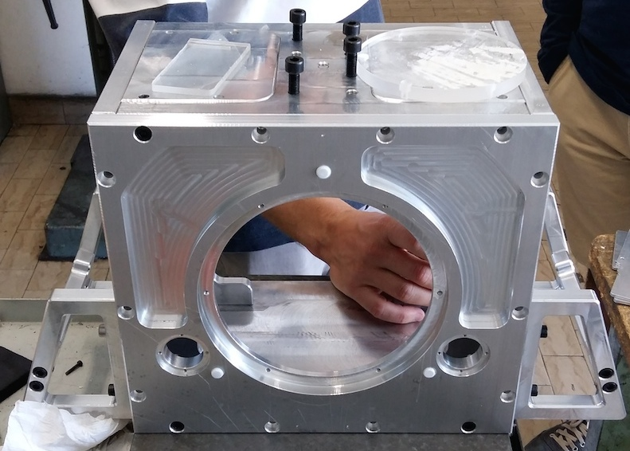
KAGRA mirror box
Perugia has already fabricated the box for KAGRA and it is in our hand now.
from Kieran’s report

Slide 5
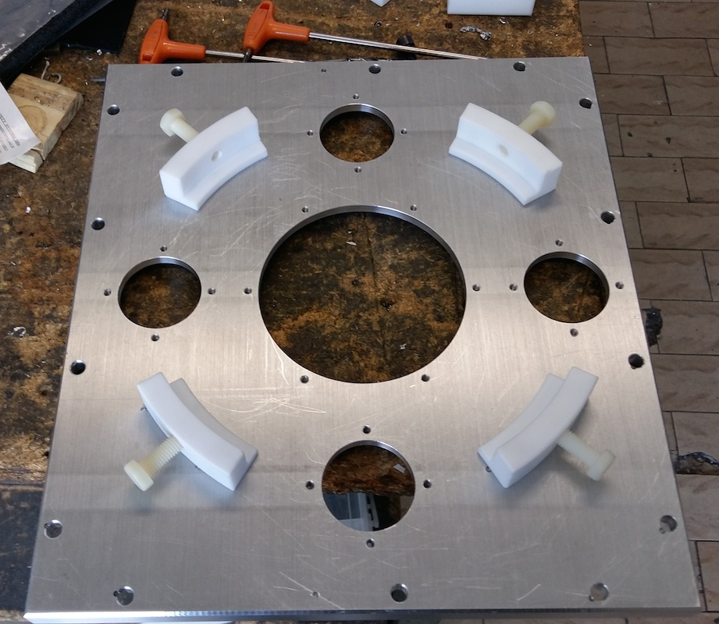
KAGRA mirror box front panel

Slide 6
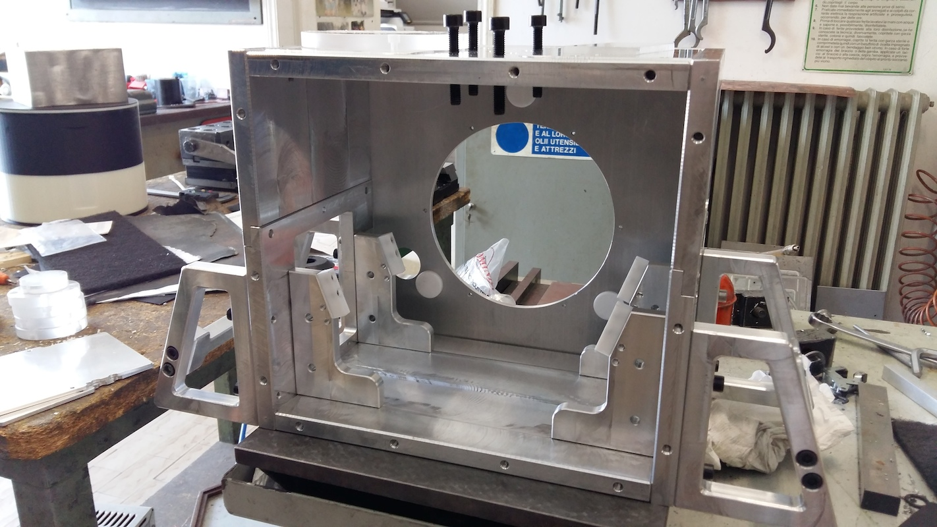
KAGRA mirror box inside

Slide 7
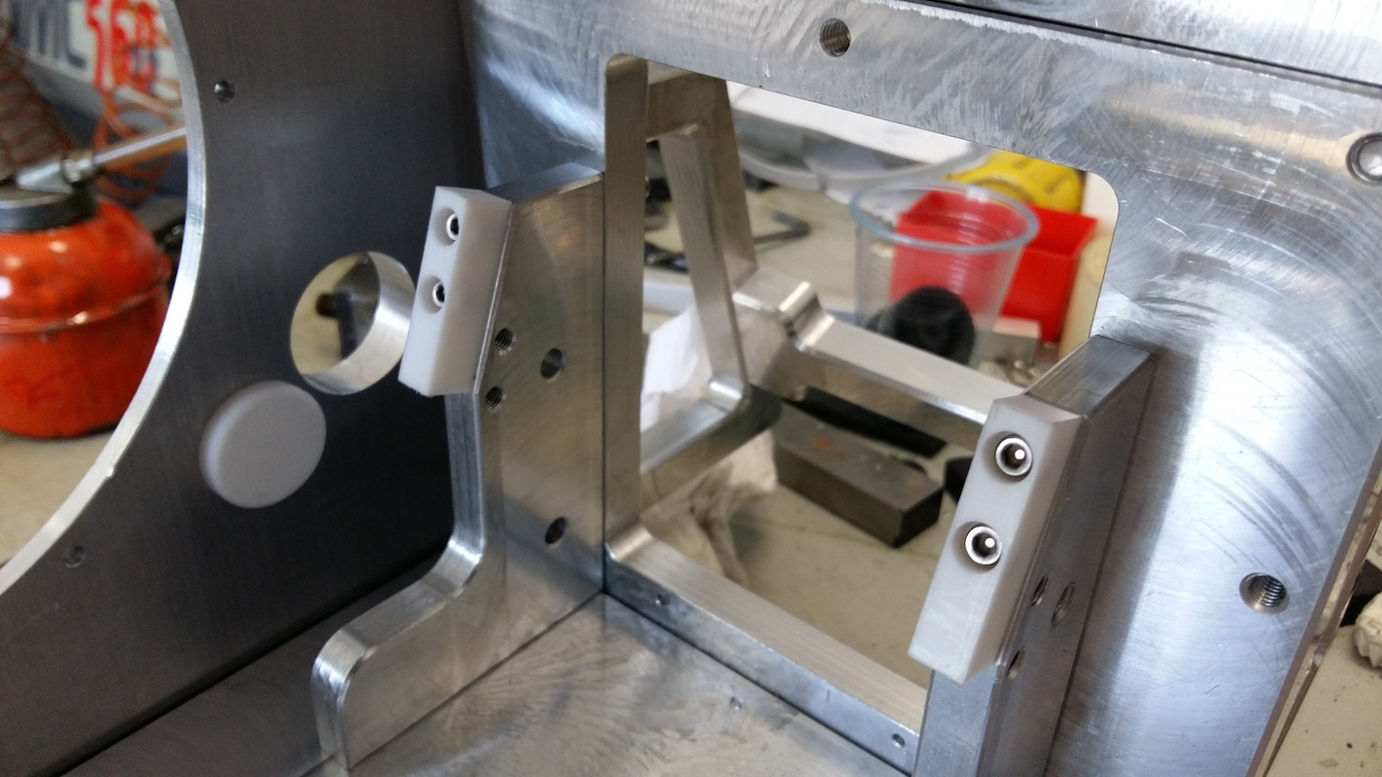
KAGRA mirror box inside - shelves

Slide 8
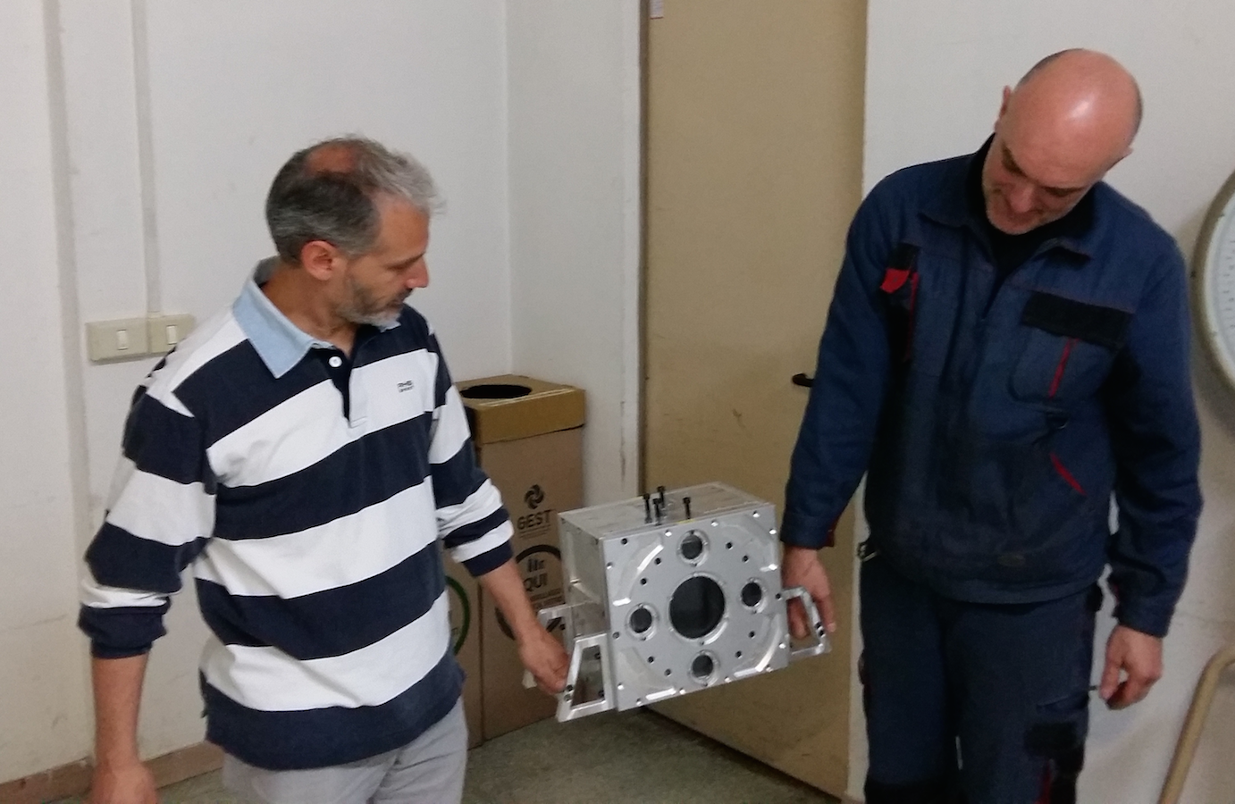

Slide 9
Discussion 2
When, where can CRY receive mirrors from MIR for HCB?
When
In present bKAGRA schedule,
• Dec. 2015: Fabrication of ETMs are done.
• Jan. 2016: Optical performance measurement of ETMs at Caltech?
• Feb. 2016: HCB on ETMs.
Where
Can we perform HCB on ETM just after coating at LMA?
aVIRGO did so.
Pros:
• Clean room use
• ETMs can be put into our assembly/transport box
No need to use a mirror lifting tool after then
Cons:
• Schedule between HCB and measurement will be reversed
• Measurement is done in the condition of ears and magnet bases
2) Performing ECB after optical measurements
• HCB will be done in Japan
• then, can we put the mirror into our box at Caltech?

Slide 10
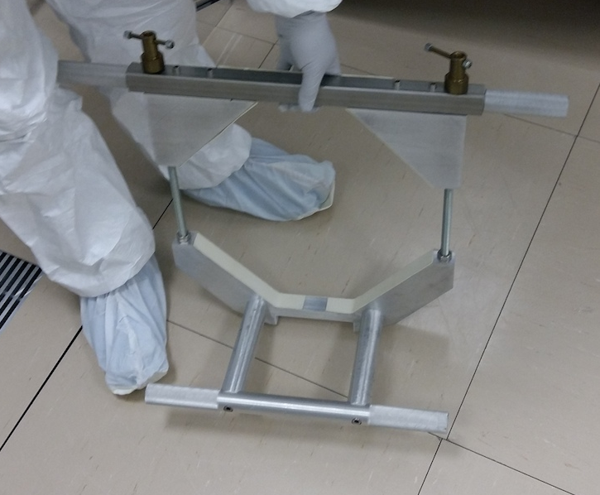
Jig to lift mirror into box in aVIRGO
If we can put mirrors into our box at Caltech, we can use Ergo arm there???

Slide 11
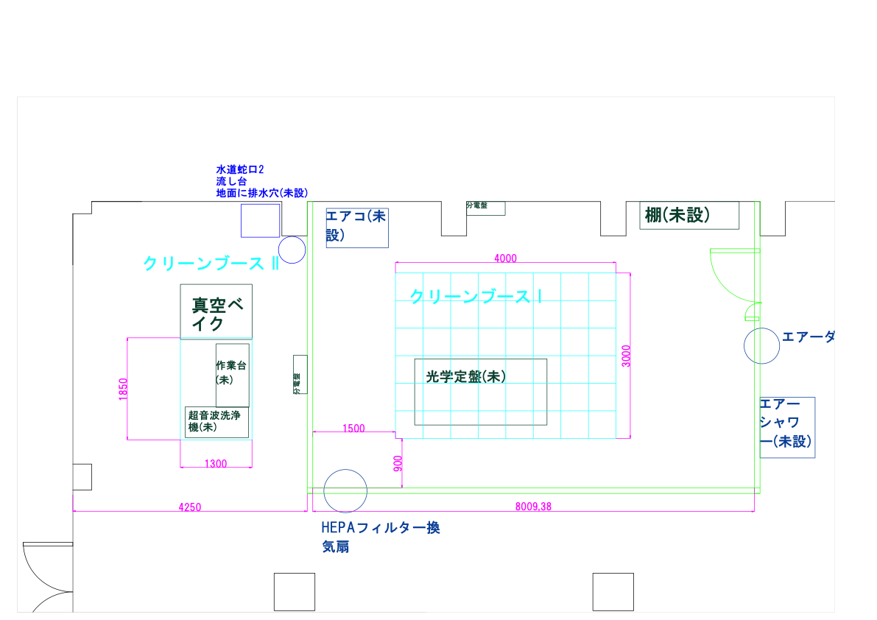
Discussion 3
Place to do HCB
1) Toyama Univ.
• ISO class 4 clean room. but we need class 3
• Not sufficient space
2) NAOJ

Slide 12
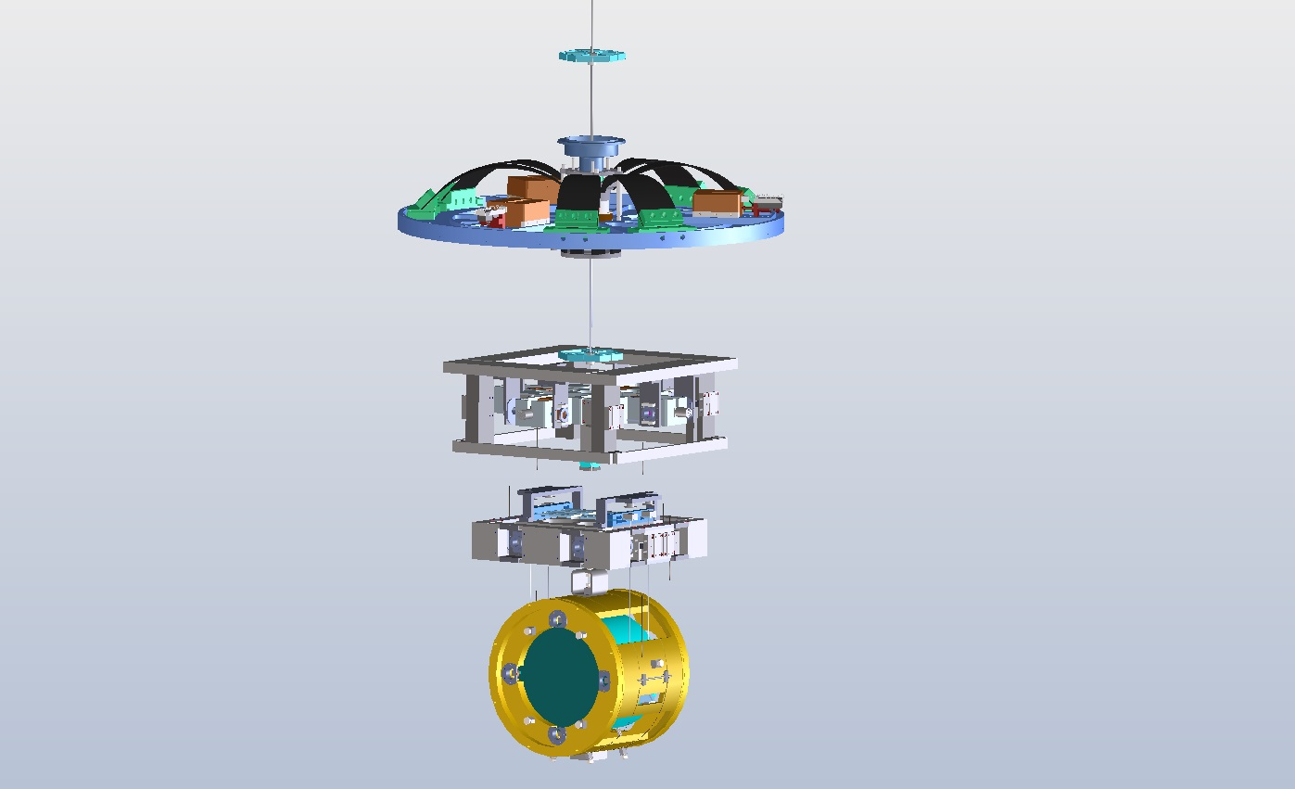
2. Readout
Payload Support Frame
Si-10
Si-1
Si-2
x1
Heater
Si-5
to Type-A
connectors
Si-6
Si-8
to Cryostat
connectors
Baffle
Si
(exist)
Si-7
x2
Si-9

Slide 13
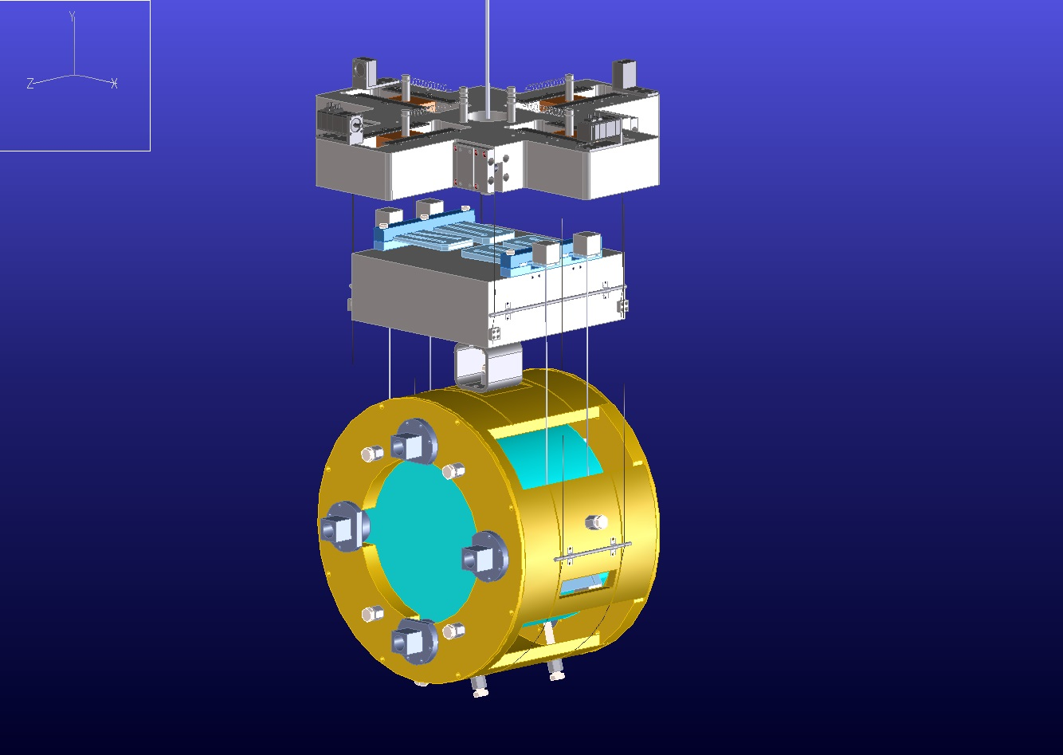
Heater
Si-3
Si-4

Slide 14
Connectors between Cryo-Payload and Type-A
Agreement between CRY and VIS
• D-sub 9pin Connector with high vac. specification
• Feed-through at Vac. port: Male
-> Connection cable: Female-Male
# connection cables between VIS and CRY are prepared by CRY
Since we need phosphorus-copper cable.
-> Connector for sensors: Male
• VIS and CRY will order high vacuum D-sub connecters to Kyocera together.
~July.
Delivery time 3 months.
Discussion 4
How many feed-throughs can CRY use?

Slide 15
3. Cool down, Type-A installation and
Room temp. operation?
First installation of Type A will start from Dec. 2015 to Mar. 2016.
This includes term of thaw.
-> Can not remove water duct on access root at Y-end
between Feb. and Mar.
Discussion 5
Which end should CRY start cool down test ?
Discussion 6
VIS plan to suspend dummy mass (silica mirror?) in cryostat for Type-A.
Then does VIS need to open large side-flanges of cryostat?
This is very hard work, so can you hire Futaba Kogyo Co.?

Slide 16
4. Optical Levers and AR coated windows
• Optical Lever themselves are prepared by AOS.
• Anchor holes for oplev Table are prepared by CRY.
• Can CRY ask AOS to prepare opleve table?
• Can CRY ask AOS to prepare AR coated windows?
• CRY can install windows if AOS hope so.
From Aso-san

