Slide 1
Movement of minute_raw
Worked pretty well.
2TB SSD became almost full last week.
We replaced it to the new 2TB another SSD.
Full SSD is mounted as
old_raw_minute_trend_dirs="/minute_raw.20181107.HDD";
and meanwhile copied to 2TB HDD.
Now HDD is mounted as old_raw_minute_trend_dirs
Question:How to write daqdrc for the multiple old disk?
old_raw_minute_trend_dirs="/minute_raw.20181107.HDD, /minute_raw.2019XXXX.HDD ";

Slide 2
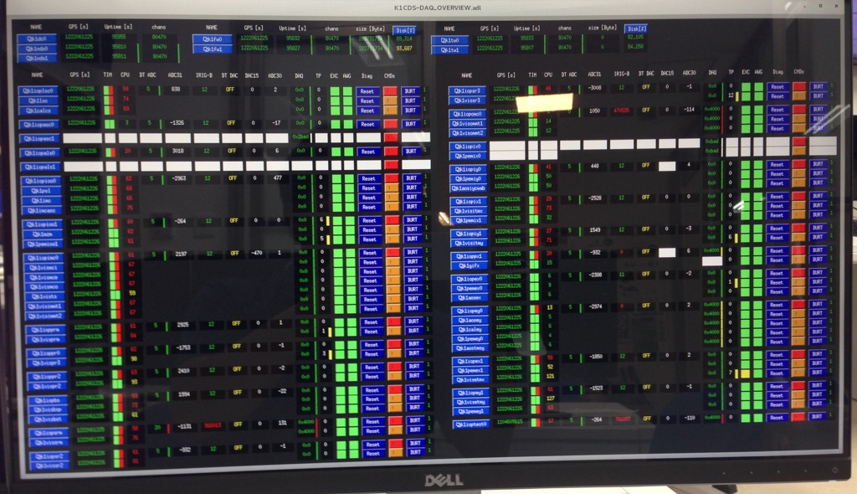
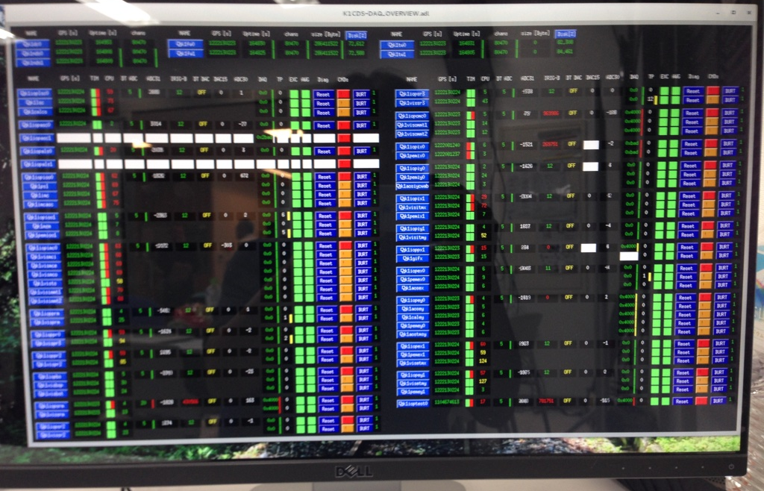
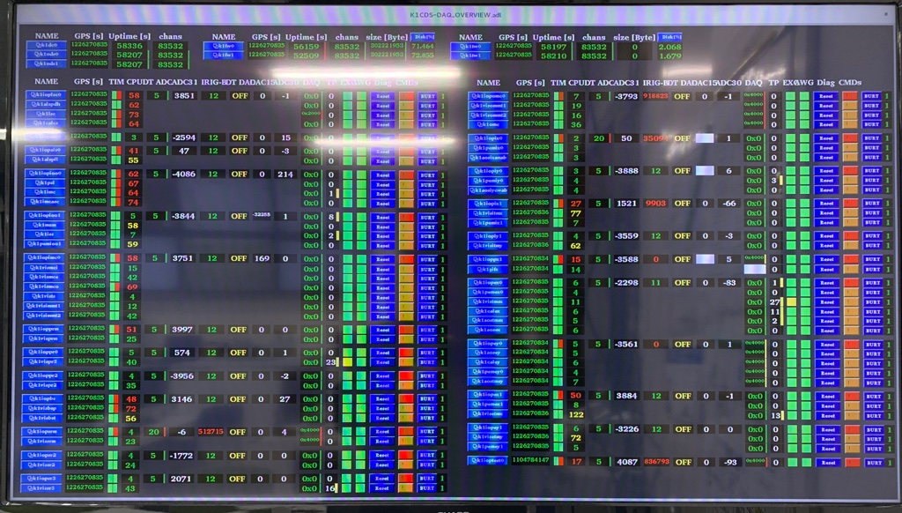
CPU-max issue
Situation is better, but still far from perfect.
We installed EPICS gateway.
We added memories to nds from 24GB to 48GB. It will be 96GB both soon.
Rebooting desktops in the control room makes less glitch for a while ~several days.
Is memory on DC important? Currently 32GB.
Some IOP models has always ~15 of CPU.

Slide 3
PCIe connection between PC and IO chassis
Gen 2 did not work at KAGRA also.
We asked One Stop Systems to modify the Gen2 card to make is work as Gen1 mode.
We sent our PC side card. It should arrive beginning of next week. Takahiro brought IO chassis side card. You can test a pair of them.
We are really glad if you can offer old Gen1 card when they are changed to the new cards. Our Gen2 based card is still not perfectly stable somehow.

Slide 4
EPICS IOC in dc, nds, fw, tw, guardian?
I could not find any IOC on dc, nds, fw, tw, guardian, but EPICS channels are defined somewhere.
For example, what does
start epics server "K1:DAQ-NDS0_" "K1:DAQ-NDS0_";
in the daqdrc make it run?

Slide 5
Some questions
Why are you using Brocade switches?
How much memory do you have on NUC 7i7bnh for Client Workstation?
Are you using 5sec delay by DIP switch setting on M4-ATX?
Next: update RCG from 2.9.7 to 3.XX

