Slide 1
LCGT SIS+PAY tentative params
23/03/2011
mc0=0; mc3=2 ; mc4=2; mcpf=1; mcbla=0.2 ;
m1=106.24;
m2=89.37;
m3=86.51;
mpf=83.65;
I1=11.43;
I2=10.83;
I3=11.43;
I4=10.83;
sdy_ma=0;
gap=0.01;
gapPF=0.001;
gapMB=0.001;
gapIM=0.003; bending point closer to COM
gapRM=0.001;
gapTM=0.001;
%RYU F1 F2 F3 F4 MB IM RM TM
m=[ m1 m2 m3 mpf 36 80 90 10.7];
Ix=[ I1 I2 I3 I4 1.6 1.2 4 0.051]; %LCGT Y
Iy=[ 20 20 20 20 3.2 2.4 4 0.051]; % LCGT Z
Iz=[ I1 I2 I3 I4 1.6 1.2 8 0.084]; % LCGT X
mcre=[ mc0 mc0 mc0 mc0 mc0 mc0 0 0 ];
frv=[ 0.33 0.33 0.33 0.33 0.33 0.33 0 0 ];
%RYU F1 F2 F3 PF MB IM RM TM
mat={ 'MA' 'MA' 'MA' 'MA' 'C70' 'MA' 'C70' 'W' };
l=[ 2.1 2.1 2.35 2.085 2.084 2.084 2.084 2.084 ];
d=[ 3.2 3.0 2.8 2.5 0.5 2.1 0.7 0.15 ]*1E-3;
sux=[ 0 0 0 0 0.40 0 0.34 0.25/2]; %LCGT Y
suz=[ 0 0 0 0 0.40 0 0.03 param]; %LCGT Z
suy=[ 0 0 0 0 0 0 0.000 0 ]; %LCGT X
sdy=[ -gap -gap -gap -gapPF -gapMB gapIM -gapRM -gapTM ]; %LCGT Z
cabl=[ 1E-1 1E-1 1E-1 1E-1 1E-3 1E-3 1E-4 1E-4 ];

Slide 2
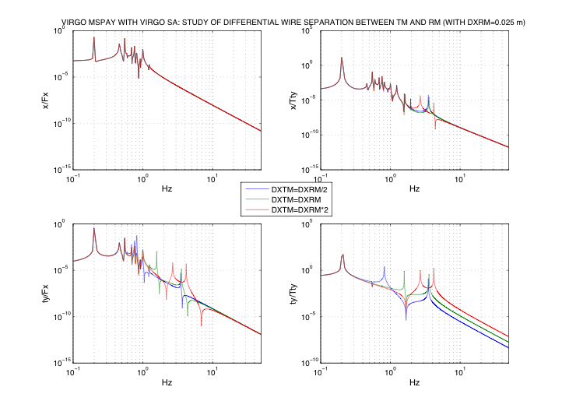
From here all MKS, and LCGT reference

Slide 3
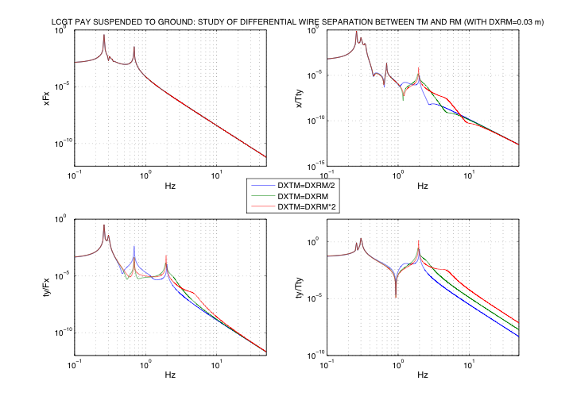

Slide 4
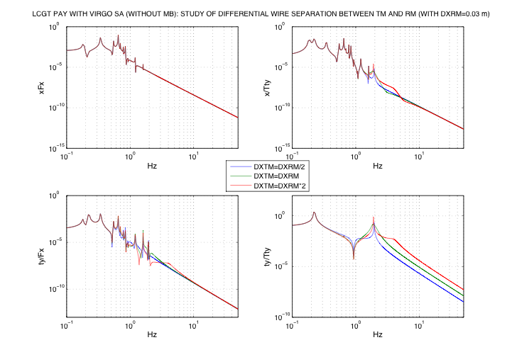

Slide 5
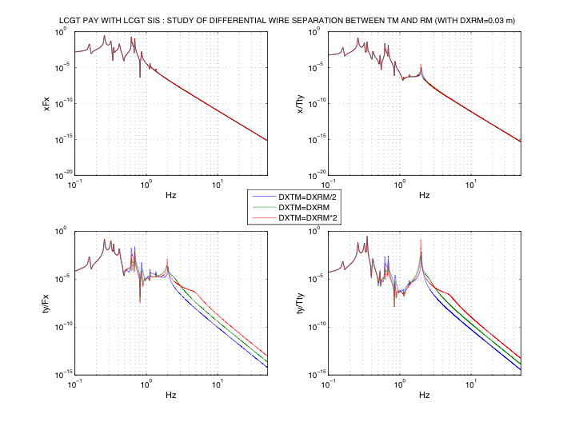
Most of those small peaks are due to coupling angular/transl
Due to position of COM vs lambda (wrong in this plot)

Slide 6
