Slide 1
Interface Optics Part
SQB1
Second version
Huali Chen

Slide 2
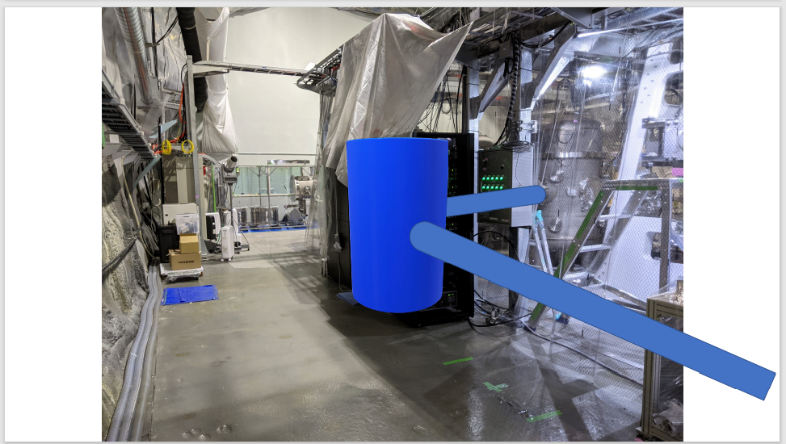
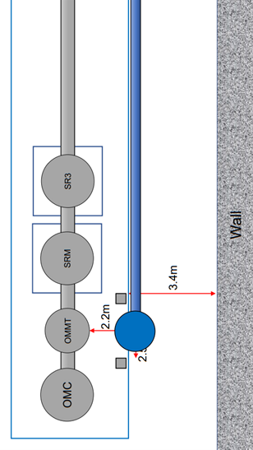
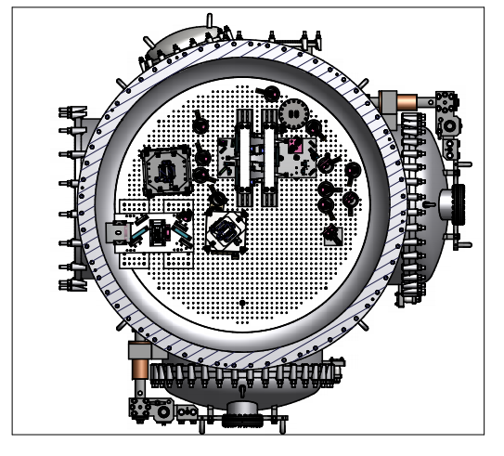
2.2m
3.4m
Y
SQB1
OMMT
X
SRM
Wall
2.5m
0.4m
SRM
1.582m
3.1m
2.338m
0.7968m
0.299m
SQB1
OMMT
1.298m
2.2m
3.4m
OMC

Slide 3
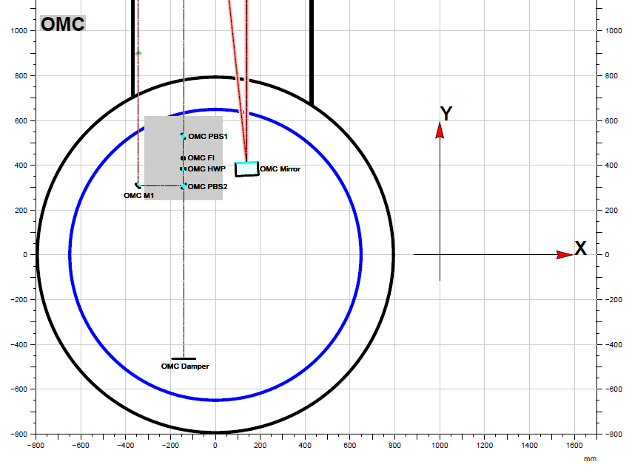
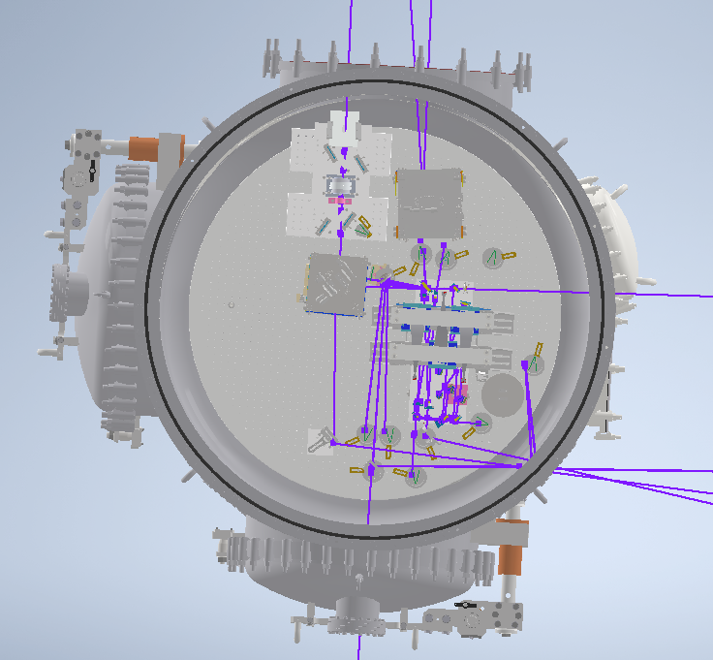
OMC FI: Wt= 841.870*10^-3 mm
Ws= 839.896*10^-3 mm
OMC M1: Plane mirror, Diameter=1 inch
Incident angle:${45}^{°}$
25.1mm
ITF signal
SQB1
OMMT
27mm
GR
FIS
FDS
OMC
ESQB1
q-parameter: -1+i*0.53 [m]
Wt=Ws=0.9047mm Rc=1.2809*10^3 mm
0mm (OMC PBS1)
Waist: Wt=Ws=0.42mm 1m (OMC PBS1)

Slide 4
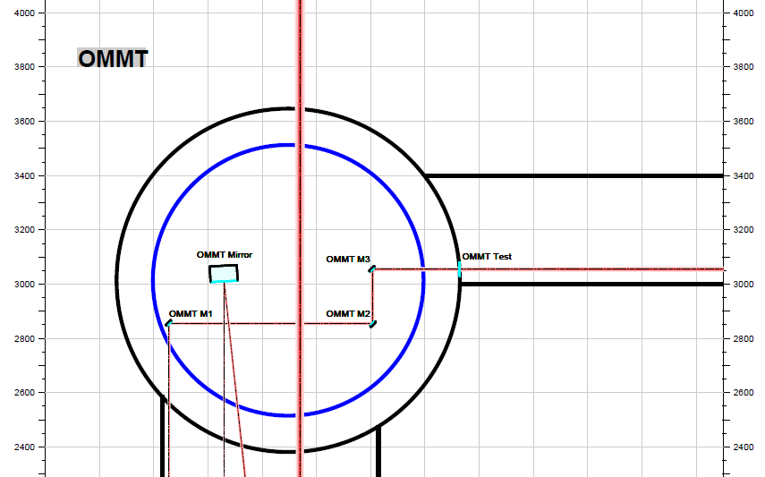
OMMT M1, OMMT M2, OMMT M2 are all Plane mirror, Diameter 1 inch
OMMT Test: Wt= 2.61412mm （OMM M3 321.0mm）
Ws= 2.61637mm
Incident angle:${45}^{°}$
ITF signal
SQB1
OMMT
GR
FIS
FDS
OMC
ESQB1

Slide 5
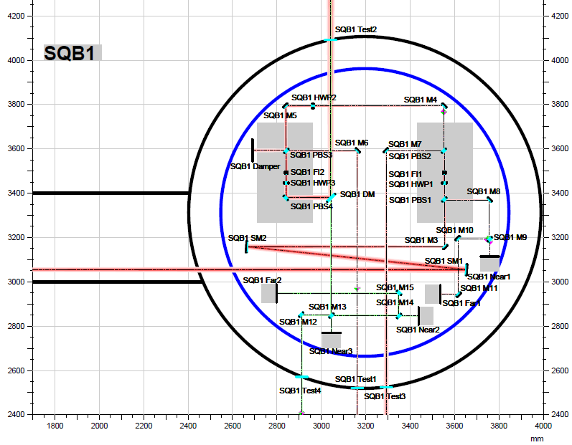
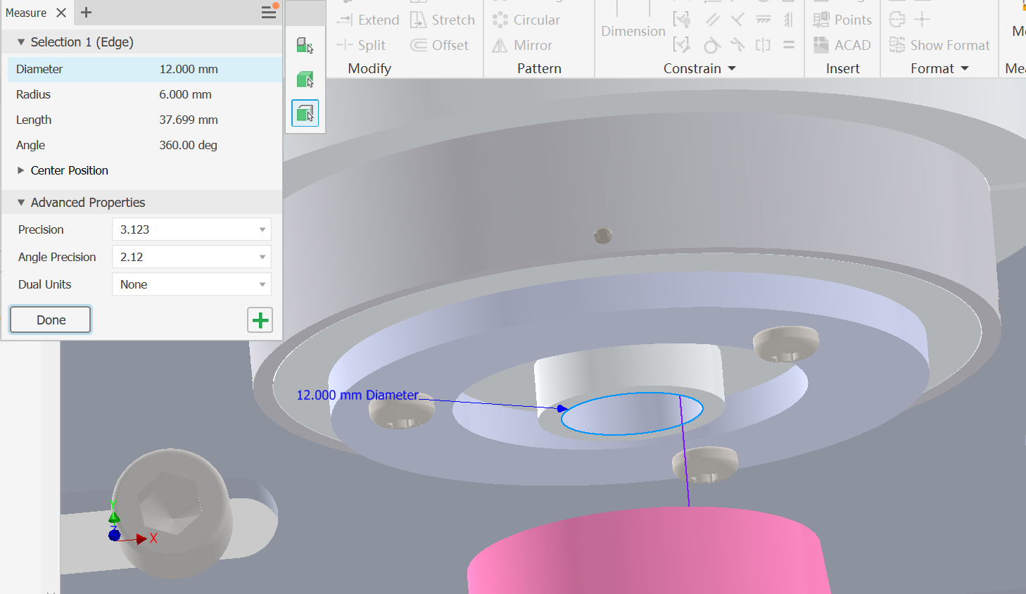
SQB1 SM1: Rc=-5.19228*10^3mm Diameter=2inch
SQB1 SM2: Rc=-5.19228*10^3mm Diameter=2inch
SQB1 M3: Plane mirror Diameter=1inch
SQB1 FI 1: Wt= 706.746*10^-3 mm Ws= 715.877*10^-3mm
SQB1 M4, M5 , M6 and M7 are all Plane mirror and Diameter=1inch
SQB1 Test1: Wt= 1.17156mm Ws=1.18044mm （SQB1 M6 1070mm)
SQB1 FI 2: Wt= 2.66683 mm Ws=2.65892 mm （SQB1 FI1 1333mm）
SQB1 DM is Dichroic mirror and Diameter=2inch
SQB1 Test2: Wt= 5.30599 mm Ws= 5.29208 mm （DM 710.0 mm)
SQB1 Test3: Wt= 3.87902 mm Ws= 3.89241 mm（SQB1 M7 1068 mm）
Plane mirror’s Incident angle:${45}^{°}$
Curved mirror’s Incident angle:$3^{°}$
ITF signal
OMMT
SQB1
OMC
GR
FDS
FIS
250mm
ESQB1
Faraday Isolator
450mm
ITF signal
SQB1
June Gyu Park
(KAGRA)
OMMT
②
①
GR
FIS
FDS
OMC
ESQB1
The diameter of OMC FI’s aperture is 12mm

Slide 6
Monitoring system:
For Red:
SQB1 QPD1 Near: Wt=223.843*10^-3mm, Ws=215.023*10^-3mm (SQB1 M9 75mm )
SQB1 QPD1 Far: Wt=1.20759mm, Ws=1.18974*10^-3mm (SQB1 M11 80mm )
SQB1 M8,M9,M10 and M11 are all 1 inch
SQB1 SM1 and SQB1 M3 (Piezo-actuated for auto-alignment)
ITF signal
SQB1
OMMT
GR
FIS
FDS
OMC
ESQB1

Slide 7
For Green:
Waist: Wt=Ws=1mm (SQB1 Test4 171mm)
SQB1 Test4: Wt= 1.00150mm, Ws= 1.00150mm
SQB1 DM: Wt= 1.31762mm,Ws= 1.06745mm(SQB1 M13 525.4mm)
SQB1 Test2:Wt= 1.17316mm,Ws= 1.17340mm(SQB1 DM 710mm)
SQB1 QPD2 Near: Wt= 1.05152mm,Ws= 1.05188mm(SQB1 M14 83mm)
SQB1 QPD2 Far: Wt= 1.12529mm,Ws= 1.12555mm(SQB1 M15 550mm)
SQB1 QPD3 Near: Wt= 1.01405mm,Ws= 1.01388mm(SQB1 M13 73mm)
SQB1 M12,M13,M14 and M15 are all 1 inch
Plane mirror’s Incident angle:${45}^{°}$
SQB1 M12 and M13 (Piezo-actuated for auto-alignment)
ITF signal
SQB1
OMMT
GR
FIS
FDS
OMC
ESQB1

Slide 8
Next work
Y
1、Learning more detail about auto-alignment system
2、Designing the SQB2’s beam path
X
SRM
Wall
SRM
?
SQB1b
OMMT
SQB1a
OMC

