Slide 1
Interface Optics Part
SQB1 and SQB2
Part of injecting FDS
Third version
Huali Chen
20230404

Slide 2
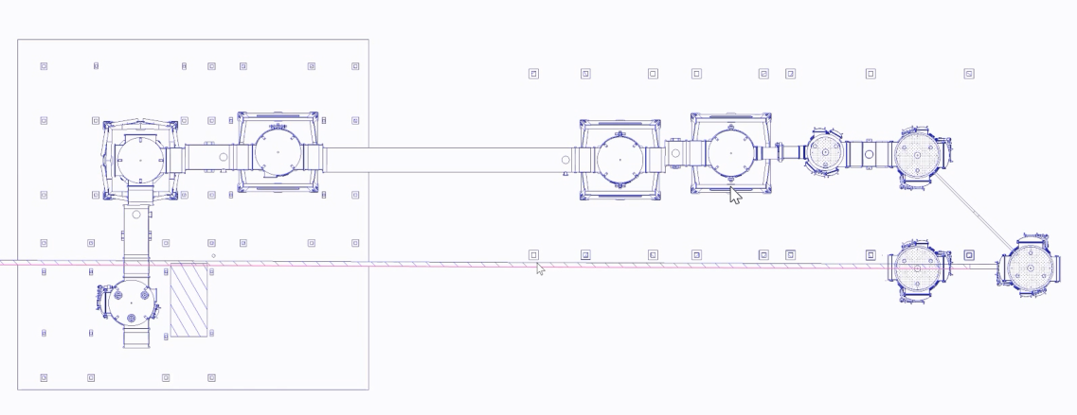
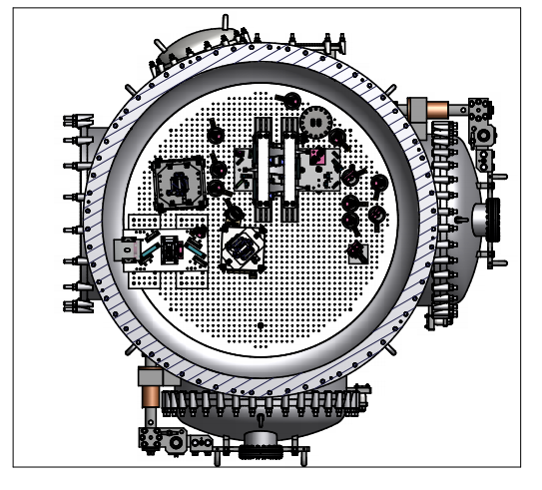
Location:
OMMT
OMC
△Y1=2.250m
△Y2=1.987m
△X1=2.8328m
SQB2
SQB1
X
Y
1.587m
1.298m

Slide 3
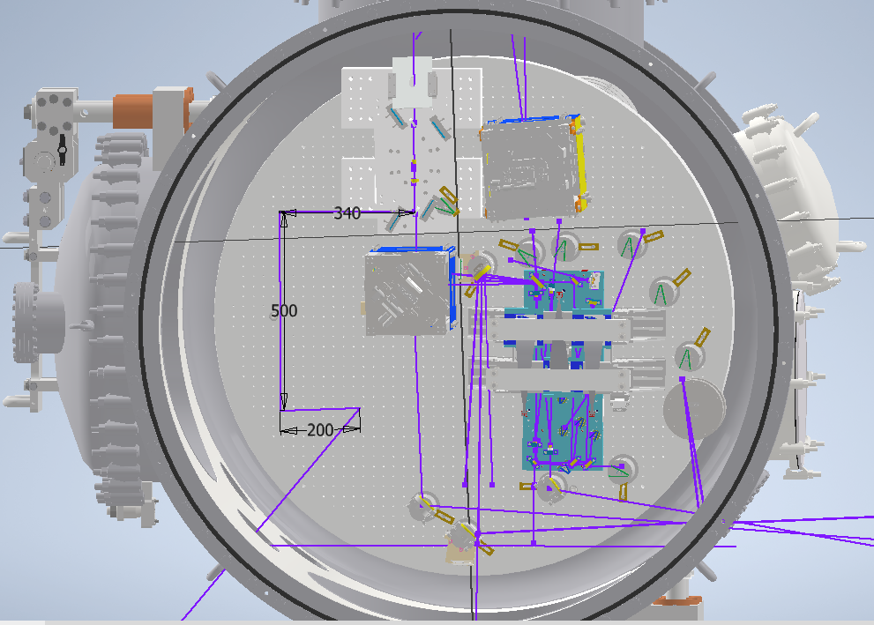
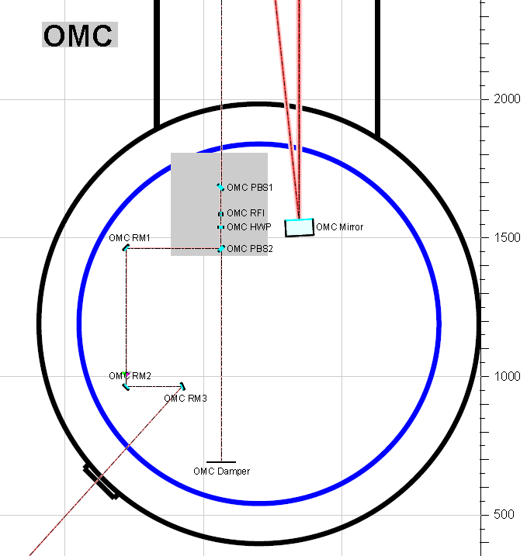
q-parameter: -1+i*0.53 [m]
Wt=Ws=0.9047mm Rc=1.281*10^3 mm (OMC PBS1: 0mm)
Waist: Wt=Ws=0.42mm (OMC PBS1: 1m)
OMC RM1, OMC RM2, OMC RM3 : Plane mirror, Diameter=1 inch
Incident angle:${45}^{°}$ and ${24}^{°}$

Slide 4
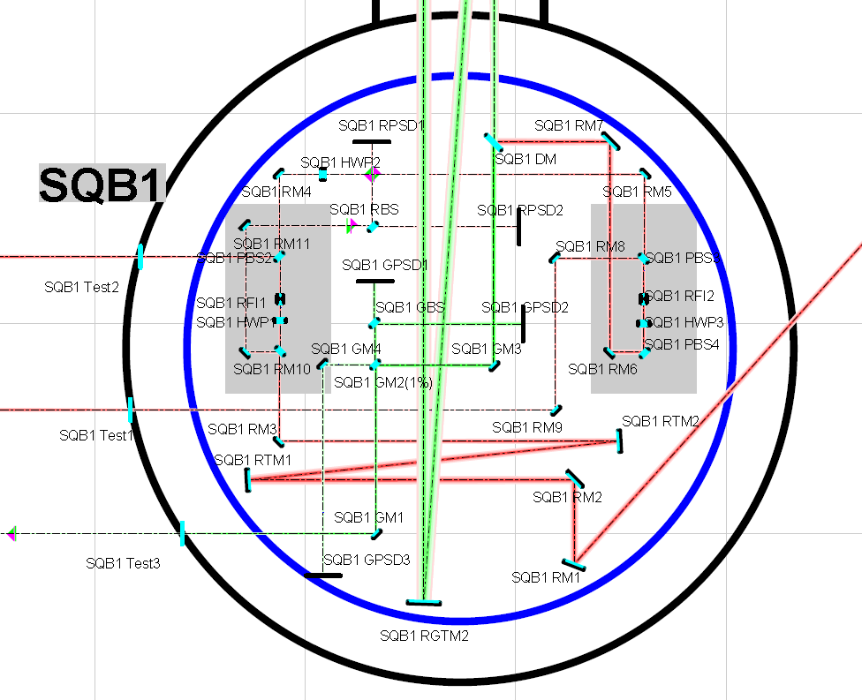
SQB1 RTM1: Rc=-3.5m Diameter=2inch Incident angle:$3^{°}$
SQB1 RTM2: Rc=-24.95m Diameter=2inch Incident angle:$3^{°}$
SQB1 RM1: Plane mirror Diameter=2inch Incident angle:${21}^{°}$
SQB1 RM2: Plane mirror Diameter=2inch Incident angle:${45}^{°}$
SQB1 RM3: Plane mirror Diameter=1inch Incident angle:${45}^{°}$
SQB1 RM4: Plane mirror Diameter=1inch Incident angle:${45}^{°}$
SQB1 RM5: Plane mirror Diameter=1inch Incident angle:${45}^{°}$
SQB1 RM6: Plane mirror Diameter=1inch Incident angle:${45}^{°}$
SQB1 RM7: Plane mirror Diameter=2inch Incident angle:${45}^{°}$
SQB1 RM8: Plane mirror Diameter=1inch Incident angle:${45}^{°}$
SQB1 RM9: Plane mirror Diameter=1inch Incident angle:${45}^{°}$
SQB1 DM: Dichroic mirror Diameter=2inch Incident angle:${45}^{°}$
SQB1 FI 1(①): Wt= 1.13241 mm Ws= 1.12016 mm
(SQB1 FI 2(②): 1.487 m )
SQB1 Test1(FIS): Wt= 1.15402mm Ws=1.16188mm
SQB1 Test2(FDS): Wt= 1.16639mm Ws=1.17682mm
SQB1 Test3(Green): Wt =0.305585 mm Ws= 0.305585 mm
qt=0. 2411 m+i* 0.1419 3m =qs

Slide 5
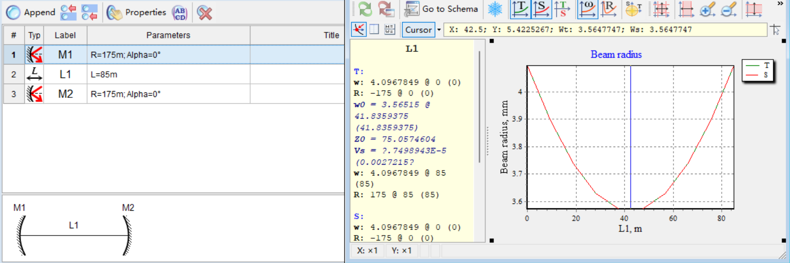
1064nm:
FC:85m ROC=175m
532nm:

Slide 6
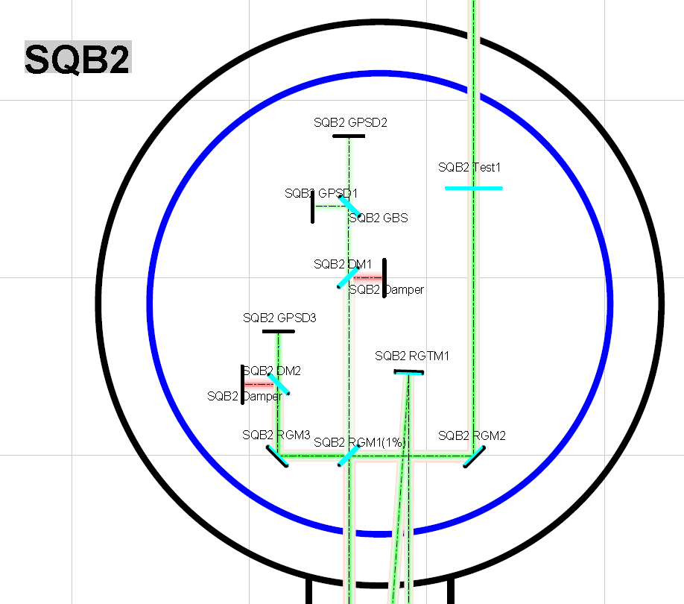
SQB2 RGTM1: Rc=-8.0m Diameter=3inch Incident angle:$2^{°}$
SQB1 RGTM2: Rc=-41.75m Diameter=3inch Incident angle:$2^{°}$
SQB2 RGM1(1%): Diameter=3inch Incident angle:${45}^{°}$
SQB2 RGM2: Plane mirror Diameter=3inch Incident angle:${45}^{°}$
SQB2 Test1(IR,FC input mirror): Wt= 5.80257mm Ws=5.79531mm
Roct=-179.1m Rocs=-162.5m
W0t=5.073mm W0s= 4.947mm
qt= 42.19m+i* 75.99m qs= 44.09m+i*72.27
SQB2 Test1(Green,FC input mirror): Wt= 4.09698 mm Ws= 4.10268 mm
Roct= -176.5 m Rocs= -171.0 m
W0t= 3.572 mm W0s= 3.547 mm
qt= 42.32 +i* 75.35m qs= 43.18 m+i*74.3

