Slide 1
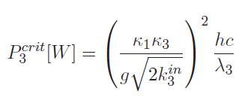
Threshold
[1]
Threshold:
Properties relating to the non-degenerate signal and idler fields are written with subscripts 1 and 2 respectively, and the pump field properties with subscript 3.
$$κ1=κ1 in+κ1out+κ1l$$
[2]
where Ri is the power reflectivity of the ith mirror. τ= L/c is the round trip time of the cavity. If the input coupler and output coupler are on the same mirror, then the R_{out}=1, then $κ_{out}$=0. L is the length of cavity.
$κ_{in}$ is the decay rate of the input coupler, $κ_{out}$ is the decay rate of the output coupler,$κl$is the decay rate of the intra-cavity loss
h is Planck constant, c is light speed. The strength of the non-linear interaction is given by g which describes the rate at which photons transfer between fields and it is related to the waist in crystal[3].
If we want to calculate the threshold of VOPO, we need to know g and intra-cavity loss
Reference:
[1]2012stefszky Thesis: Generation and Detection of Low-Frequency Squeezing for Gravitational-Wave Detection
[2]2018 Mansell G L Thesis :Squeezed light sources for current and future interferometric gravitational-wave detectors
[3]2016 Andrew Wade Thesis : Quantum limited measurements in gravitational wave
[4]2017 TT1700104-v2 aLIGO, SQZ, VOPO Cavity, Final Optical Design vopoFDD_v2

Slide 2
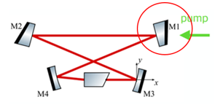
Intra-cavity loss:
According the reference[1], we can evaluate the Intra-cavity loss by the loss of each component in cavity:
For VOPO,
R_{in1064}=0.875
R_{loss1064}: 0.9985(M2 coating )*0.9999²(M3,M4 HR coating)*0.9998(PPKTP absorption )* 0.999²(PPKTP AR coating) =0.996105 (loss₁₀₆₄=1-R_{loss1064}= 0.00389455)
R_{in532}=0.875
R_{loss532}: 0.9999(M2 coating )*0.9999²(M3,M4 HR coating)*0.9998(PPKTP absorption )* 0.995²(PPKTP AR coating) = 0.98953 (loss₅₃₂=1-R_{loss532}= 0.0104699)
These parameter are show in next page.
However, according to reference[1], this method for estimating the intra-cavity loss is very roughly.

Slide 3
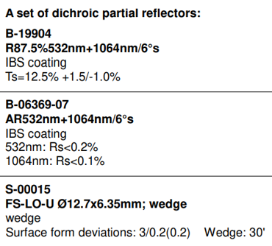
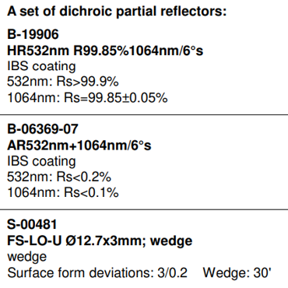
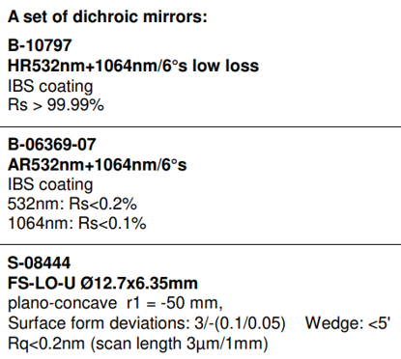
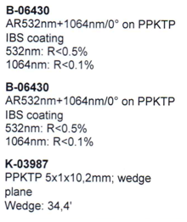
M1:
M2:
M3,M4:
PPKTP coating:
Crystal absorption[1]

Slide 4
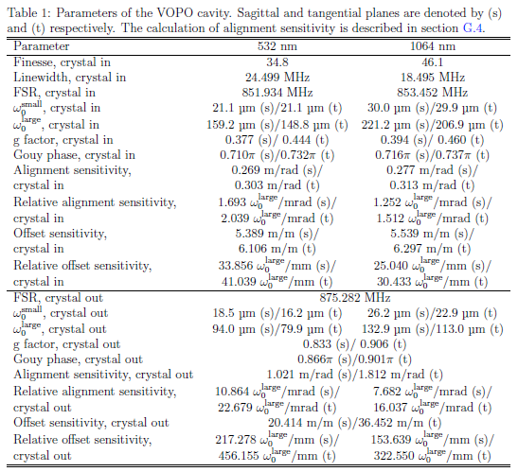
② Our VOPO is the same with LIGO-VOPO[4], so we can use their finesse in Table 1 and formula below to get the Intra-cavity loss
Finesse:
[1]
where Ri is the power reflectivity of the ith mirror. If the in coupler is the same with out coupler, then the R_{out}=1.
R_{in1064}=0.875
Finesse₁₀₆₄=46.1
R_{in532}=0.875
Finesse₅₃₂=34.8
We can get: R_{loss1064}= 0.997267
R_{loss532}= 0.954127
According to[1,2], this method is more accuratly
[3]

Slide 5
③ According to reference[2], we can measure the intra-cavity loss
where P_{inc} is the incident power and P_{re f l} is the reflected power.
when any mode mismatch or cavity misalignment, we need to subtract the high-order-mode power
where $κloss$is the decay rate of the intra-cavity loss
Input/output coupler
where Ri is the power reflectivity of the ith mirror.
τ= L/c where τ is the round trip time of the cavity

Slide 6
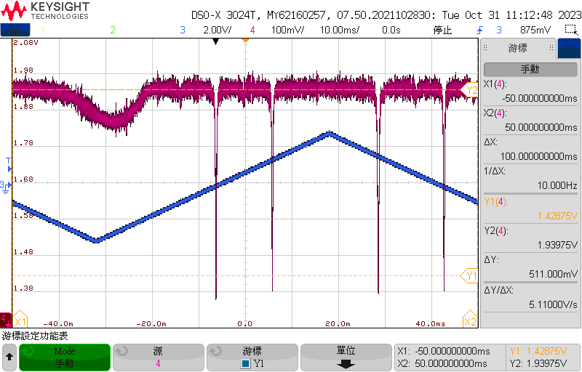
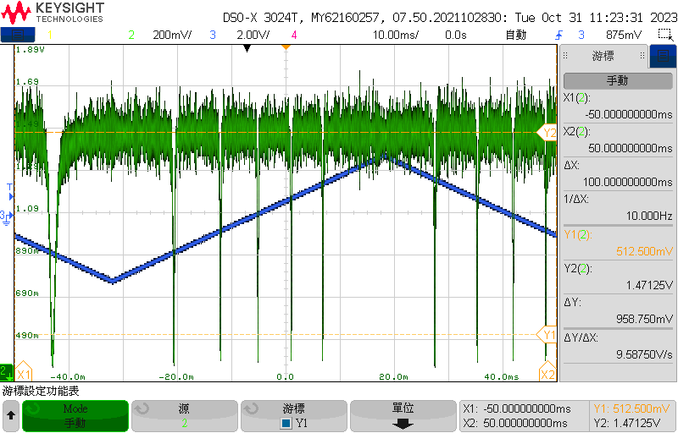
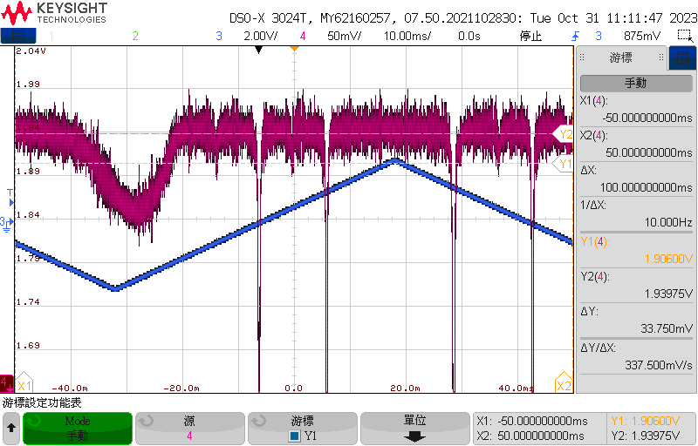
VOPO 1064nm reflected signal: P_{inc}=4.72mW , P_{refl}=4.66mW
High-order-mode/(High-order-mode+Main-mode)=0.061955
VOPO 532nm reflected signal: P_{inc}=4.70mW , P_{refl}=4.59mW
0.2887mW
R_{532 loss}= 0.99921,Finesse ₅₃₂= 46.7684(34.8)
R_{1064 loss}= 0.999545, Finesse ₁₀₆₄= 46.8854(46.1)

Slide 7
The strength of the non-linear interaction g:
 | PPKTP Length(mm) | Cavity Length(m) | Reflectivity of Mir | Waist of Cavity in crystal(μm) 532nm | Radius of M3,M4(mm) | g
Our VOPO | 10.7 | 0.344 | R1=0.875(0.875) R2=0.9985(0.999) R3=R4=0.9999(0.9999) | 21 | -50 | 1016
[1] | 10.5 | 0.273 | R1=0.839(0.722) R2=0.9985(0.9985) R3=R4=0.999(0.999) | 23.01 | -38 | 1891
[3] | 10.5 | 0.345 | R1=0.845(0.7) R2=0.9985(0.9985) R3=R4=0.9999(0.9999) | 21.2 | -50 | 1016
According to the reference [1,3], the g is related to the waist in the crystal. Our VOPO’s waist in crystal is the almost the same with reference[3], so we can use g=1016(1/s).

Slide 8
Summary
Using the formula:
where
τ= L/c
Ri is the power reflectivity of the ith mirror
in our case
L is the length of cavity
$$κ=κ_{in}+κloss$$
$κ$₁=$κ$_{1064nm}
$κ$₃=$κ$_{532nm}
Substitute the non-linear interaction strength g=1016(s⁻¹) and R_{in}=87.5%, R_{loss} into it
We can get the threshold:
Oscilloscope
 | Component specs | LIGO’s parameter | Experiment measurement
Finesse | 43.6067 45.7088 | 34.8 46.1 | 46.8 46.9 | 17 36
Threshold(mW) | 44 | 68 | 36.1 | Haven’t finish

