Slide 1



Thermal Noise in Opto-Mechanical Systems
Ronny Nawrodt
Workshop, Jena 07/2015

Slide 2
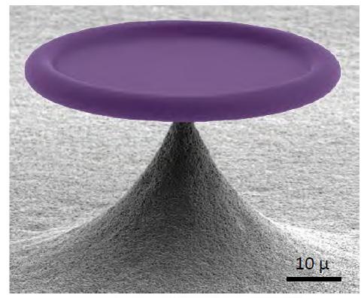
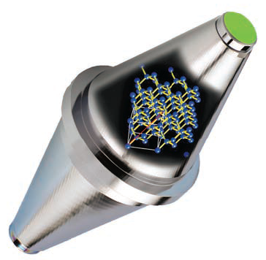
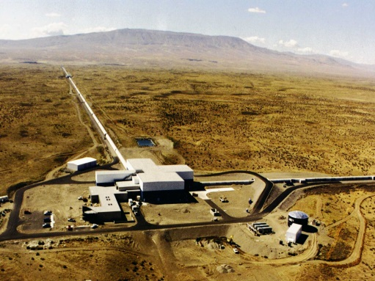
Noise on different scales
micro /nano resonators
laser stabilization
GW detection
[Schließer et al. Nature Physics 2008]
µm
[Kessler et al. Nature Photonics 2012]
cm
[LIGO Hanford]
km

Slide 3
Overview
limitations to 2nd generation of GW detectors
thermal noise and materials in opto-mechanical systems
towards a 3rd generation GW observatory – the Einstein Telescope
summary

Slide 4
Limitations in the second generation

Slide 5
Improving the sensitivity
improved/longer suspensions
low thermal noise material
bigger test masses
higher laser power
low thermal noise material

Slide 6
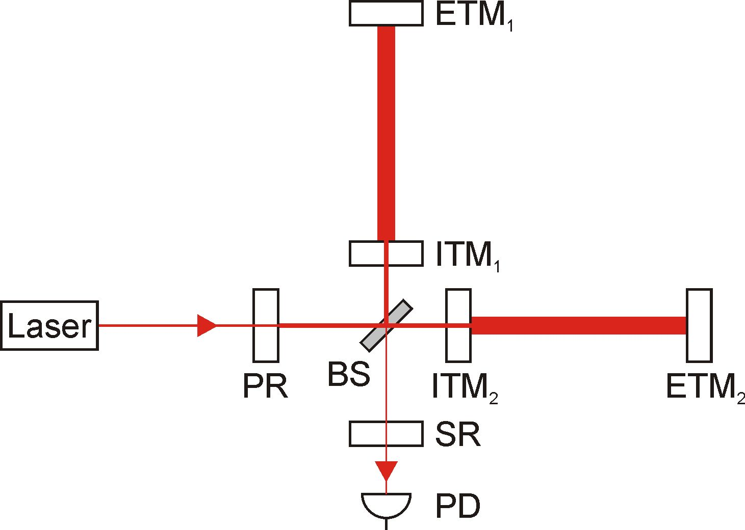
Improving the sensitivity
suspended optics
transmissive and reflective components
schematic view of a Michelson-based iGWD

Slide 7
Improving the sensitivity
low noise material
  novel materials for optics and suspensions
  (crystalline instead of
  amorphous media)
  cryogenic operational temperature
high laser power
  use of high power lasers
  thermal compensation of beam distortion in transmissive components
  use of non-classical light

Slide 8
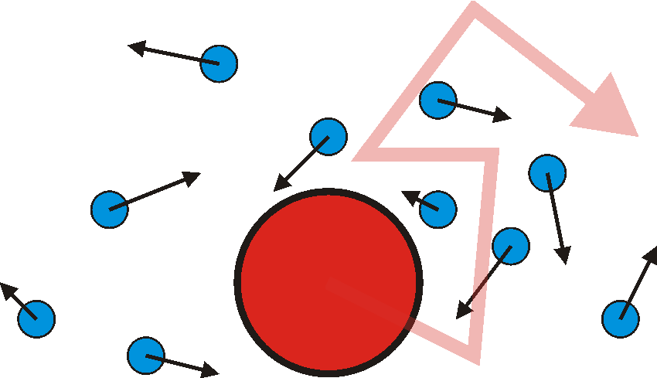
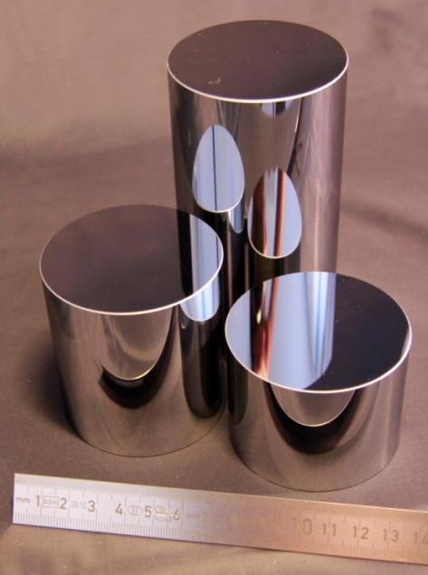
Thermal noise and materials in opto-mechanical systems

Slide 9
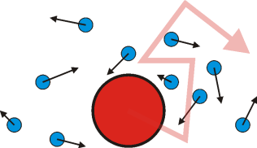
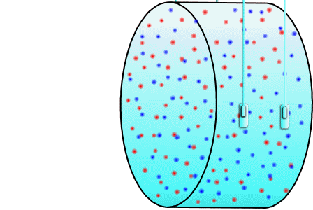
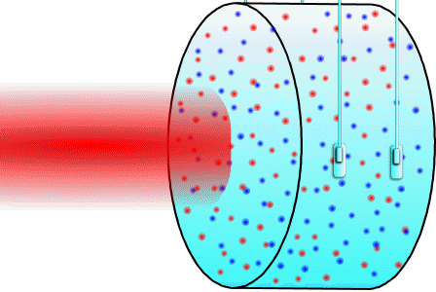
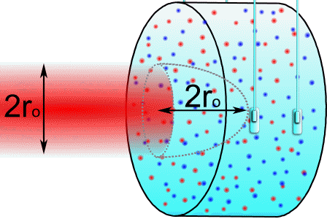
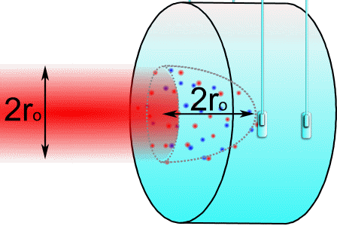
Thermal noise in opto-mechanical systems
What is thermal noise?
fluctuation that couples into the read-out of the system
e.g. optical read-out → only fluctuation at the read-out spot of interest

Slide 10
Thermal noise in opto-mechanical systems
2 types of thermal noise originating from
  fluctuations of thermal energy k_{B}T
  → Brownian noise
  fluctuations of temperature ΔT
  → coupling into the read-out by means of material parameters (dL/dT, dn/dT, etc.)

Slide 11
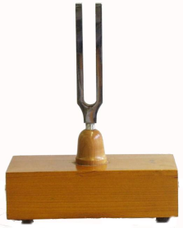
Fluctuation-Dissipation-Theorem
dissipation
heat bath
loss φ
macroscopic
mode
microscopic
modes
fluctuations / noise
large dissipation → large noise

Slide 12

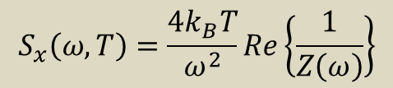
Fluctuation-Dissipation-Theorem
simple systems:
Z(ω) obtained from equation of motion
What about large systems, e.g. macroscopical optics with 10²⁵ atoms and individual coupling/damping of atoms?
→ approach fails due to complexity
$$S_{x}\left(ω,T\right)=\frac{4k_{B}T}{ω^{2}}Re\left\{\frac{1}{Z\left(ω\right)}\right\}$$
$$Z\left(ω\right)= \frac{F(ω)}{v(ω)}$$
with mechanical impedance

Slide 13
Fluctuation-Dissipation-Theorem
general solution by means of direct approach by Y. Levin (1998)
applying a pressure with force F₀ and spatial distribution of read-out beam to surface of optics → deformation energy density u(x,y,z)
Brownian thermal noise is given by
low noise operation: minimize u(x,y,z) × φ(x,y,z)
with

Slide 14
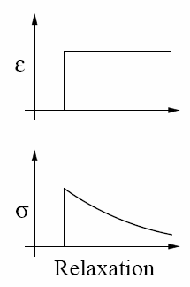
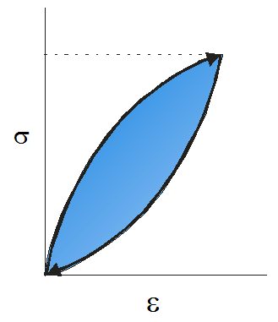
What is the mechanical loss?
ε = ΔL/L
σ
relaxation of stress due to microscopical reordering → hysteretic effect → phase lag between deformation ε and strain σ is called mechanical loss or internal friction

Slide 15
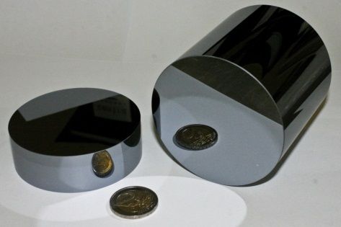
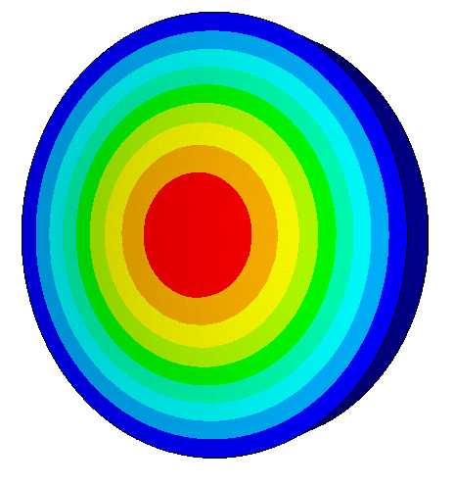
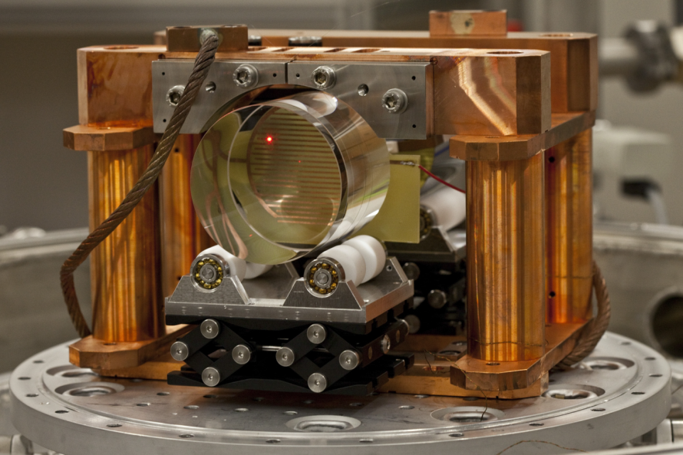
What is the mechanical loss?
mechanical loss / internal friction measured by ring-down technique
amplitude
time

Slide 16
What is the mechanical loss?
unique setup developed within the SFB TR7 to study
  bulk materials
  coated materials (dielectric, gratings, etc.)
  bonded materials
wide parameter range
  (2K) 5K – 300K
  up to 500 kHz
  vibrations detectable down to sub nm
  large sample volume
many international collaborations

Slide 17
Comparison of bulk materials
S_{x} ~ T × φ
candidate materials:
sapphire
silicon

Slide 18
Study of defects in optical materials
What causes different losses in chemical identical materials?
What is the origin of loss peaks? Which is the optimum operational temperature?
Notes:
Bitte hier nur Quarz und Fused Silica drin lassen und ggf. Achsen anpassen. Temperaturschritte 3, 10, 30, 100, 300 K

Slide 19
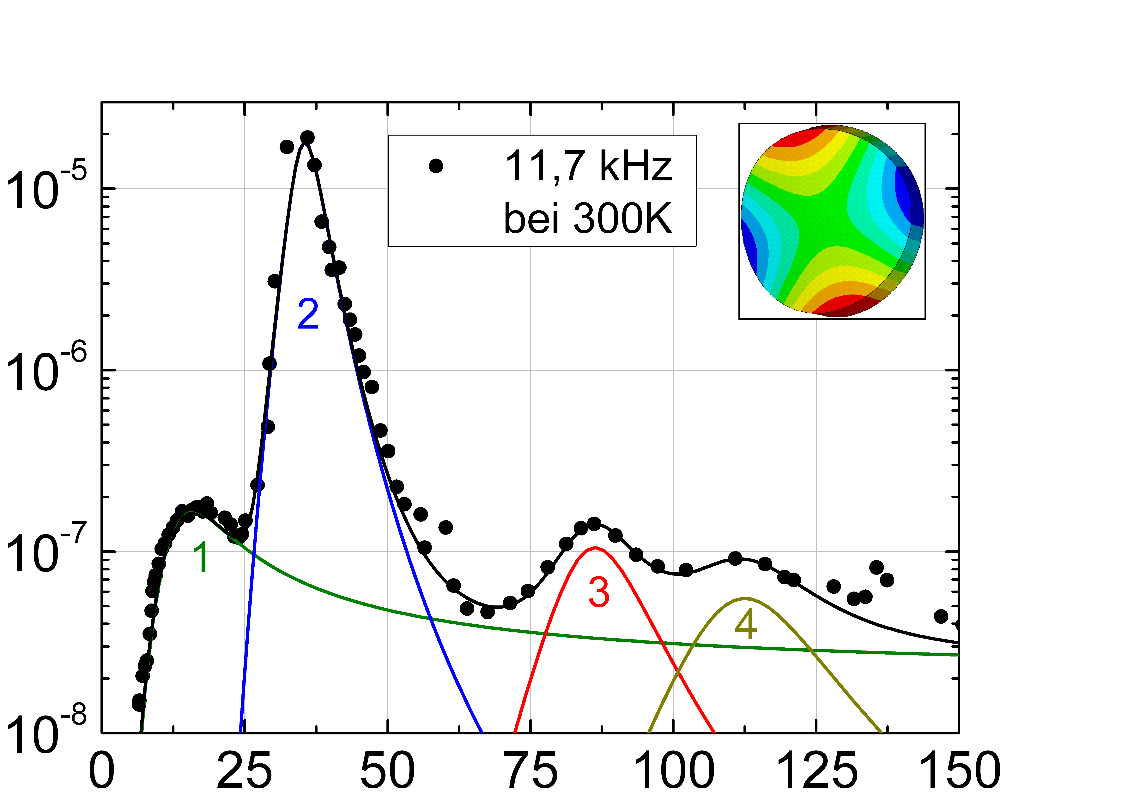
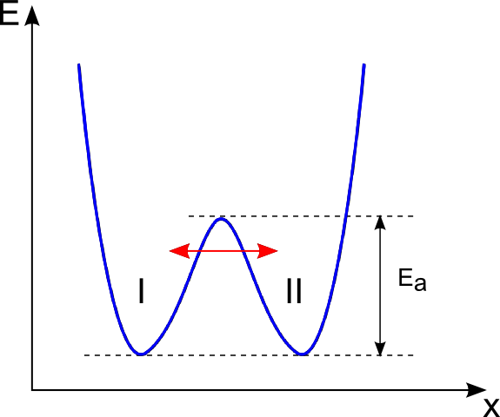
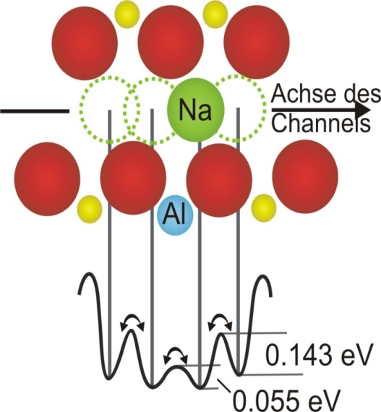
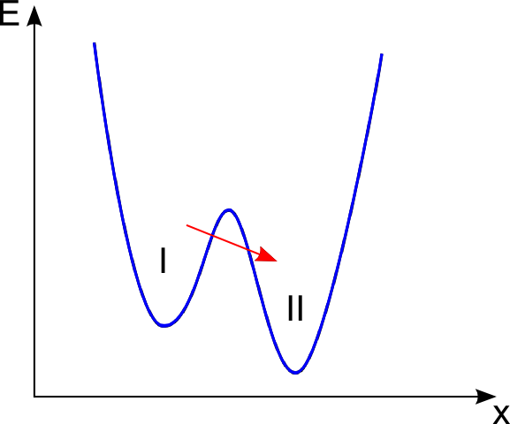
Study of defects in optical materials
example: crystalline quartz to calibrate investigations
12 kHz
z-axis
mechanical loss
temperature (K)

Slide 20
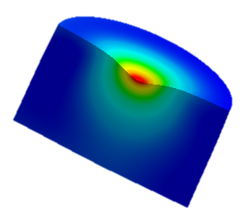
Study of coating materials
HR coating applied to the front of the test mass to form a mirror
mechanical loss of coatings critical → dominating noise source
u(x,y,z) × φ(x,y,z)

Slide 21
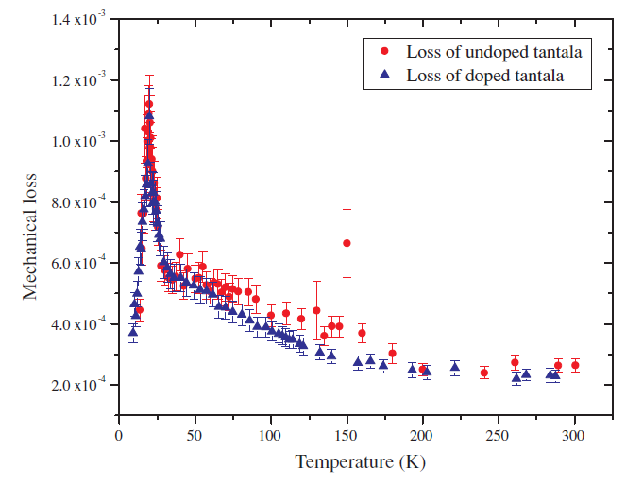
Study of coating materials
detailed study of coatings
  deposition technique
  heat treatments
  co-doping (implantation)
  alternative coatings (e.g. crystalline materials, gratings)
4 µm

Slide 22
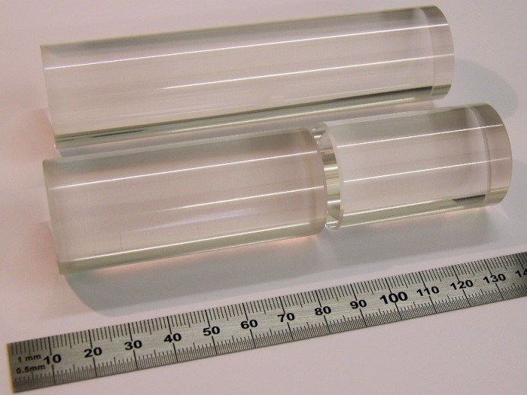
Study of jointing techniques
crystalline materials cannot be welded as amorphous ones
detailed study of jointing techniques (hydroxide catalysis bonds, indium, etc.)

Slide 23
Study of indium bonding
indium bond
bonded sample
unbonded sample
Notes:
Englische Beschriftung der Achsen, 25K oder 50K Schritte auf T-Achse.

Slide 24

Novel terms of thermal noise
free carriers cause change in refractive index → noise
parts of system operated at thermal non-equilibrium → treatment still true?
thermal noise of grating structures
Khalili etalons / cavities
…

Slide 25
Other properties of the materials
mechanical loss and thermal noise is only 50% of the story
other parameters:
  thermal properties
  optical properties
  mechanical properties
  machining, polishing, coating
  availability (size, purity, …)

Slide 26
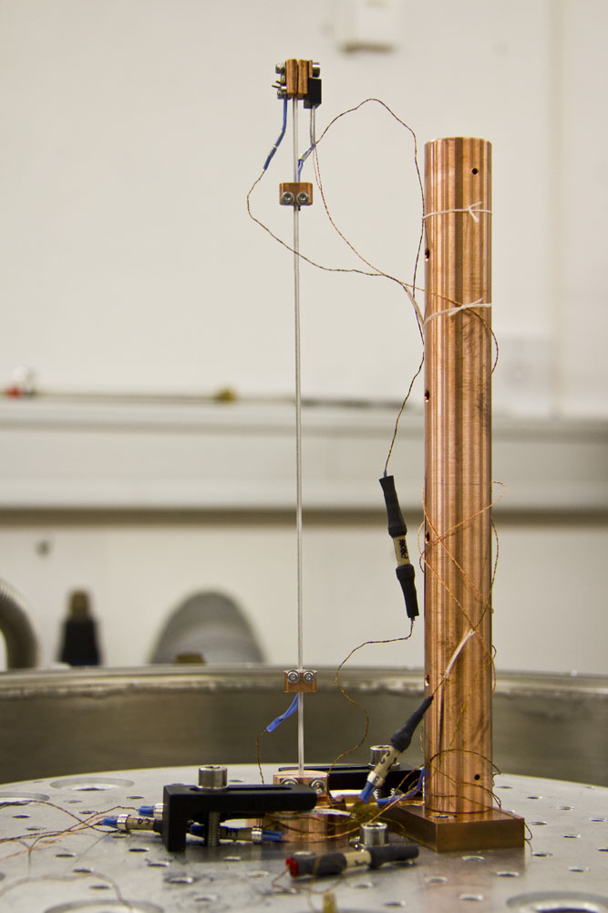
Heat extraction through crystalline materials
expected laser power at mirrors ~ MW
heat removal only through suspension
possible → crystalline fibers needed

Slide 27
Heat extraction through crystalline materials
detailed study of thermal conductivity (polishing, purity, bonds, …)
Comparison of different surfaces
Comparison of different bonds

Slide 28
Optical properties of silicon
optical absorption
  little known by 2010 about silicon absorption (especially at cryogenic temperatures)
  project C9 „Optical properties of silicon-based optics“ born
band gap of silicon at 1.12 eV (@ 300K)
  absorption @ 1064nm ~ 80%
  change to 1550nm needed
  residual absorption beyond the gap
  needs measurements
conduction band
phonons
valence band
electronic absorption of silicon

Slide 29
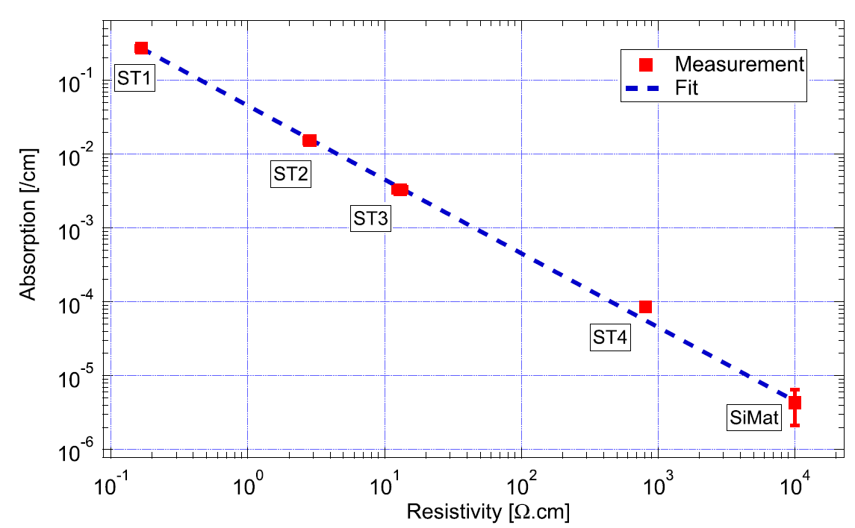
Optical properties of silicon
room temperature
cryogenic temperature
4 ppm/cm
demonstrated
level at low temperatures ~ level
at room temperature
4 ppm sensitivity demonstrated

Slide 30
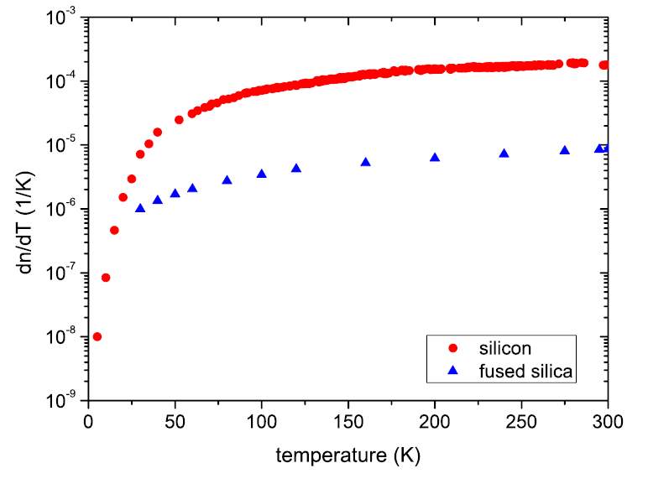
Optical properties of silicon
thermo-refractive index
  temperatur fluctuations in transmissive optics cause phase change due to dn/dT → unknown parameter

Slide 31
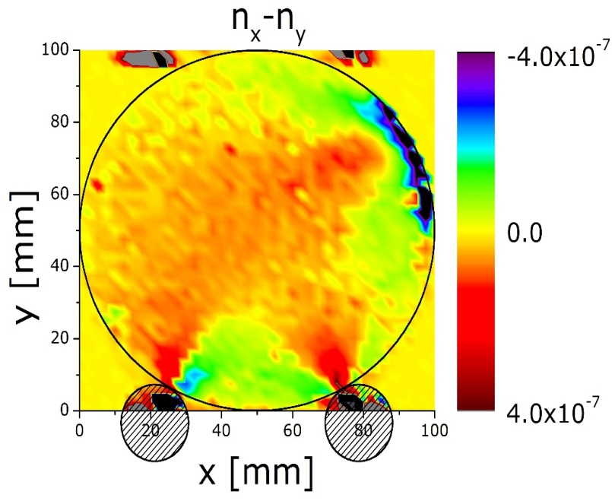
Optical properties of silicon
birefringence
  stress (impurities, gravity) can induce birefringence
  level Δn ~ 10⁻⁷
  imaging setup developed to „see“
  birefringence

Slide 32
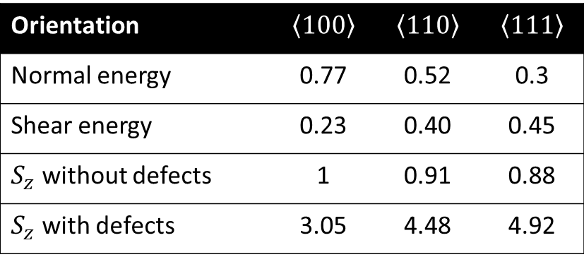
Mechanical properties of silicon
Young‘s modulus influences deformation energy and this thermal noise
Breaking strength tests of Si, Si-Sapphire, Sapphire-Sapphire samples
Orientation | $$\left\langle 100\right\rangle$$ | $$\left\langle 110\right\rangle$$ | $$\left\langle 111\right\rangle$$
Normal energy | 0.77 | 0.52 | 0.3
Shear energy | 0.23 | 0.40 | 0.45
$S_{z}$ without defects | 1 | 0.91 | 0.88
$S_{z}$ with defects | 3.05 | 4.48 | 4.92

Slide 33
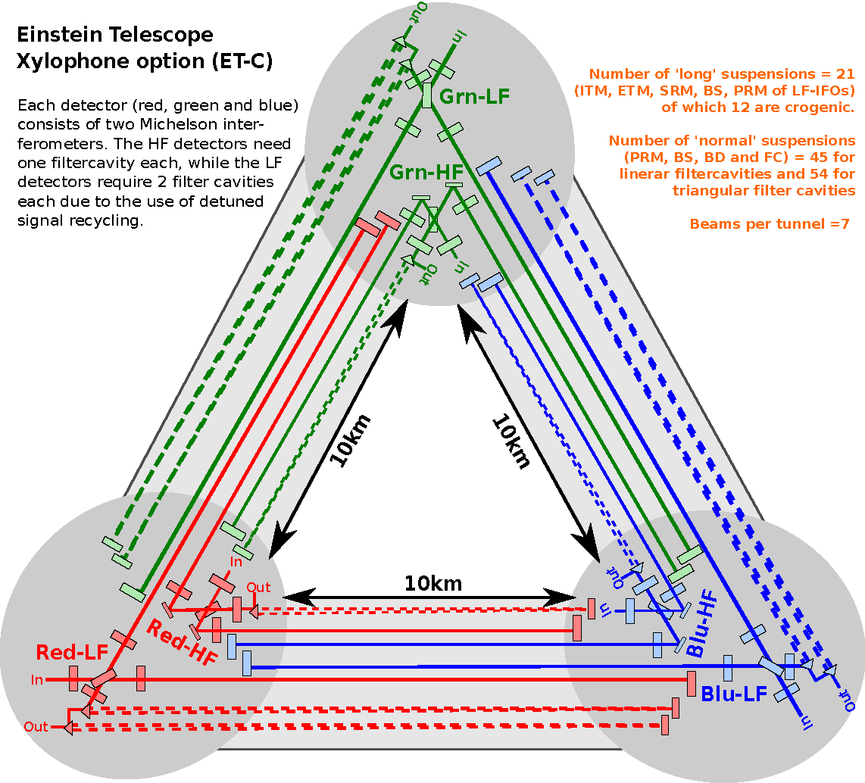
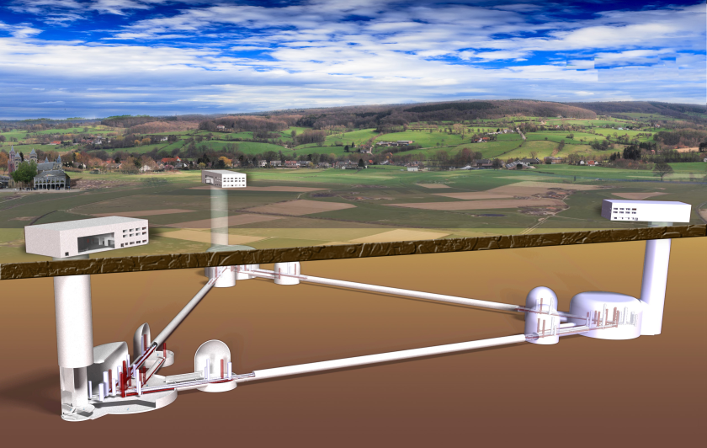
The einstein telescope
Towards a 3rd generation gravitational wave observatory

Slide 34
Sensitivity goals
?
cryogenics
high laser power

Slide 35
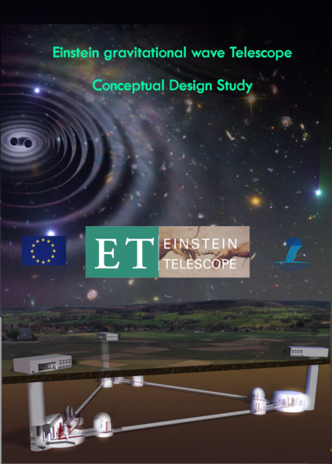
Design study for the Einstein Telescope
many people of the SFB TR7 involved
lots of results (squeezing, material issues, thermal noise modelling) of SFB groups went into the conceptual design
to be found on www.et-gw.eu

Slide 36
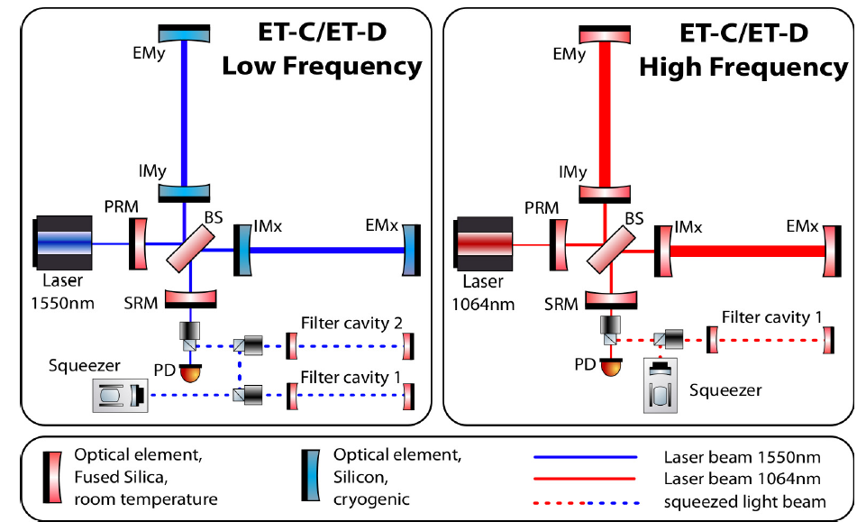
Xylophone design of the Einstein Telescope
10-20K, 18kW, 1550nm
300K, 3MW, 1064nm

Slide 37
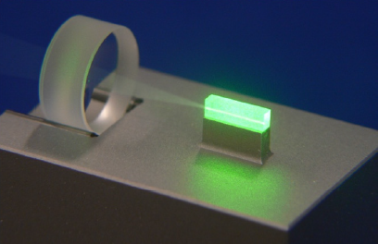
Use of squeezed light
reduced laser power needed for
same sensitivity
less thermal load in the system
(thermal lensing)
key feature of ET-HF
Squeezing

Slide 38
The Einstein Telescope as a GW Observatory
Combination of several detectors in one site → correlation can be used to reduce technical noises

Slide 39
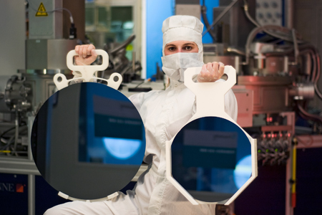
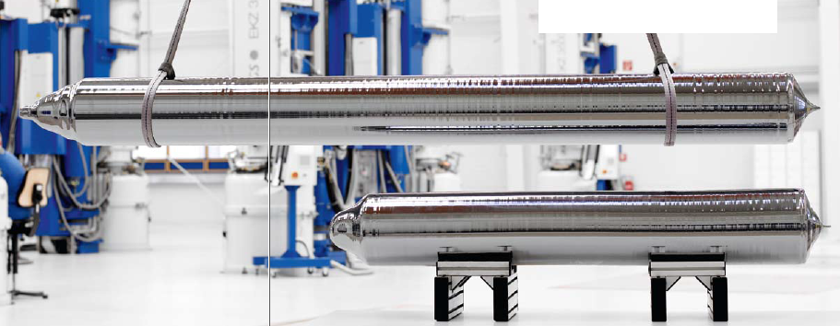
Materials for the Einstein Telescope
Source: www.pvatepla.com
1m
450 mm
300 mm
size available
purity under development
Source: http://www.iisb.fraunhofer.de/content/dam/iisb/de/images/geschaeftsfelder/halbleiterfertigungsgeraete_und_methoden/gadest_2011/

Slide 40
Low thermal noise suspensions
300K detector: low thermal noise
good seismic isolation of test mass
low temperature detector:
low thermal noise
good seismic isolation of test mass
high thermal conductivity to remove heat
?

Slide 41
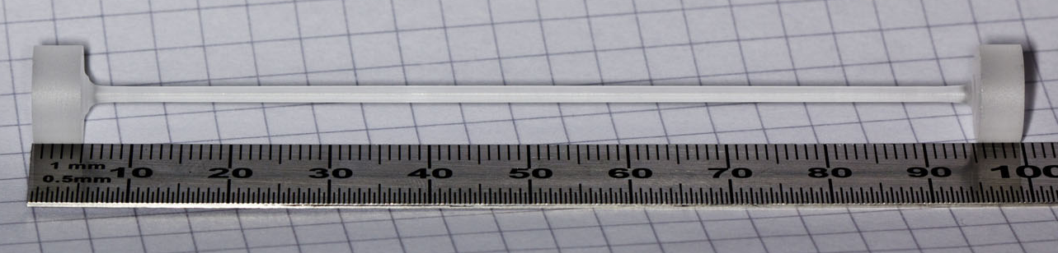
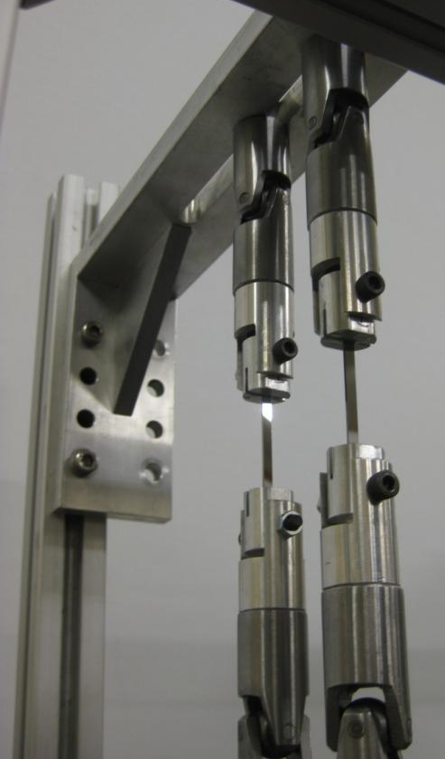
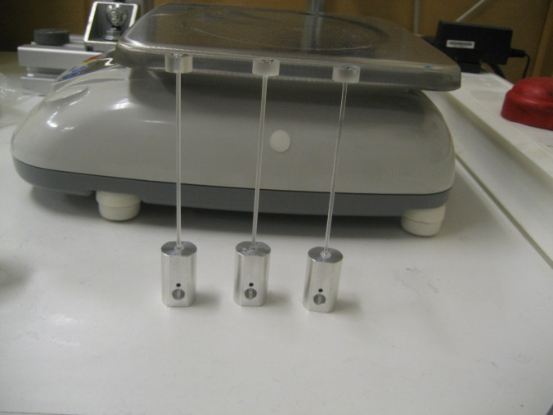
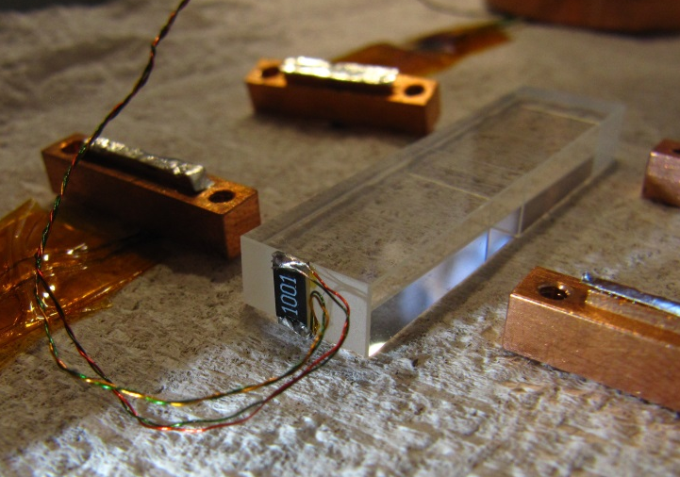
Low thermal noise suspensions

Slide 42
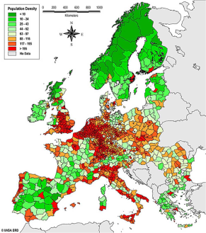
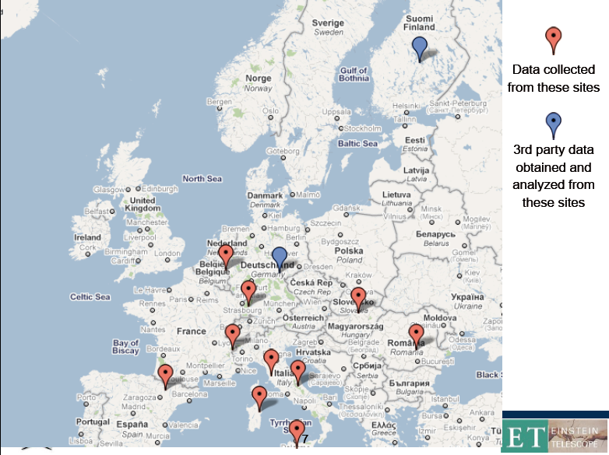
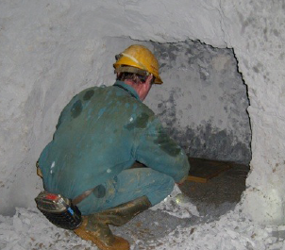
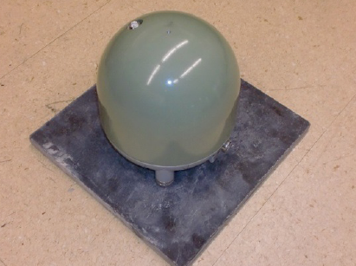
Investigation of possible sites
seismic studies throughout Europe

Slide 43
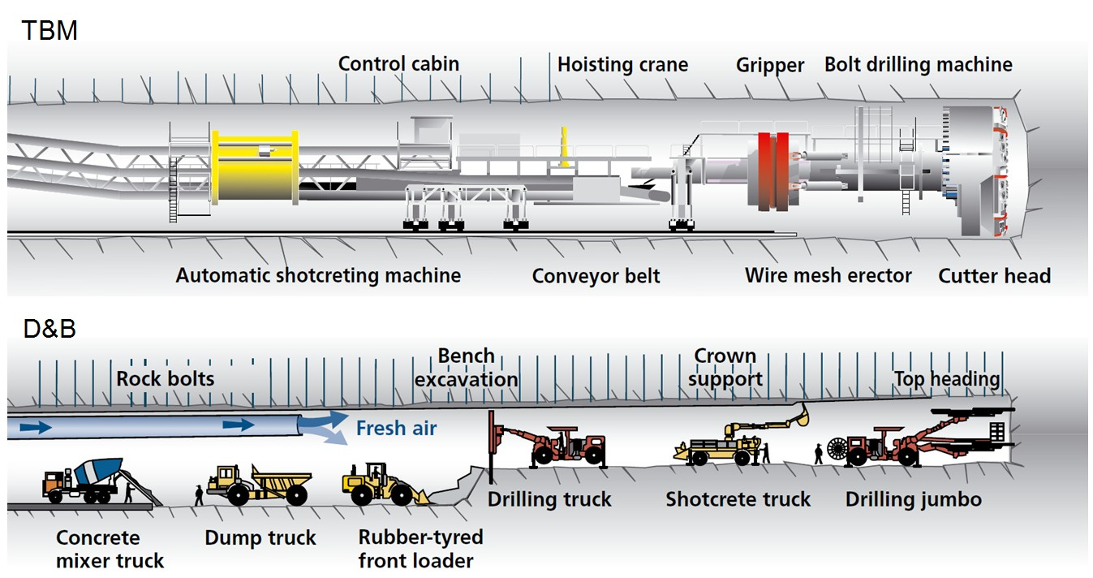
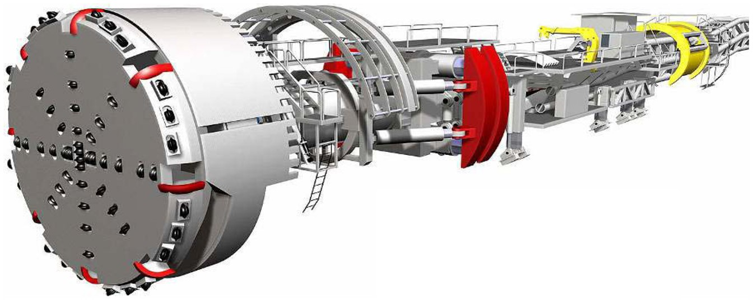
How to built an underground facility?
NIKHEF

Slide 44
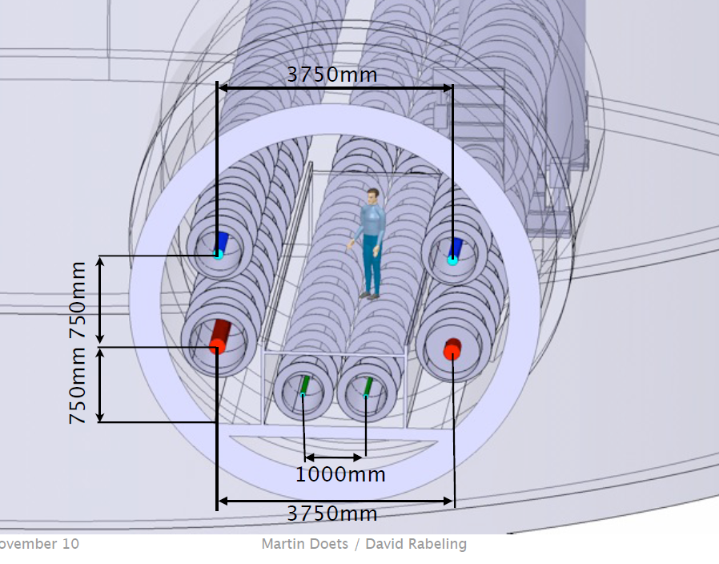
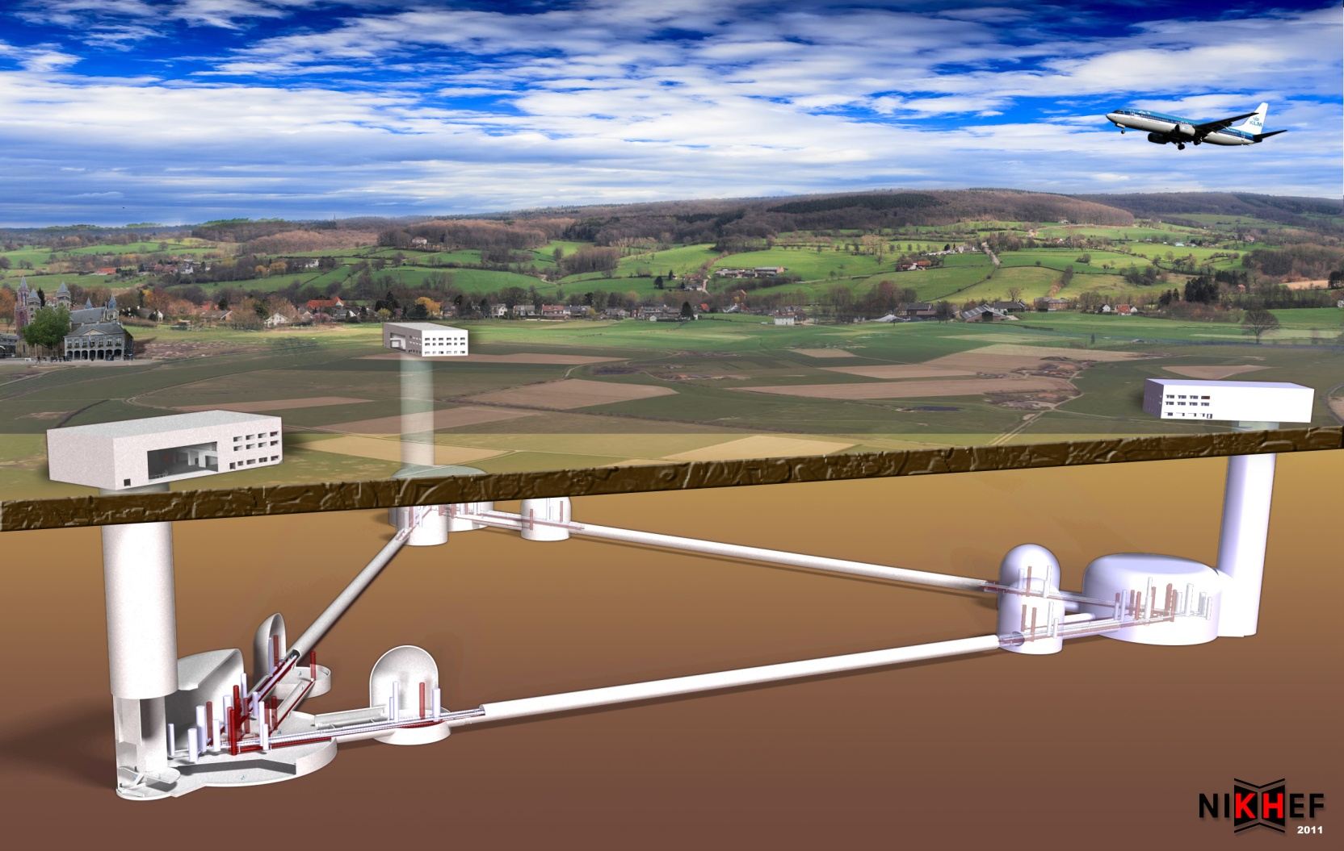

The Einstein Telescope – An artist view
vertical vs. horizontal access
artist view of ET

Slide 45

From 0th to 3rd generation
KAGRA

Slide 46

Sensitivity of the Einstein Telescope (BNS)
GRB050509B
1ST GENERATION
aLIGO
AdV
KAGRA
Einstein Telescope
[G. Cagnoli, LMA)

Slide 47
Summary and conclusions

Slide 48
Summary and Conclusions
2nd generation of GW detectors will provide first direct observation of GWs
3rd generation of GW detectors will be needed to do GW astronomy
materials and cryogenic operation will play cruicial role for 3rd generation detectors

