Slide 1
Gravitational-wave detectors
The 3rd Thermal Noise Workshop at Jena
July 2015
Tokyo Inst of Technology
Kentaro Somiya
K.Somiya

Slide 2
What is a gravitational wave?

Slide 3
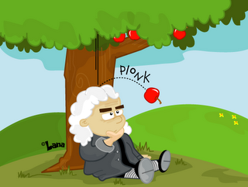
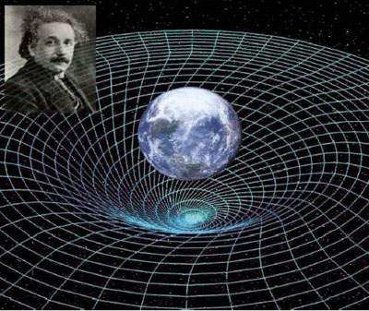
Gravitational waves
Newton’s gravity
“attracting force btw apple and earth”
Einstein’s gravity
“free fall in a curved space-time”
“Dynamic change of the space-time
will propagate as a wave”
Prediction of GW
by Einstein
(1916)

Slide 4
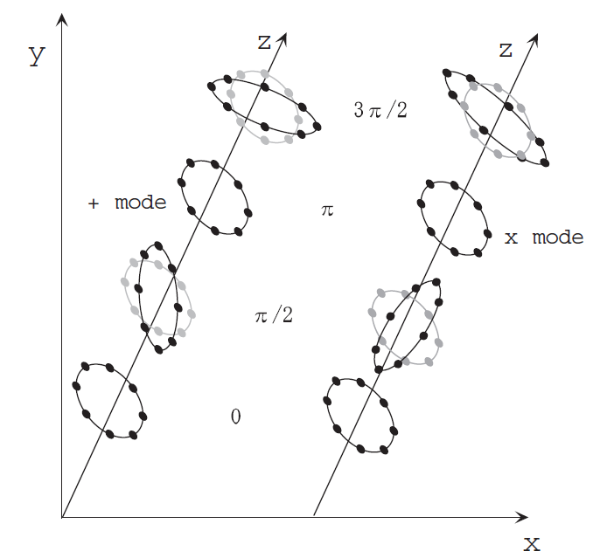


Effect of gravitational waves
+ mode
x mode
Distance of 2 objects shrinks in one direction and
expands in the other direction.

Slide 5
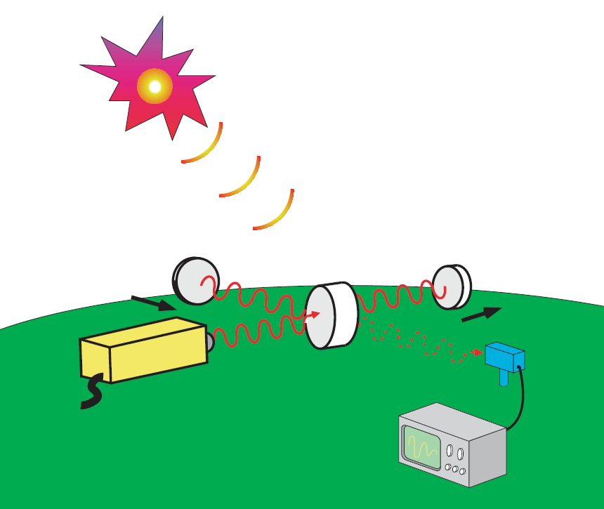
Interferometric GW detector
Far Galaxy
Massive Astronomical events
Supernova explosion,
Black hole binaries, etc.
Gravitational Waves
Distance of two objects changes
Shrink
Expand
Observe the change with
big high-power interferometers
Laser
Photo-
detector
LIGO in US [4km]
Virgo in Italy [3km]
GEO in Germany [600m]
KAGRA in Japan [3km]
Earth

Slide 6
What can we learn from GW?

Slide 7
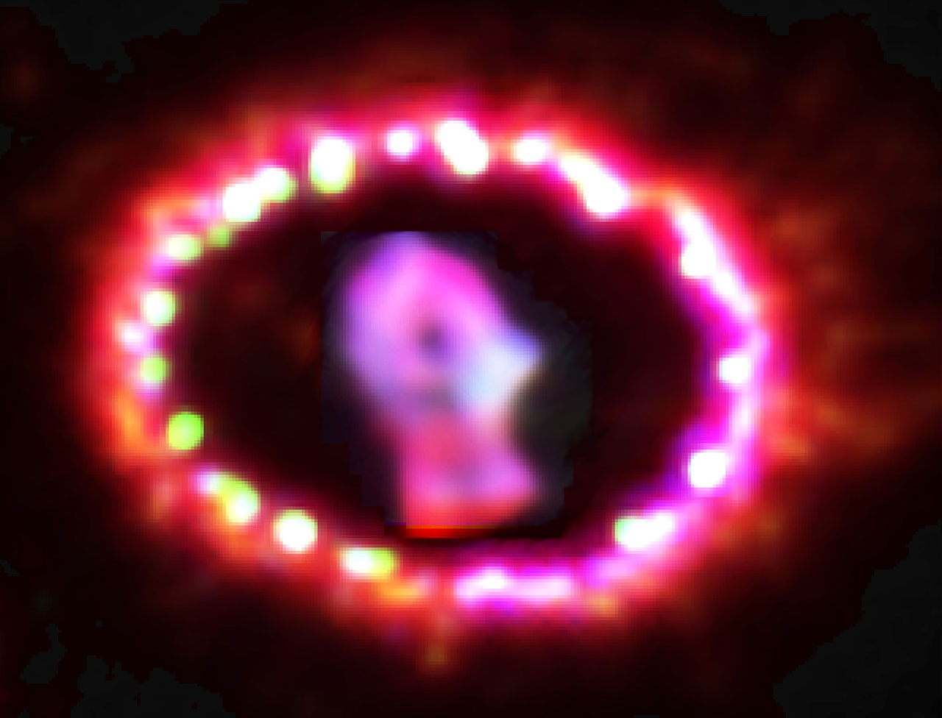
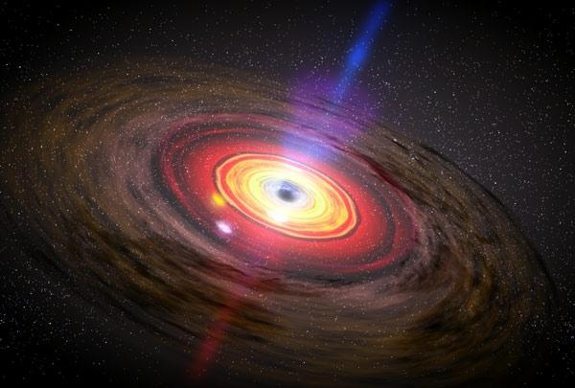
Supernovae
[CG: NASA]
[image: Hubble]
Black Hole
Quasi-normal mode

Slide 8
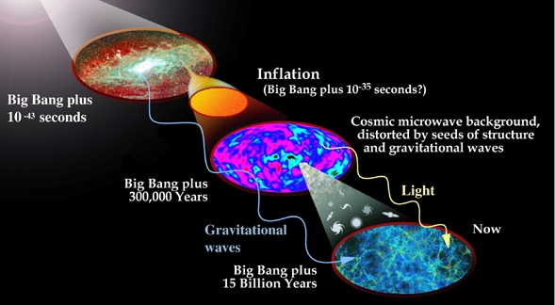
Early Universe
[image: NASA]

Slide 9
Astronomy
Blackhole
Relativity
Supernova
Pulsar
GW
Nuclear
Physics
Neutron Star Binary
Unknown
Cosmic
Background
Cosmology

Slide 10
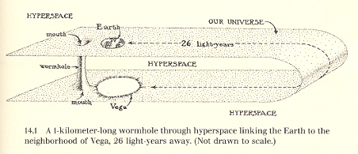
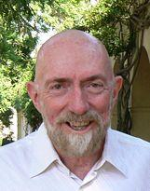
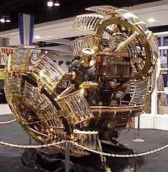
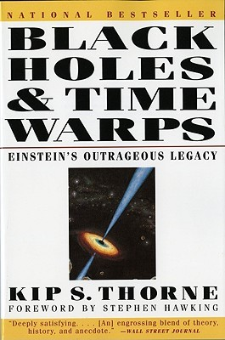
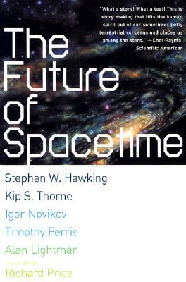
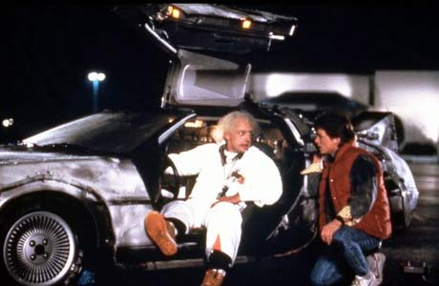
GW in books about time-machine
Time-machine study requires more knowledge on Quantum Gravity, and GW observation is the way to understand Quantum Gravity.
Kip Thorne’s time-machine using a warm hole
[Phys Rev Lett 1988]
Reference
Kip Thorne

Slide 11
GW observation history

Slide 12
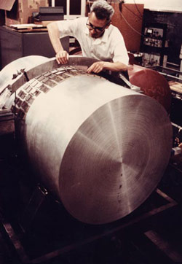
1969 Weber

Slide 13
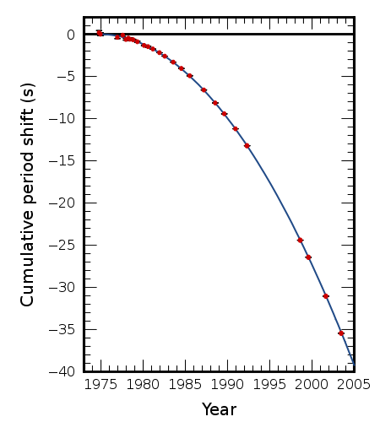
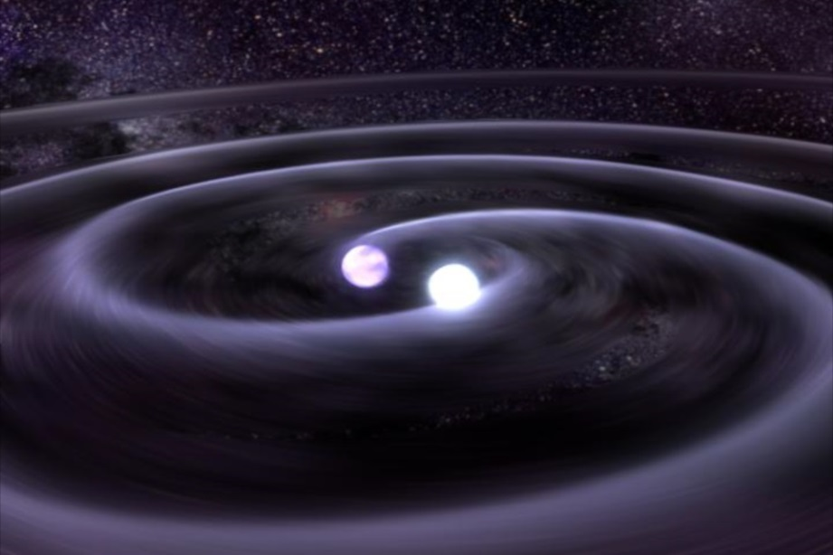
1974 Hulse & Taylor
(1993 Novel Prize)

Slide 14
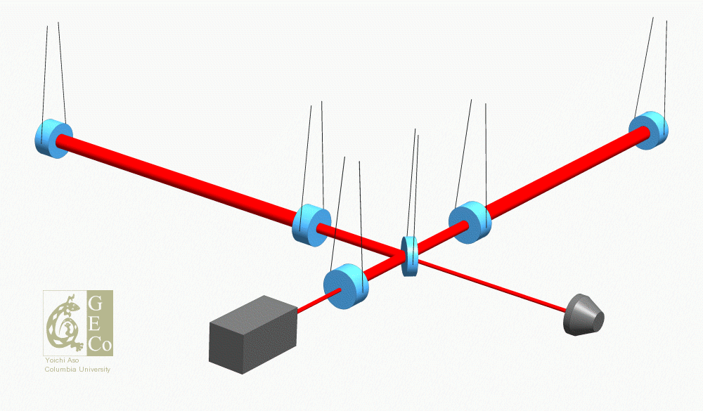
1970's Interferometric GW detector

Slide 15
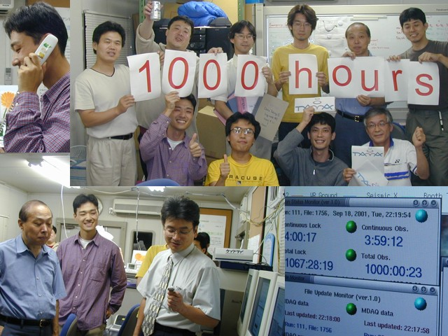
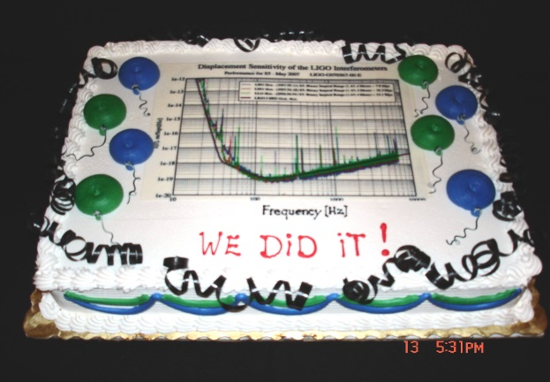
1999 TAMA(Japan) started observation
2002 LIGO(US) started observation
2005 GEO(GER/UK) started observation
2007 Virgo(ITA/FRA) started observation

Slide 16
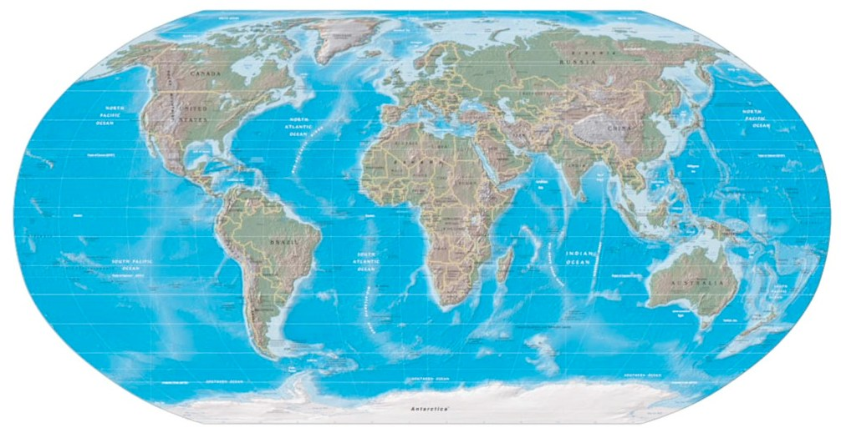
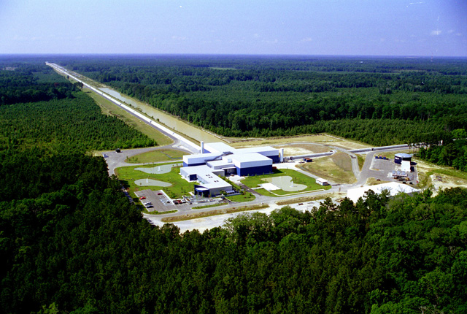
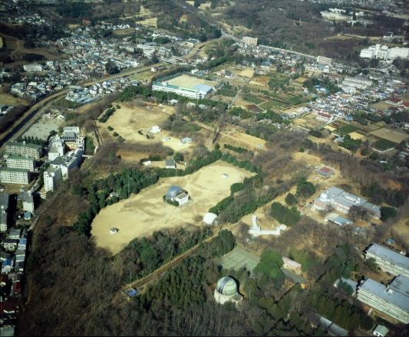
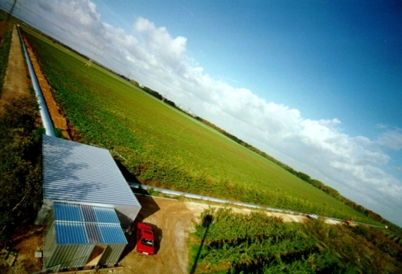
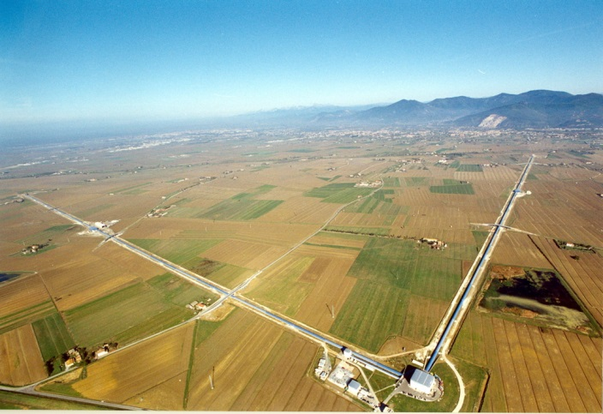
Global GW observation network
Virgo
GEO
LIGO
TAMA
LIGO

Slide 17
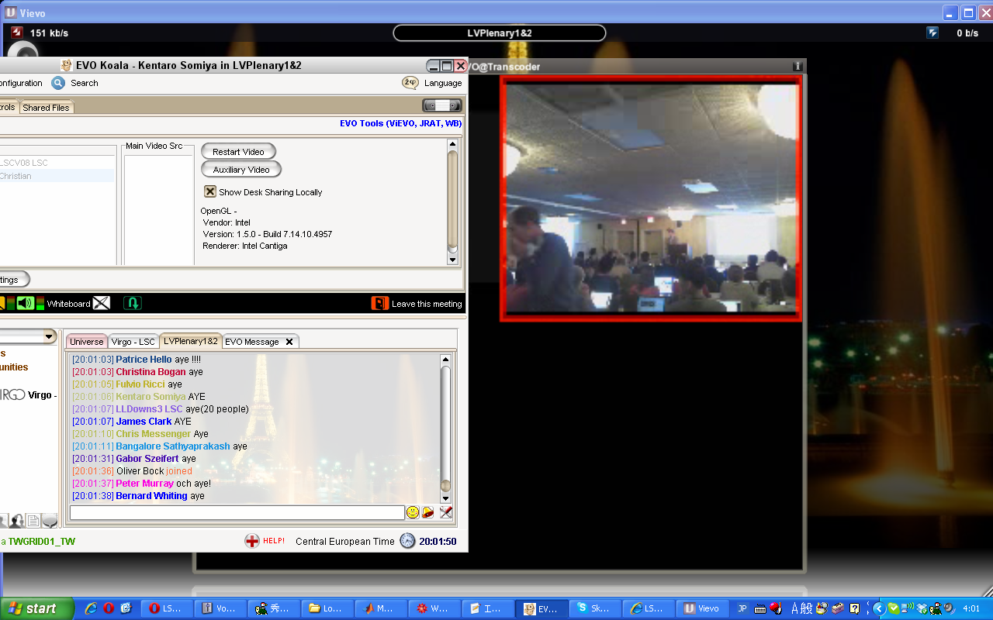
2010 News:Discovery of GW!?

Slide 18
1G detectors observed up to 70M LY, but no GW signal was found
Upgrade to higher-sensitivity
2G detectors

Slide 19
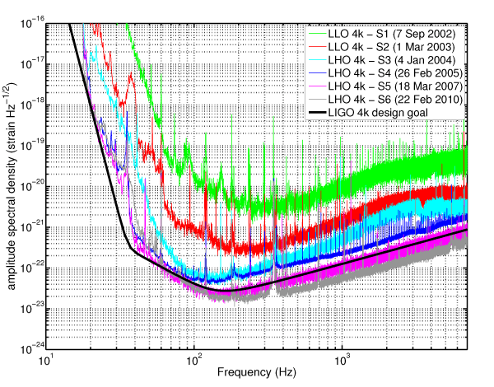
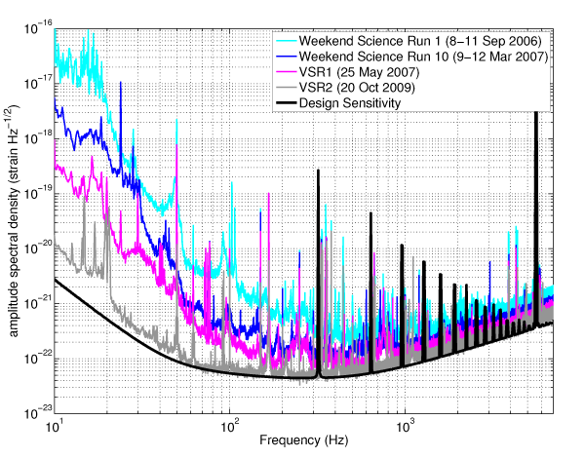
Sensitivity of 1G detectors
Virgo
LIGO
Strain of 10⁻²³
(~10⁻¹⁹m/rtHz)
Sensitivity is limited by
(i)seismic noise (ii)thermal noise (iii)quantum noise

Slide 20
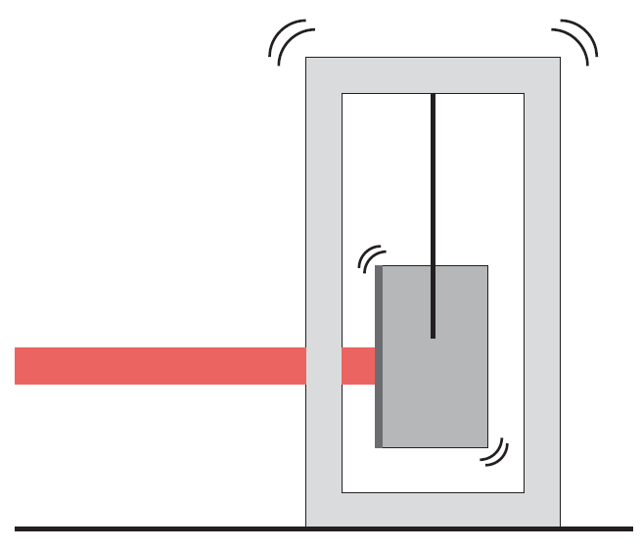
Seismic
Solutions
Isolation
Underground
Feedforward

Slide 21
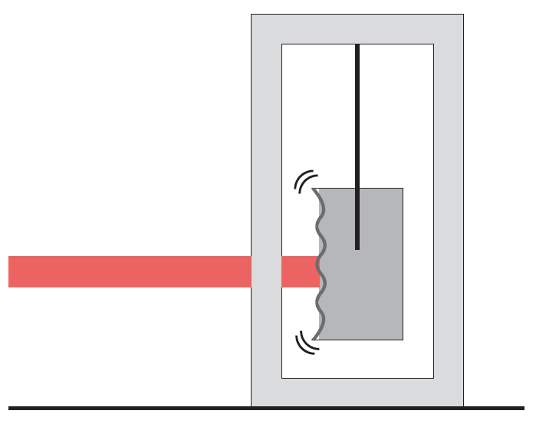
Thermal
Solutions
Material
Cryogenic
Large beam
Beam shape
Mirror shape

Slide 22
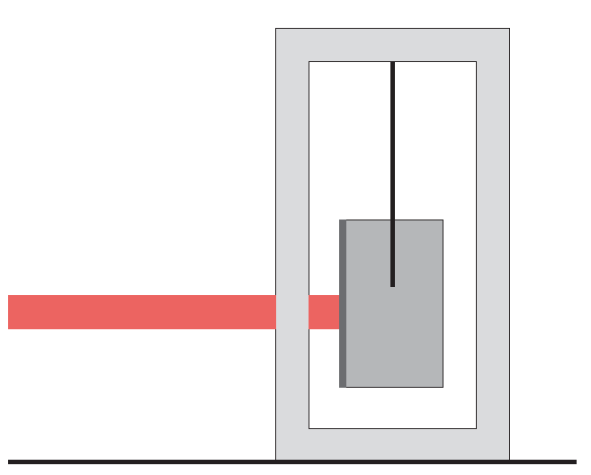
Quantum
Solutions
Photon-number
fluctuation
High power
Resonator
Squeezing

Slide 23
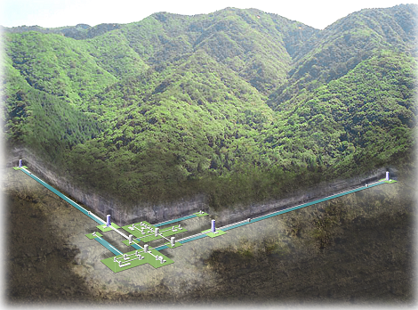
Second generation detectors
Virgo
GEO
LIGO
TAMA
LIGO
LIGO
Virgo
GEO
upgrade
Advanced LIGO
Advanced Virgo
GEO-HF
KAGRA

Slide 24
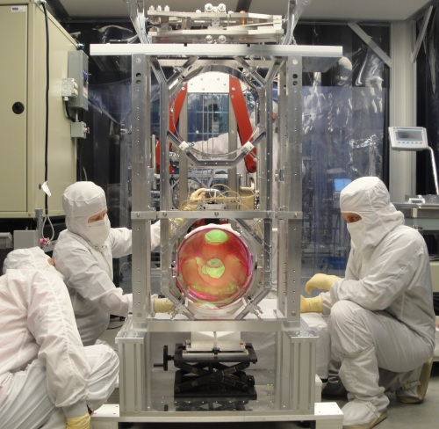
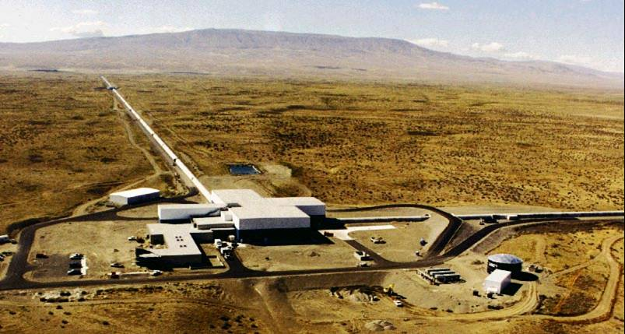
Advanced LIGO

Slide 25
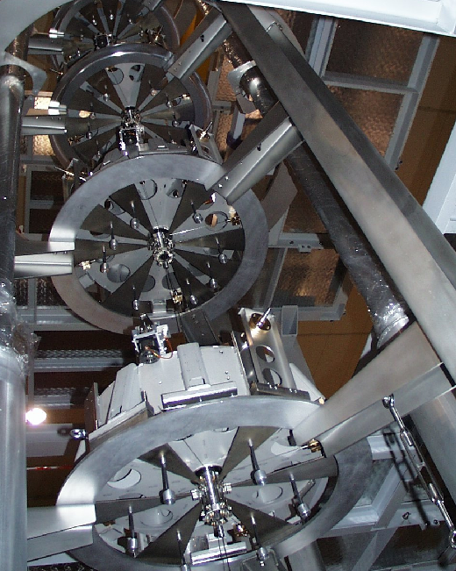
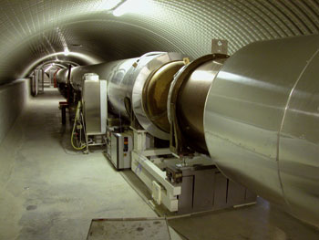
Advanced Virgo

Slide 26
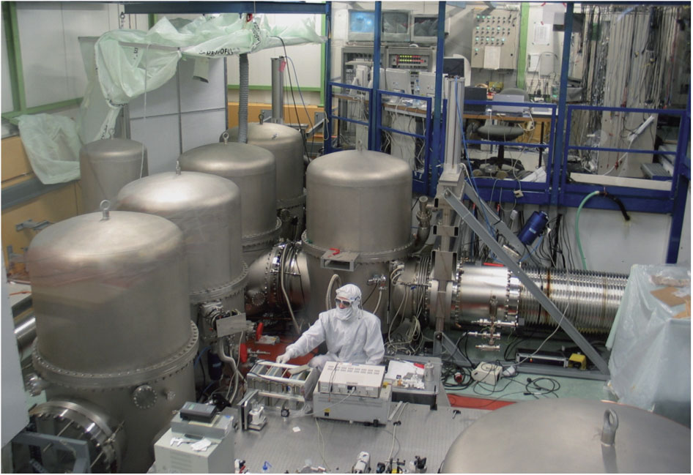
GEO-HF

Slide 27

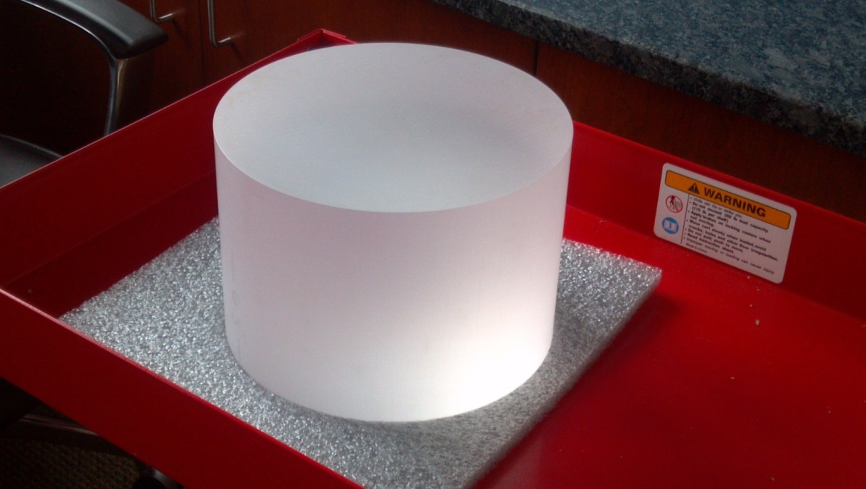
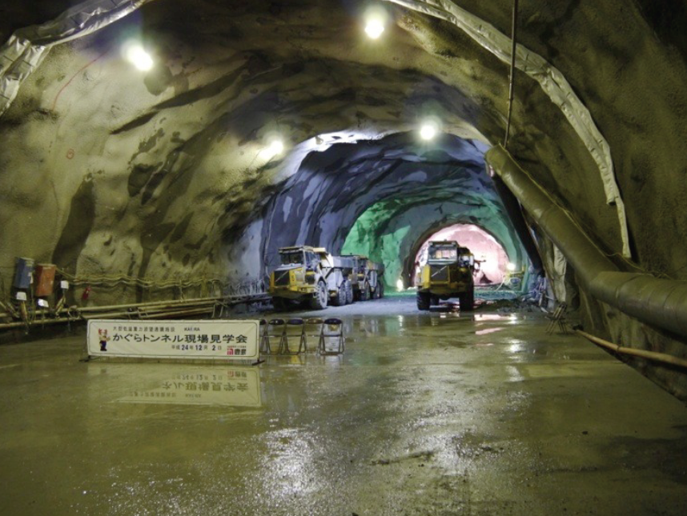
KAGRA
223mm
153mm

Slide 28
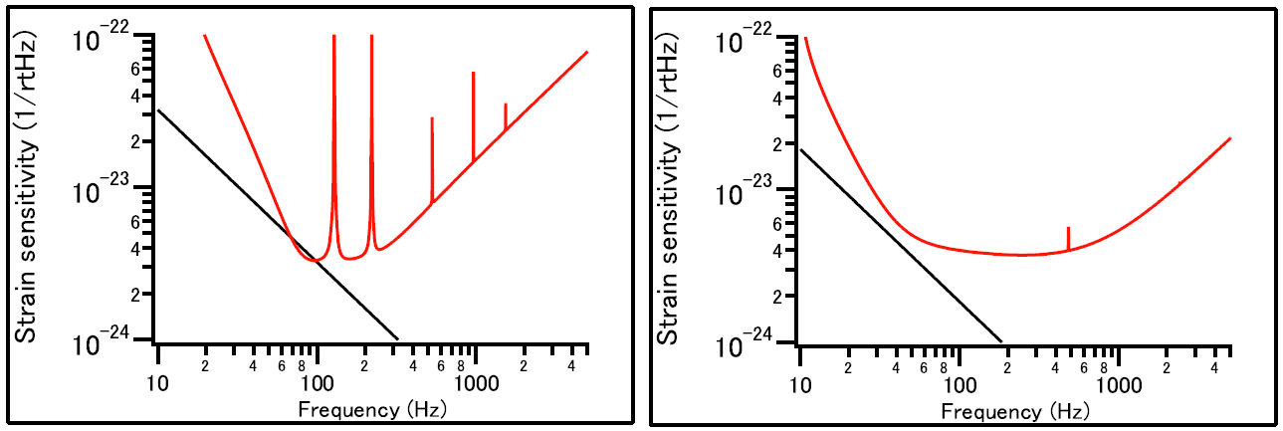
Comparison of Advanced LIGO and KAGRA
Advanced LIGO
KAGRA
Heisenberg
Limit (23kg)
Heisenberg
Limit (40kg)
 | KAGRA | Advanced LIGO
Temperature | 20K | 290K
Test masses | 23kg Sapphire | 40kg Silica
Limiting noise | Quantum | Coating thermal
Configuration | Detuned RSE | Broadband RSE
Circulating power | 250-400kW | 800kW

Slide 29
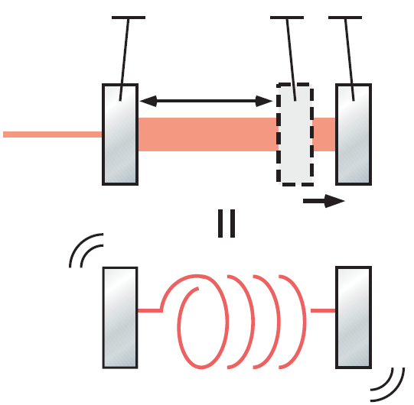
Detuning and optical spring
Locked to a detuned position from resonance
Nλ
Laser
Go far from reso >> less RP
Come close to reso >> more RP
detune
Optical Spring!
Spring
With the optical spring, the sensitivity can exceed the
Heisenberg's Standard Quantum Limit (SQL)

Slide 30
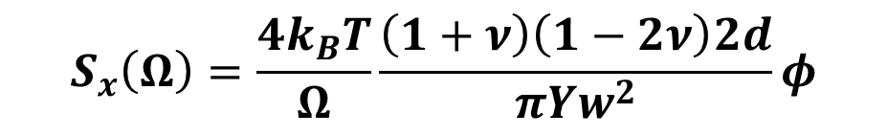
Coating thermal noise
Power spectrum of coating TN (the simplest form)
$$S_{x}\left(Ω\right)=\frac{4k_{B}T}{Ω}\frac{\left(1+ν\right)\left(1−2ν\right)2d}{πYw_{}^{2}}φ$$
T: Temperature, ν: Poisson ratio,
d: coating thickness, Y: Young's modulus,
w: beam radius, φ: mechanical loss
Advanced LIGO is in the room temperature
Thickness cannot be changed much for high reflectivity
Poisson ratio being 0.5 means extreme softness
Young's modulus represents the hardness (of the mirror)
LIGO has been trying to reduce φ and increase w

Slide 31
What will happen in the near future?

Slide 32
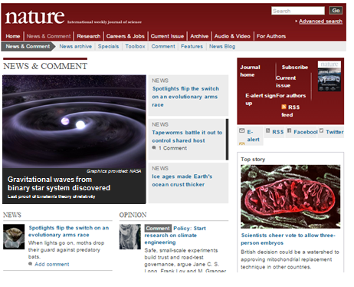
2018 First detection of GW
aLIGO's project term is till 2018 and
it has to realize the first detection.
The prospect is
10% for the detection in '15 (O1)
50% for the detection in '16-17 (O2).
No GW in O2 -> O3 in '18
GW in O2 -> Major upgrade in '17-18
Ad-Virgo is trying to join from O2.
KAGRA is trying to join from O3.
If we see no GW in O3, it will mean that the theory
must be wrong.

Slide 33
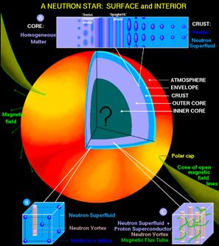
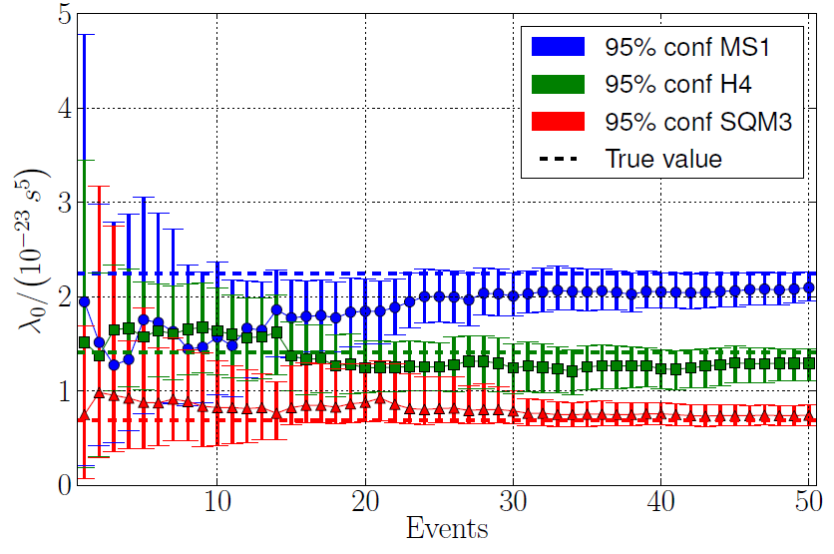
2020 GW astronomy
Del Pozzo et al, PRL (2013)
With all the detectors in operation at the design sensitivities,
we will see multiple events per year to find new Physics.

Slide 34
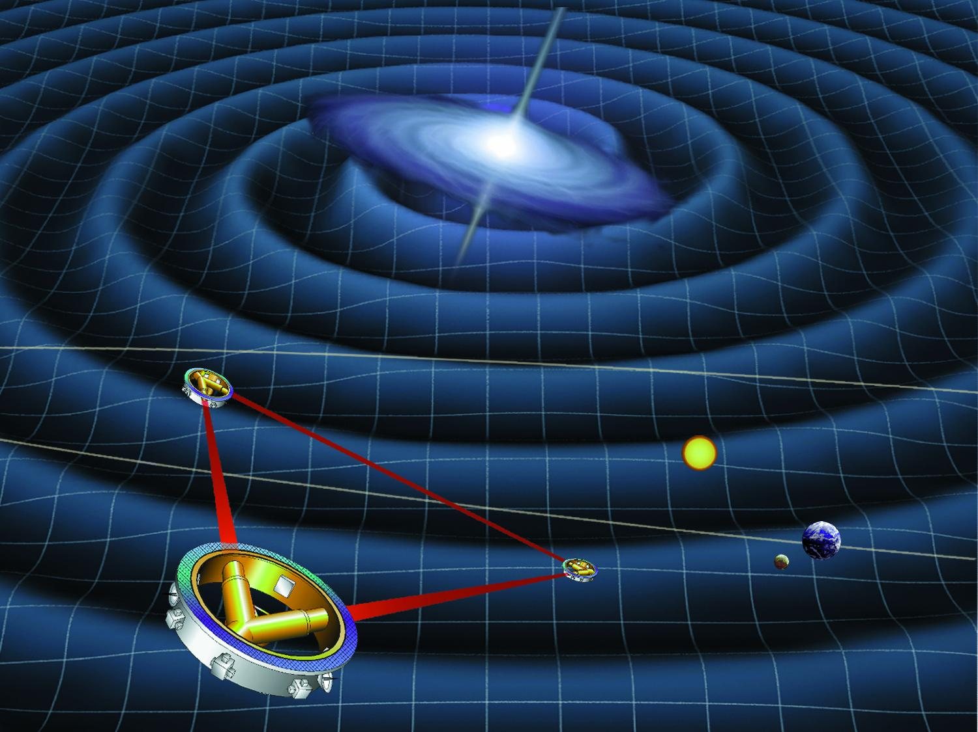
2020 Space detector projects back
LISA has been stopped in the US but
there is a chance to restart the project
if the first detection happens by '17.
eLISA in Europe: plan to launch in '45
LISA in US: aiming at launch in '25

Slide 35
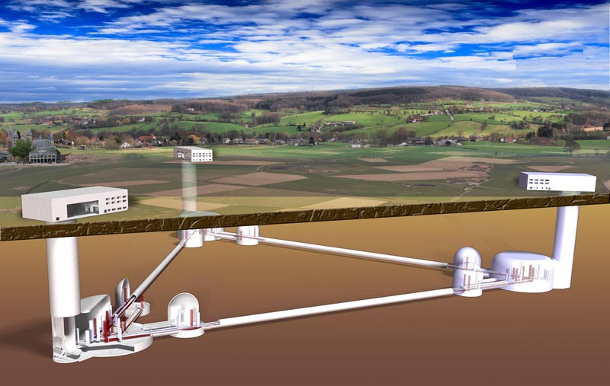
2020~ Einstein Telescope and Cosmic Explorer
ET in Europe
- Consists of two detectors
(high-power HF and cryo LF)
- 10km triangle
- Underground
CE in the US
- 290K Single detector
- 40km (probably triangle)
- On-ground
3G detectors may share a single global project
The first joint workshop is held in 2015 Feb.

Slide 36
Comparison of KAGRA and ET-LF
KAGRA and ET-LF have many in common.
 | KAGRA | ET-LF
Temperature | 20K | 10-20K
Test masses | 23kg Sapphire | 120-200kg Silicon
Configuration | Detuned RSE | Detuned RSE with squeezing
Circulating power | 250-400kW | ~20kW
wavelength | 1064nm | 1550nm
Arm length | 3km (underground) | 10km (underground)
ET-LF has solved some of the problems in KAGRA.
Large crystal is available for Silicon
Low-power operation eases the heat extraction
One problem that remains is the absorption of a large Silicon.

Slide 37
Current status of KAGRA

Slide 38
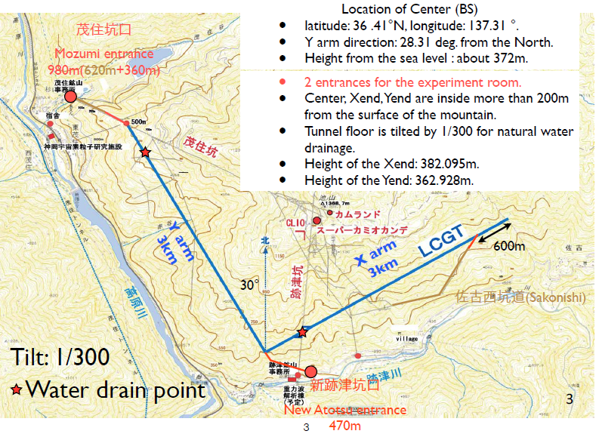
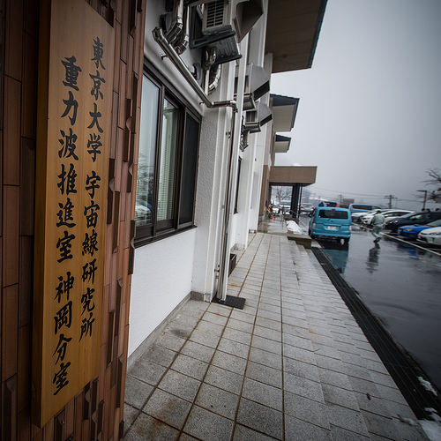
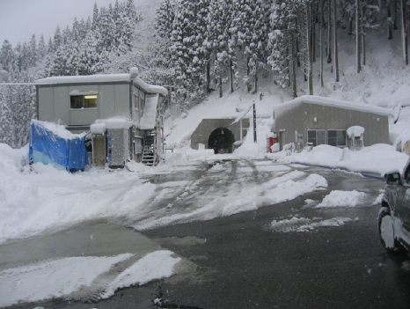
KAGRA is in Kamioka

Slide 39
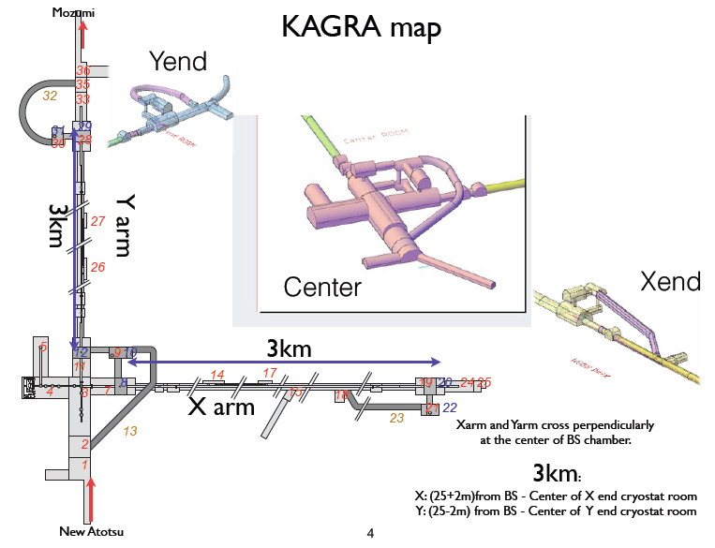



Inside the mine
Nissan's electric car
Electric
bike
Bicycle

Slide 40



Installation works
Installation of a stack system
Cryostat installation
External view of the Laser room

Slide 41



KAGRA's cryogenic system
[Heat flow]
laser -> Sapphire mirror -> Sapphire fiber
-> Al heat link -> shield -> cryo-cooler
Toshiba factory in Yokohama
Sapphire test masses are cooled down to 20K

Slide 42

Cryogenic suspension
Sapphire
blade spring
ear
Indium
bonding
nailhead
Mirror side will be cut
and polished for HCB.
Various tests have been done.

Slide 43


Sapphire test mass
Absorption and refraction index maps of the Sapphire path-finder
Influence of the inhomogeneity
is to be simulated.
Absorption of four test masses that have been delivered
S1
absorption inside 100mm aperture | S1 [ppm/cm] | S2 [ppm/cm] | S3 [ppm/cm]
#1 (F62-22) | 40.7 | 63.5 | 62.7
#2 (F47-21) | 69.4 | 84.0 | 91.2
#3 (AC-179) | 55.6 | 34.0 | 48.7
#4 (F39-56) | 85.3 | 334.9 | 148.3
S2
S3
#3 has bubbles.

Slide 44

Summary
Second-generation GW detectors are to start
the operation and to realize the first detection
Third-generation GW detectors have started
the design study and can share a single design
KAGRA and ET-LF have some techniques in
common and have been collaborating under ELiTES

Slide 46

Coating thermal noise
Power spectrum of coating TN (actual form)
$$S_{x}\left(Ω\right)=\frac{4k_{B}T}{Ω}\frac{d}{πw_{}^{2}}\frac{Y_{c}^{2}{\left(1+ν_{s}\right)}^{2}{\left(1−2ν_{s}\right)}^{2}+Y_{s}^{2}{\left(1+ν_{c}\right)}^{2}(1−2ν_{c})}{Y_{s}^{2}Y_{c}(1−ν_{c}^{2})}φ$$
T: Temperature, ν: Poisson ratio,
d: coating thickness, Y: Young's modulus,
w: beam radius, φ: mechanical loss
Sapphire Y=4.0e11, nu=0.23
Silica Y=7.2e10, nu=0.17
Silicon Y=1.3e11, nu=0.22
Tantala Y=1.4e10, nu=0.23
Advanced LIGO is in the room temperature
Thickness cannot be changed much for high reflectivity
Poisson ratio being 0.5 means extreme softness
Young's modulus represents the hardness (of the mirror)
LIGO has been trying to reduce φ and increase w

Slide 47

Frequency-dependent squeezing in KAGRA
FD squeezing effectively increases laser power & mass.
With 6dB FD SQ, KAGA BNS obs range will be ~200Mpc.

