Slide 1
LCGT Vacuum System
110510 VAC (YS)
for realizing UHV (ultra high vacuum)
● beam tube (500 of 12-m long and 0.8 m in diameter)
** “surface passivation” of stainless steel prior to tunnel installation is required,
so as to have an “outgassing rate” (per unit area for 50 hrs pumping) of the order of 10⁻⁸ Pa m³ m⁻² s⁻¹, or lower.
** “flange connection” for tube installation is chosen.
vacuum group have only one year to install all of the tubes!
● optical baffle (diamond-like-carbon/DLC coated)
** based on the tube vibrating test in TAMA300, 500 of optical baffles are planned to place at “every 12 meters” along tubes
** measured outgassing rate of DLC is 4×10⁻⁹ Pa m³ m⁻² s⁻¹,
● chamber (4 of 14 chambers are equipped with a cryogenic system)
** installed materials, having low outgassing rate, should be chosen.
careful investigation for elastomer and plastomer (generally large outgassing)
** the amount of the adsorbed molecules on the “cool-downed mirror” is to be discussed and investigated.
● pumping system (dry-pump and ion-pump)
** pumping unit consisted of dry-pump, TMP and ion-pump is distributed “every 100 meters” along tubes

Slide 2
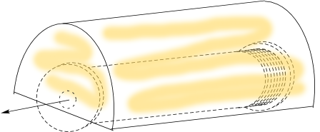
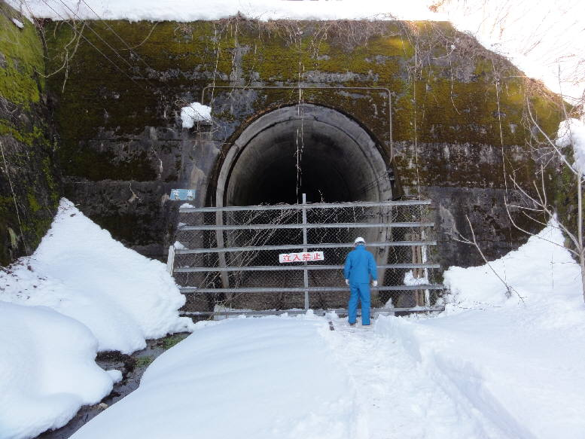
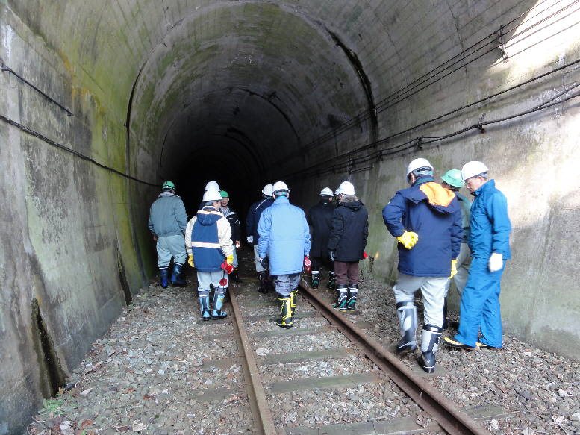
** manufacturing process of 12-m long tube
110510 VAC (YS)
LCGT Vacuum System
* pre-baking
→ dry air venting
→ seal
furnace（200℃，〜3days）
vacuum pumping
* storage (one year, or more, before installation)
→ in the railway tunnel
Mozumi tunnel of Kamioka Mining Railway (not in service)

Slide 3
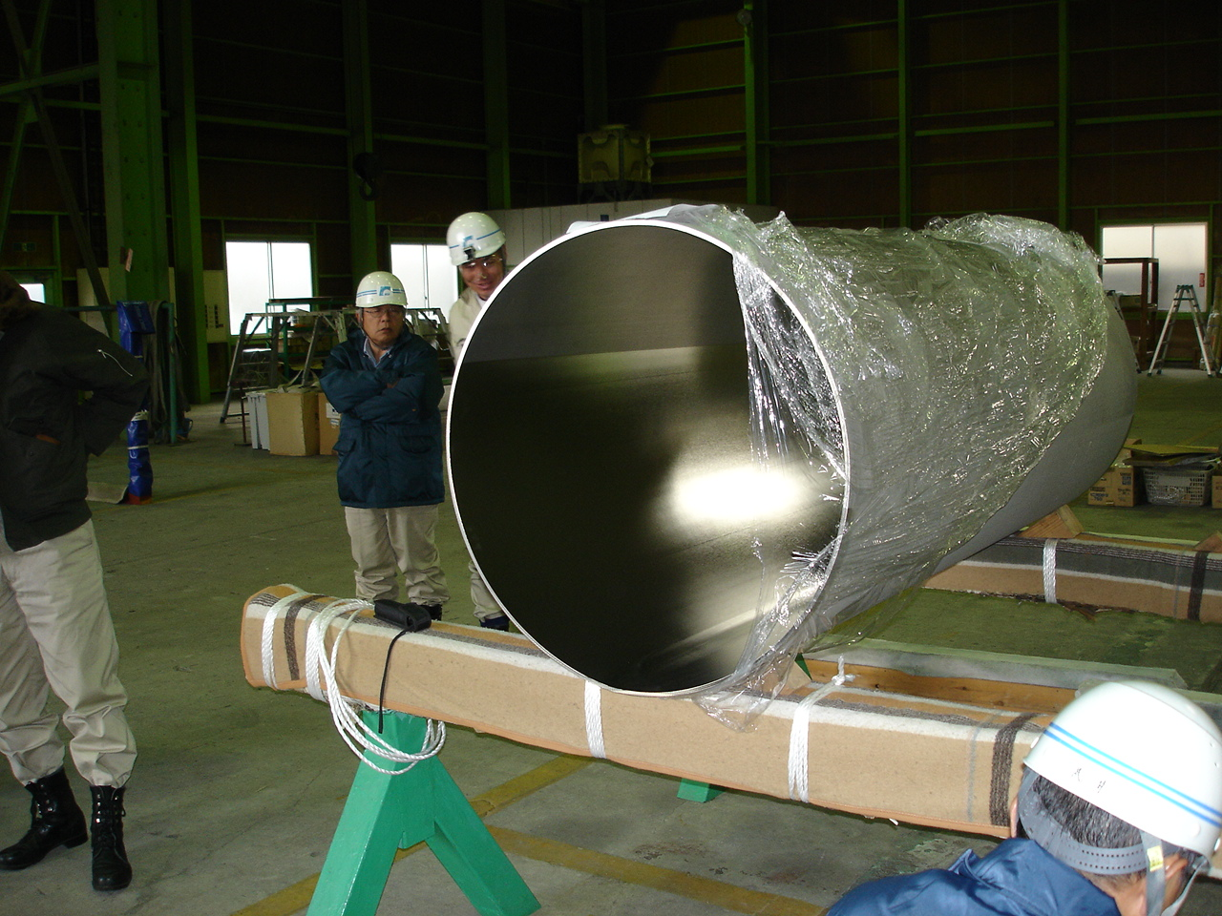
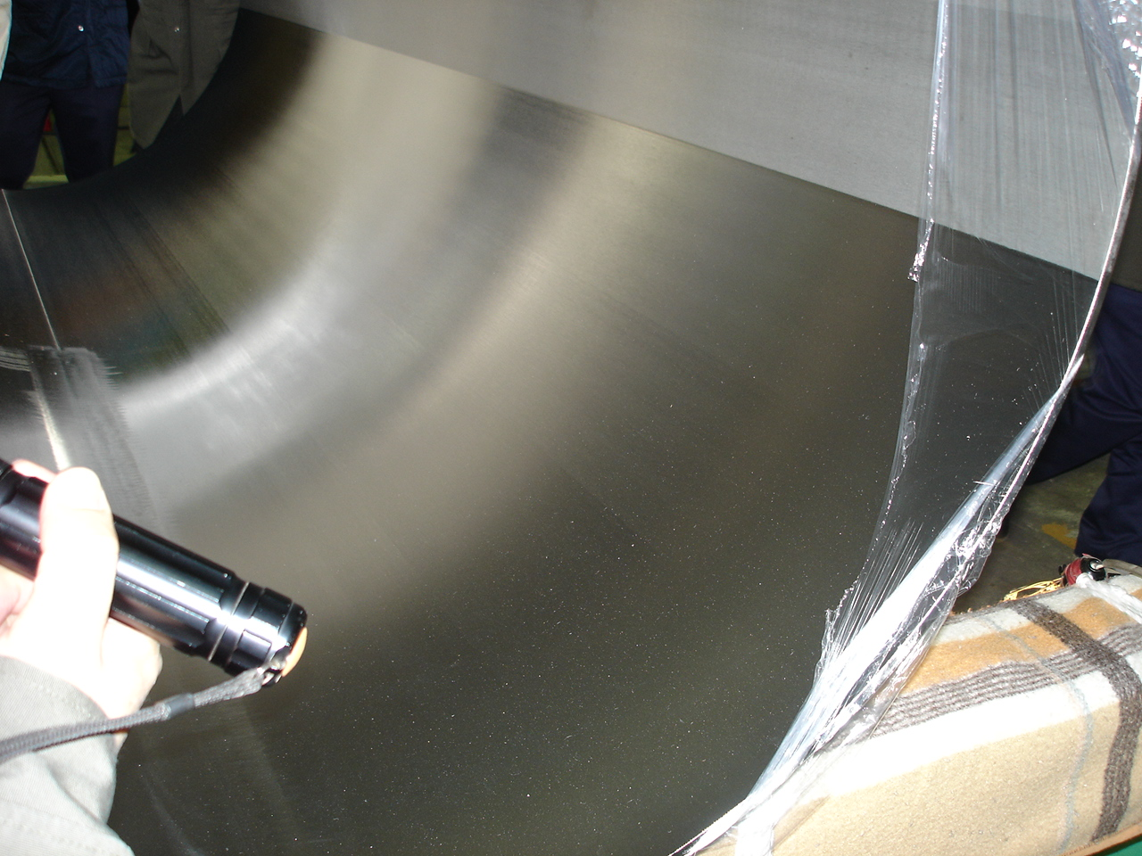
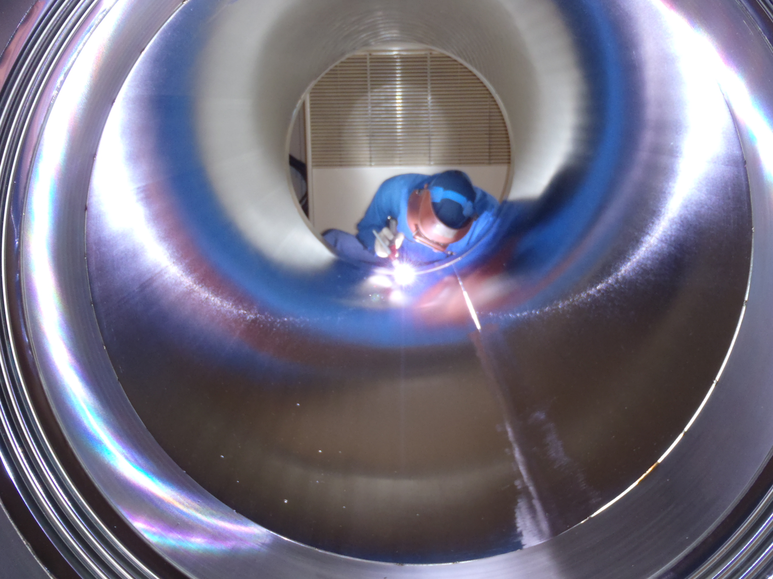
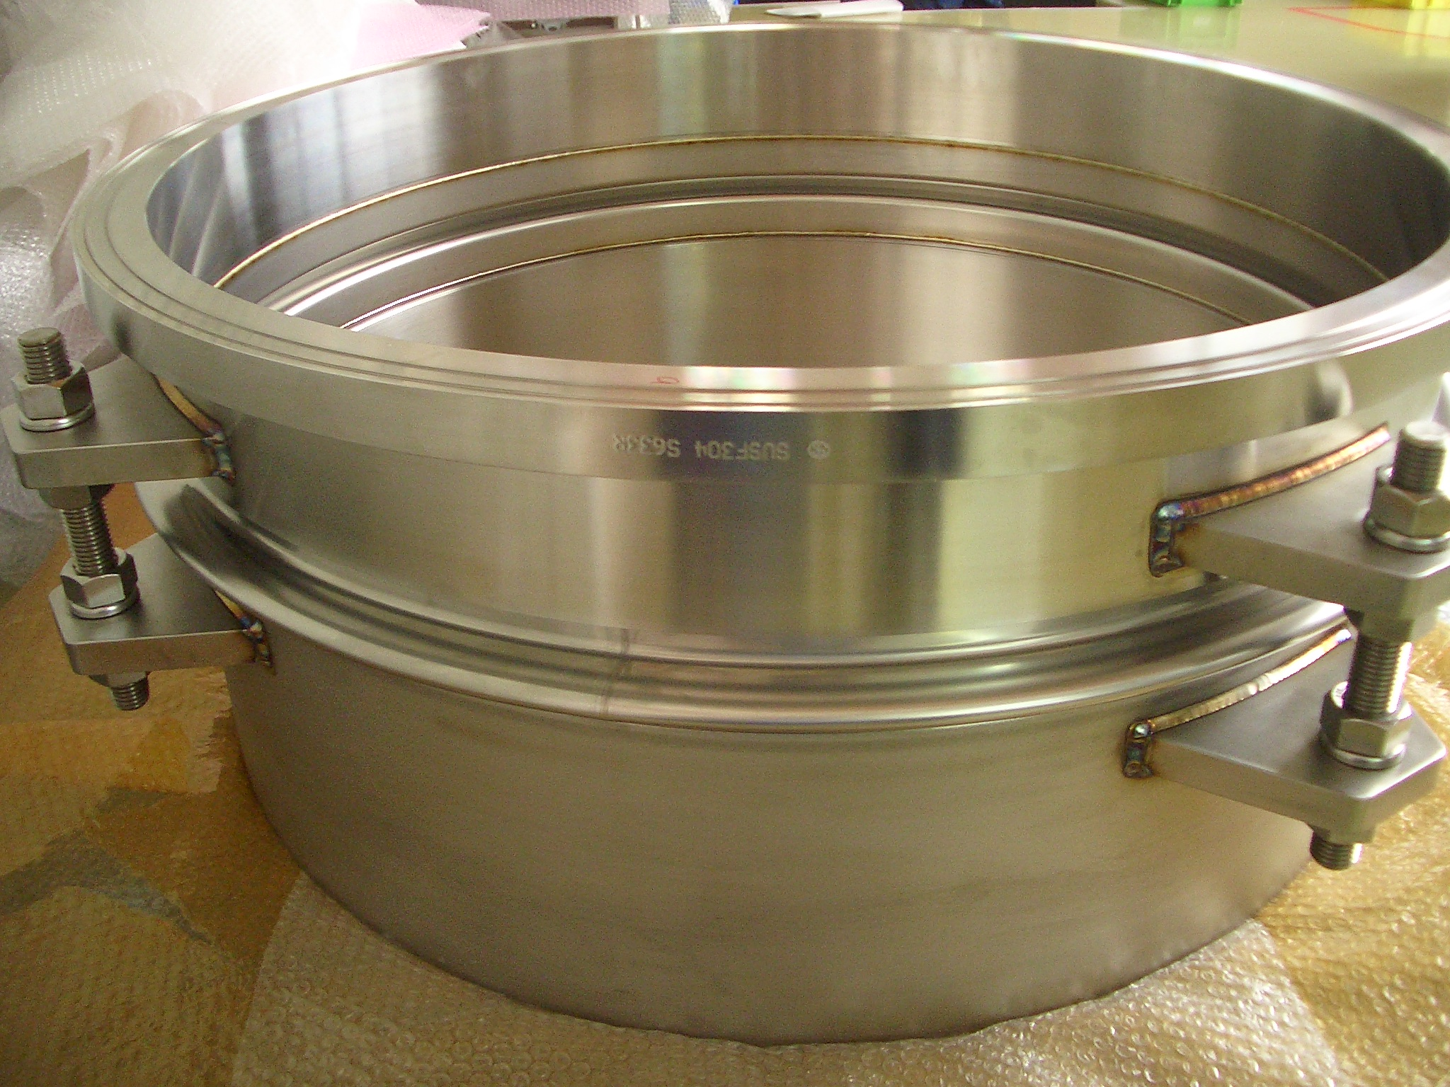
110510 VAC (YS)
LCGT Vacuum System
** test product of the tube
* A 4-m long tube was manufactured and a half of the inner surface was electro polished.
* A flange with a bellows (one convolution) was manufactured.

Slide 4
LCGT Vacuum System
110510 VAC (YS)
● chambers (4 of 14 chambers are equipped with a cryogenic system)
double chambers (2.4 and 1.5 m in dia.)
//GASF + I-Pendulum + cryogenic//
ETMY
chambers (2 m in dia.)
//stack + D-Pendulum//
MC
ITMY
ITMX
3000 m
ETMX
MCF
PRM
PR3
PR2
BS
SR2
chambers (1.5 m in dia./2 m for BS)
//GASF + I-Pendulum//
SR3
SRM
IP
TMP
DRY P
PD

Slide 5
LCGT Vacuum System
110510 VAC (YS)
● expected schedule for installing
1) manufacturing 500 of tubes; from April 2011 to September 2013.
2) installing tube in X arm; from November 2012 to July 2013.
3) installing tube in Y arm; from March 2013 to November 2013.
4) manufacturing chambers (w/o type A); from October 2011 to October 2012.
5) installing chambers in X, Y end (horizontally); December 2012.
6) installing chambers in Center Room (horizontally); from March 2013 to May 2013.
7) pumping down; from December 2012 to November 2013.

