Slide 1
Pre-Isolator Control
T. Sekiguchi

Slide 2
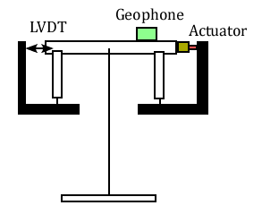
Pre-isolator Prototype

Slide 3
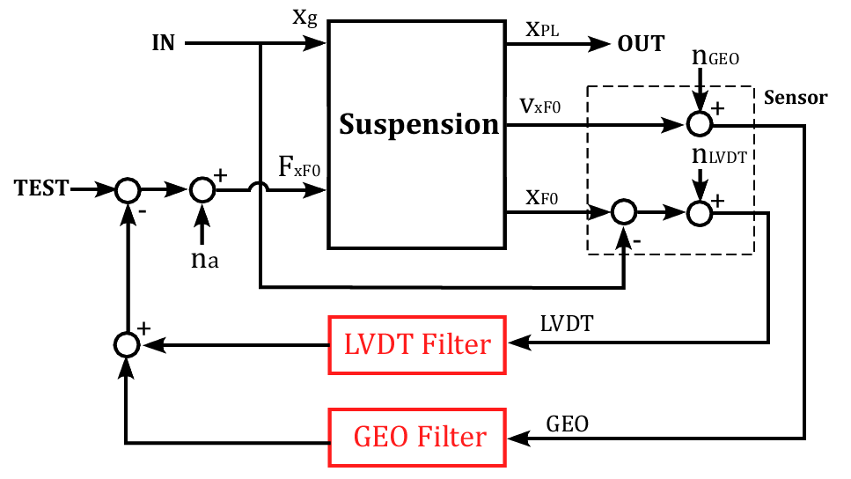
Control Model

Slide 4
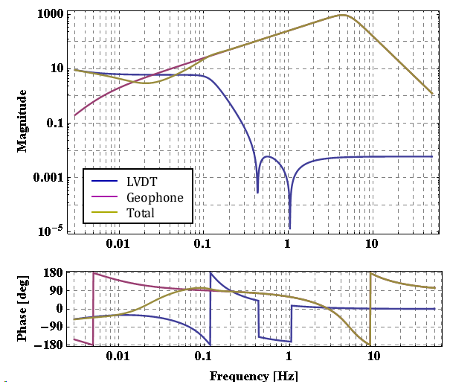
Servo Filter

Slide 5
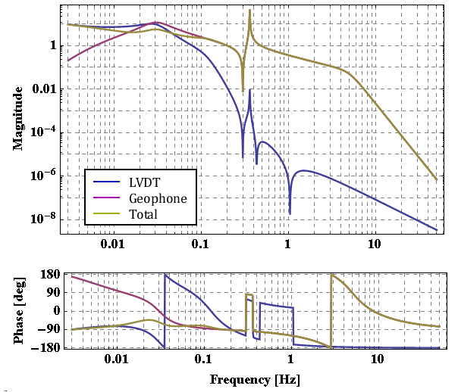
Open-loop TF

Slide 6
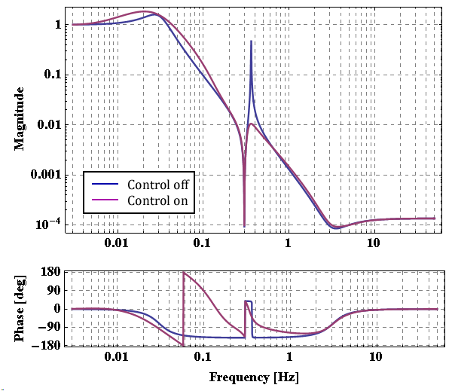
TF with Controlled IP

Slide 7
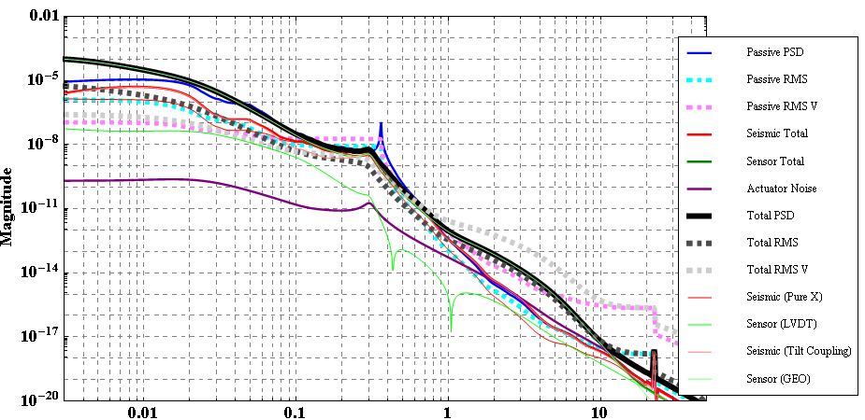
Noise Budget, Kamioka [Normal]
 | RMS Disp. [0.1 Hz] | RMS Vel. [0.1 Hz] | RMS Disp. [0.01 Hz] | RMS Vel. [0.01 Hz]
Passive | 0.01 μm | 0.02 μm/s | 1 μm | 0.09 μm/s
Controlled | 0.003 μm | 0.003 μm/s | 2 μm | 0.2 μm/s

Slide 8
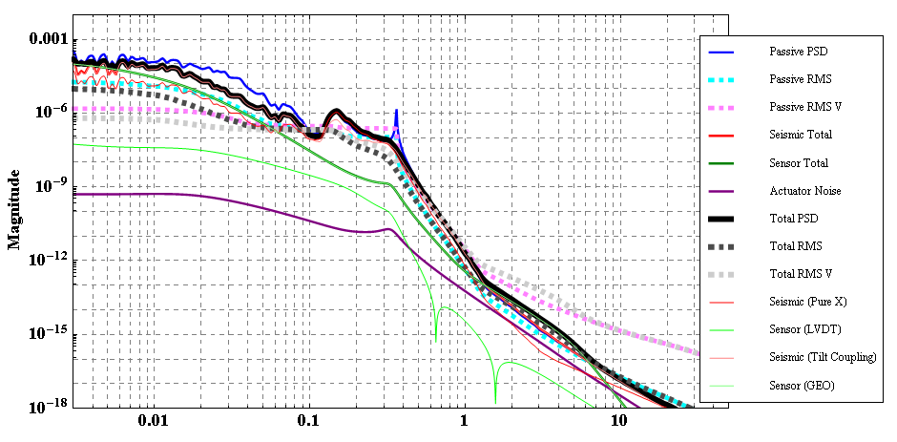
Noise Budget, Kamioka [Stormy]
 | RMS Disp. [0.1 Hz] | RMS Vel. [0.1 Hz] | RMS Disp. [0.01 Hz] | RMS Vel. [0.01 Hz]
Passive | 0.15 μm | 0.2 μm/s | 15 μm | 1.2 μm/s
Controlled | 0.15 μm | 0.15 μm/s | 9 μm | 0.8 μm/s

Slide 9
Discussion
Geophone noise increases RMS displacement and velocity at low freq.
In stormy day, it is difficult to achieve 0.1 μm(/sec) due to enormous micro seismic peak.

Slide 10
Appendix

Slide 11
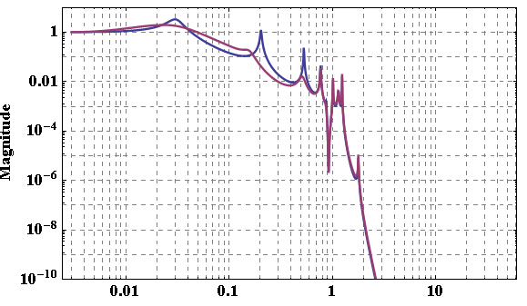
Type-A Full, TF with Control

Slide 12
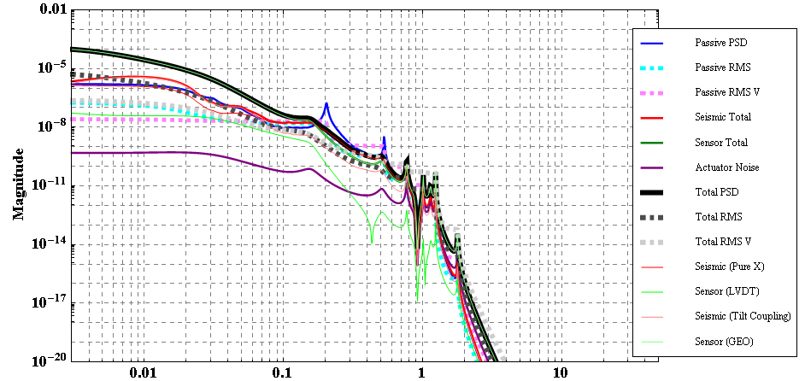
Type-A Full, Noise Budget

Slide 13
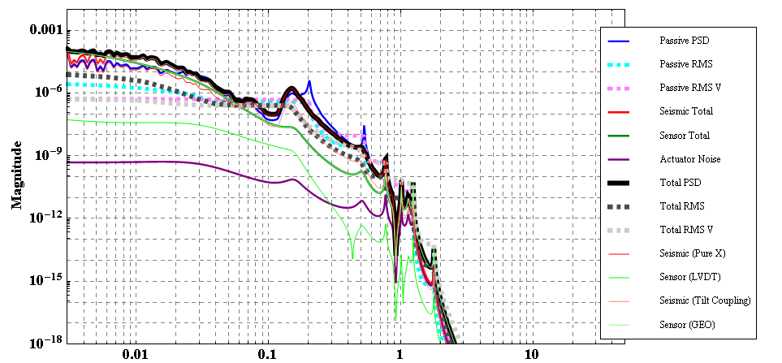
Type-A Full, Noise Budget

Slide 14
Angular Control (Preliminary)
T. Sekiguchi

Slide 15
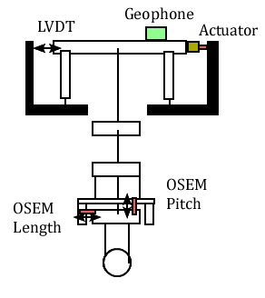
Type-B X-Pitch Control

Slide 16
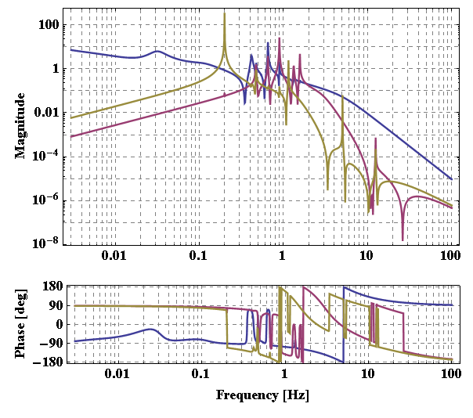
Open Loop TF

Slide 17
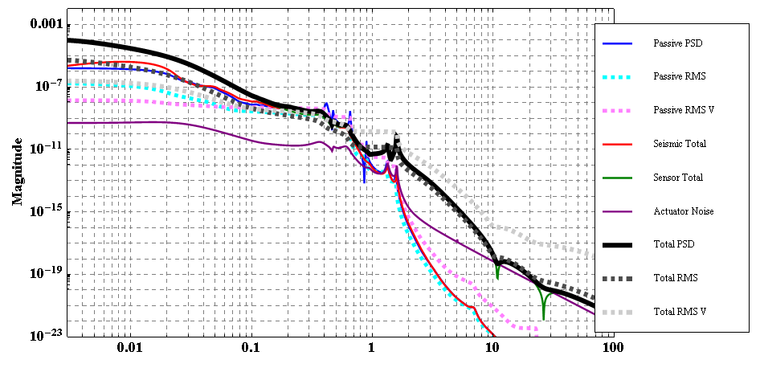
Type-B Length Noise

Slide 18
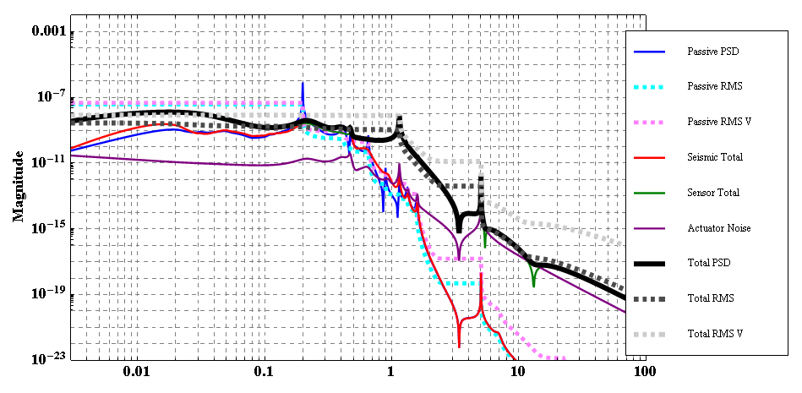
Type-B Pitch Noise

